Slide 1


ROCKIN RHINOS
VISUAL GUIDE

Slide 2

What is a Visual Guide?
A visual guide gives you lots of information about the show you are going to see, using pictures and accessible text.
They are suitable for anyone who would benefit from a clear and accessible introduction to the show you have booked to see.

Slide 3
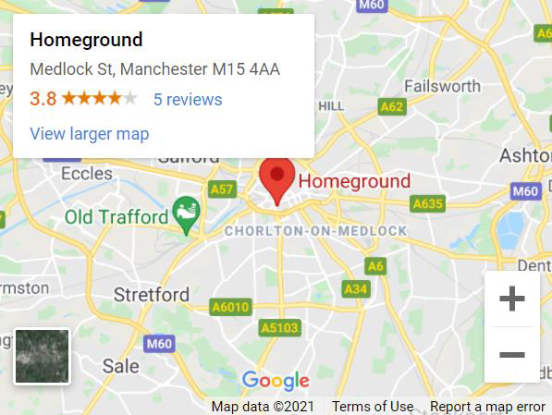
How to Get to the Show
Homeground is a temporary pop up
venue on First Street. It is a socially
distanced space, located close to HOME.
The postcode for the site is M15 4AA.
There are four main areas on the site. You can watch The Rockin' Rhinos at the Auto Trader Showground. You will need your ticket to access this area.
Details of bus routes, parking,
etc can be found here.

Slide 4
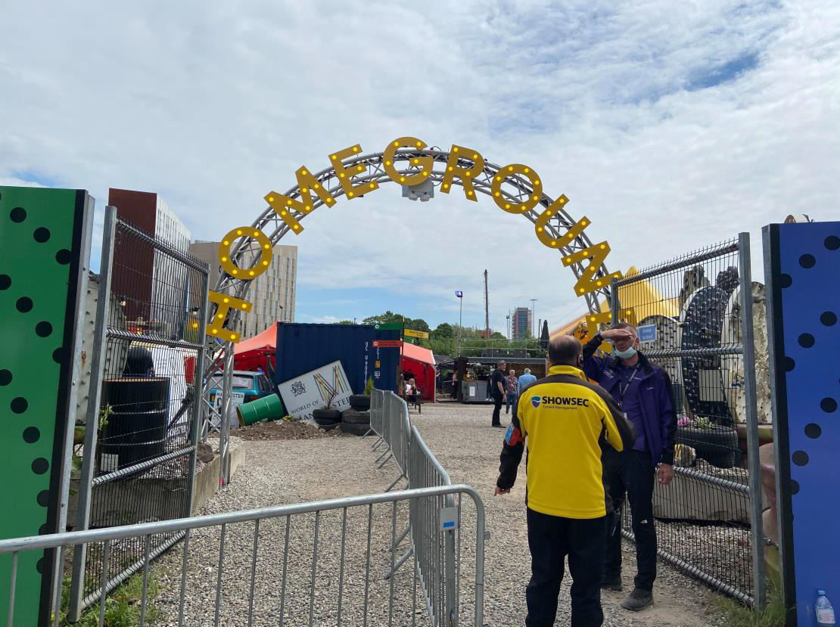
Homeground Access Information
Homeground have created a useful document which includes information about wheelchair access, assistance dogs, strobe lighting, accessible toilets and much more. Click here to download the Homeground Access Information.
If you have any questions in relation to
accessibility, please contact access@homemcr.org, call 0161 200
1500 or drop into HOME.

Slide 5
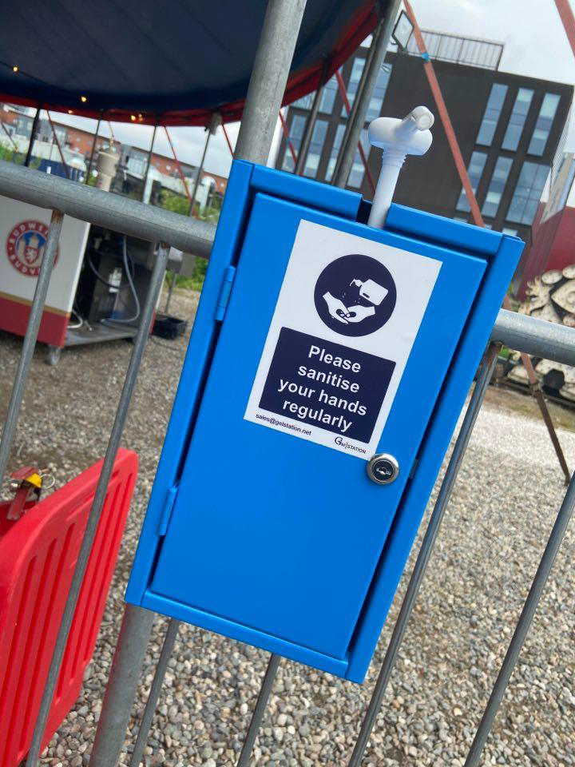
COVID- 19 Safety Measures
Homeground is an outdoor, socially distanced space and will be adhering to all government guidelines.
There are hand sanitiser stations based all over the site.
The site is large (approx. 200metres across in each direction).

Slide 6
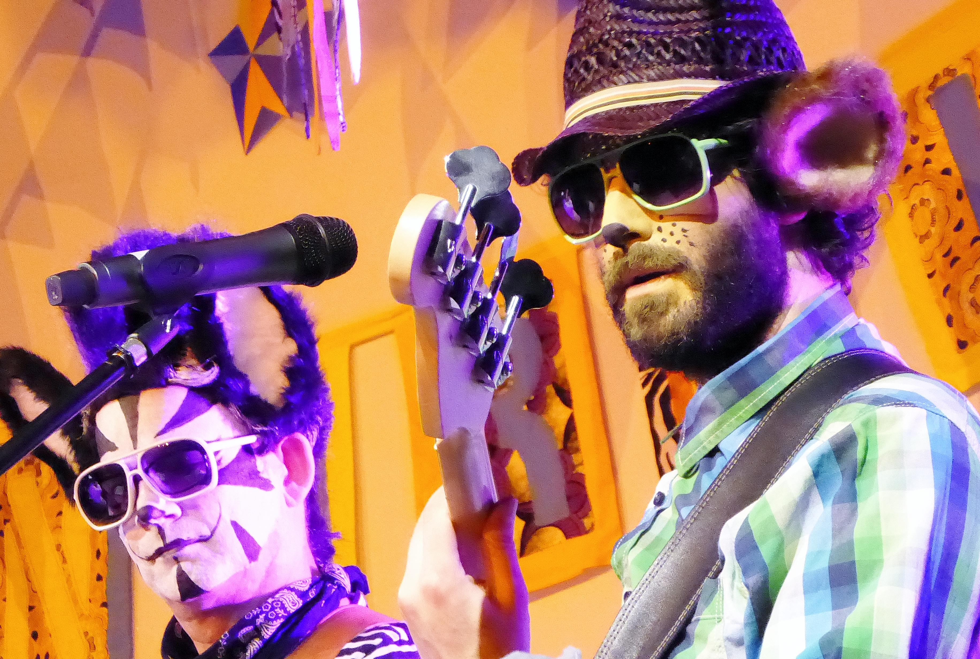
What to expect
6 animals, 1 mission: to rescue the under 7’s from bland music and offer families with young children gigs they can enjoy - together!
A real gig for growing and old humans alike – led by John Cooper Cat ably aided & abetted by Liam Lion, Mani Mouse & many more.

Slide 7


Do you have any other questions about the show?
Please get in touch!
@Z_arts_mcr
tiffany@z-arts.org
We hope you enjoy the show!

