Slide 1
THE HARE AND THE MOON
VISUAL GUIDE

Slide 2
What is a Visual Guide?
A visual guide gives you lots of information about the show you are going to see, using pictures and accessible text.
They are suitable for anyone who would benefit from a clear and accessible introduction to the show you have booked to see.

Slide 3
How to Get to the Show
Homeground is a temporary pop-up venue on First Street. It is a socially distanced space, located close to HOME.
The postcode for the site is M15 4AA.
There are four main areas on the site. You can watch The Hare and The Moon at the Auto Trader Showground. You will need your ticket to access this area.
Details of bus routes, parking, etc can be found here.

Slide 4
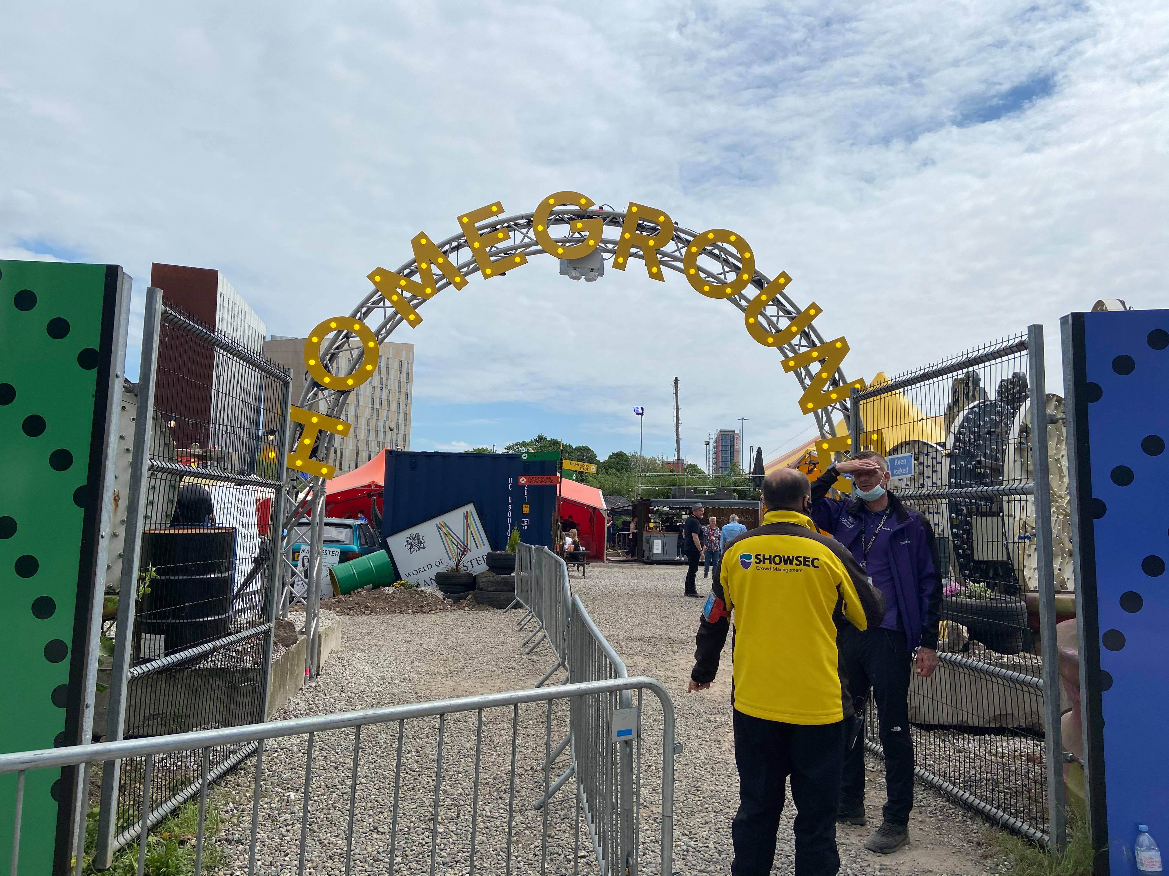
Homeground Access Information
Homeground have created a useful document which includes information about wheelchair access, assistance dogs, strobe lighting, accessible toilets and much more. Click here to download the Homeground Access Information document (word document).
If you have any questions in relation to accessibility, please contact access@homemcr.org, call 0161 200 1500 or drop into HOME.
​

Slide 5
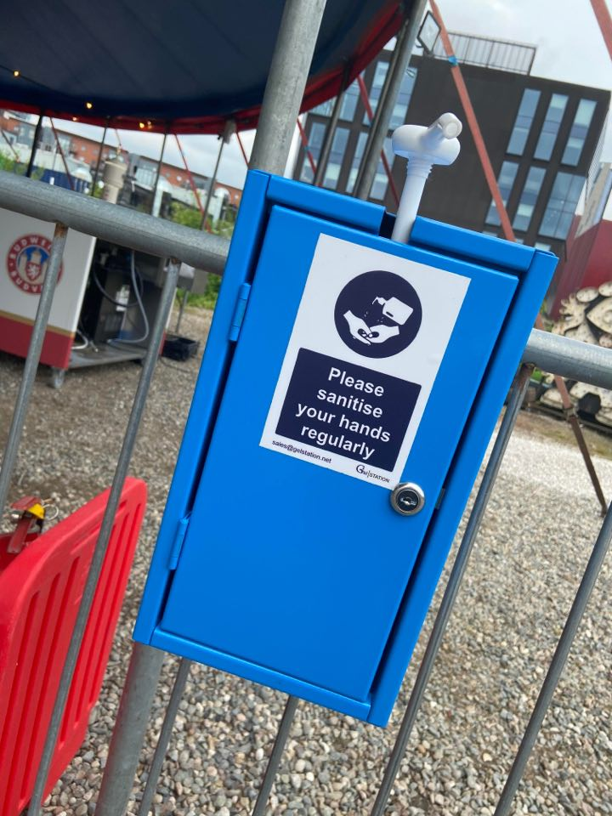
COVID-19 Safety Measures
Homeground is an outdoor, socially distanced space and will be adhering to all government guidelines.
There are hand sanitiser stations based all over the site.
The site is large (approx. 200 metres across in each direction).

Slide 6
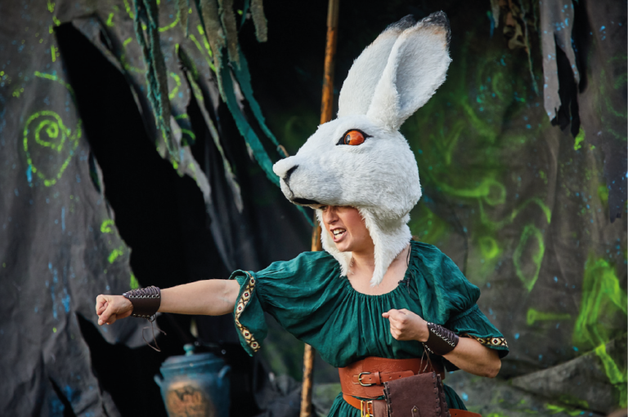
What to expect in the show
You will meet Leapa the Arctic Hare, who is a furry fearless female. She brings the light back to the day and makes the night sky glow!
Samuel Mills photography

Slide 7
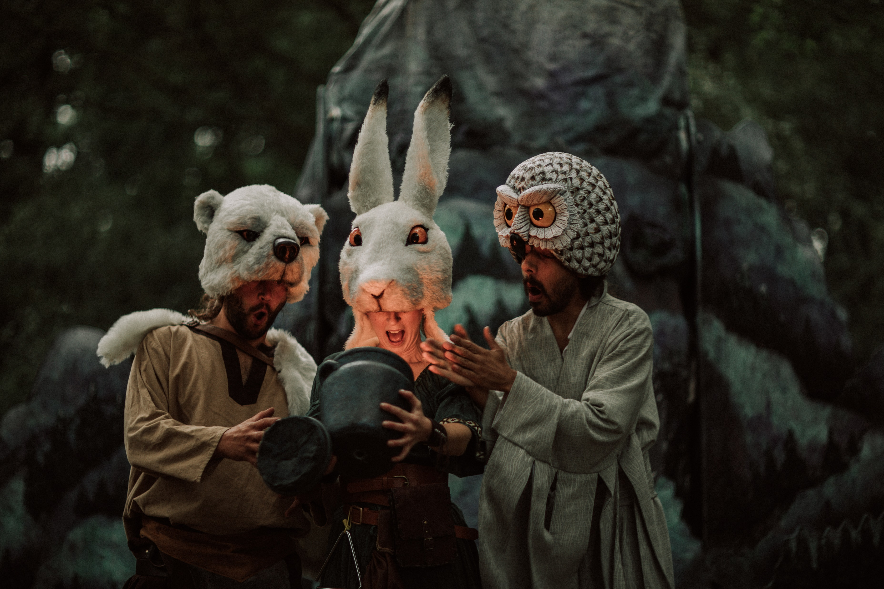
What to expect in the show
The Artic Animals band together to find and reclaim the sun, which has disappeared from the sky.
You will get to see animal headpieces, puppets and exciting illuminations!
Samuel Mills photography

Slide 8
Do you have any other questions about the show?
Please get in touch! @Z_arts_mcr
tiffany@z-arts.org
We hope you enjoy the show!

