Slide 1
Fairy Tales
VISUAL GUIDE

Slide 2
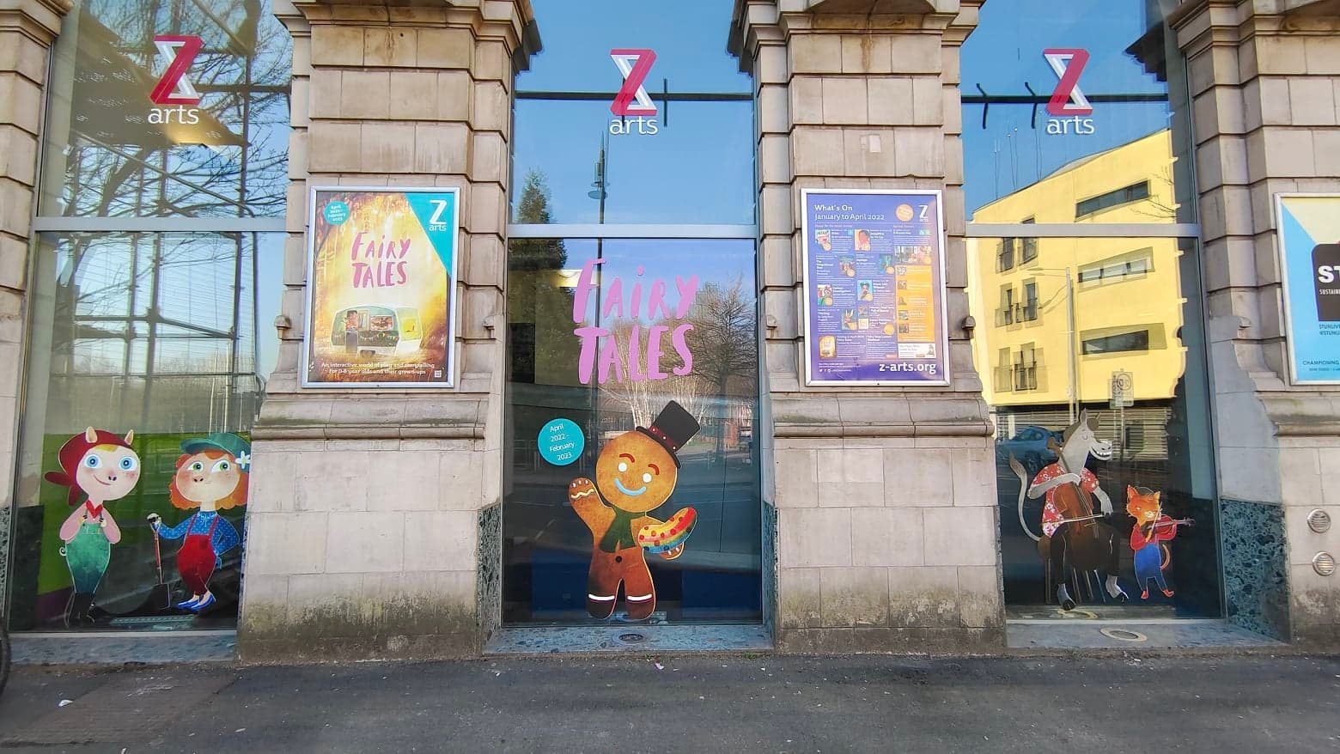
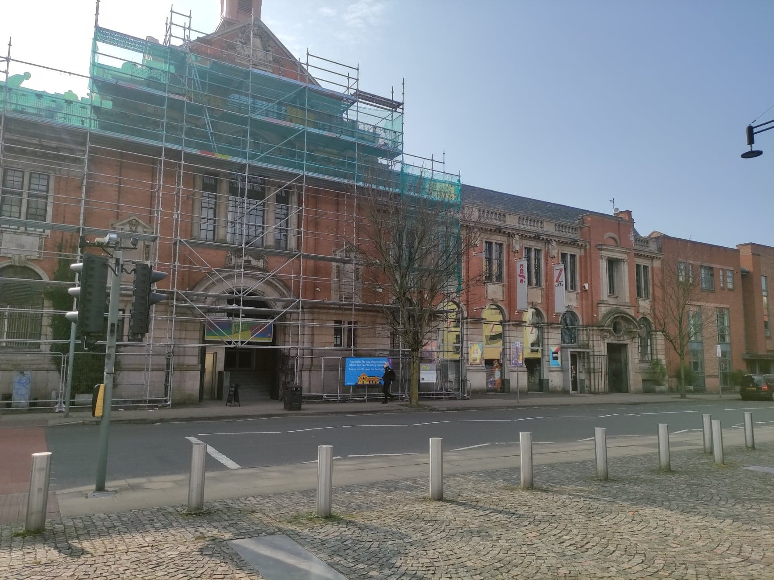
Getting to Z-arts
335 Stretford Road, Hulme, Manchester, M15 5ZA
Box Office: 0161 226 1912
Z-arts is directly opposite Hulme Park.
We have scaffolding up at the moment as we are getting a new roof!

Slide 3
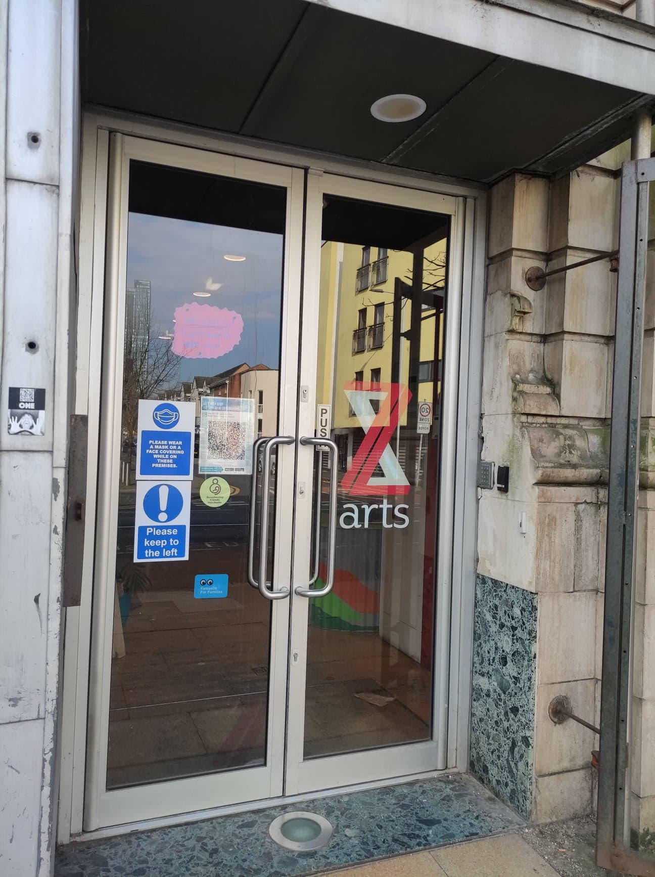
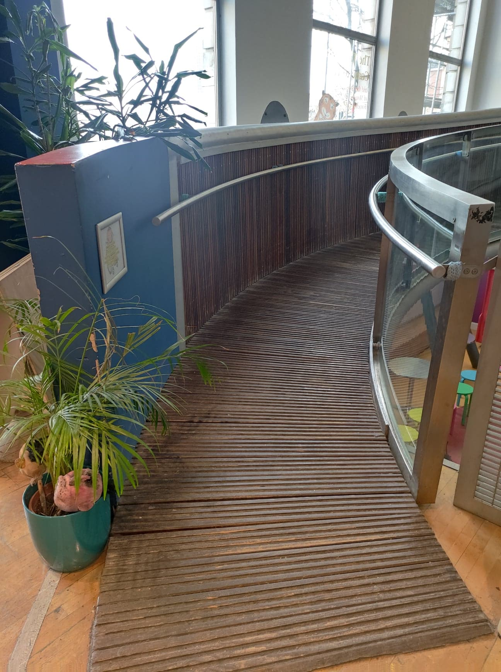
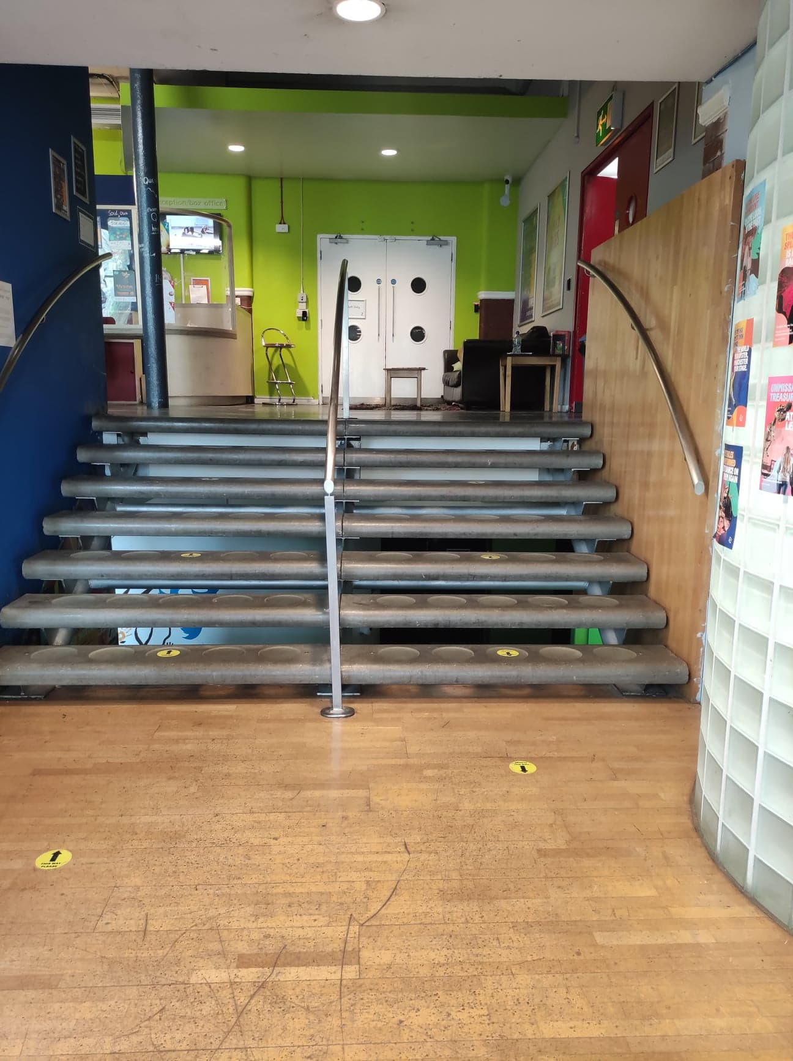
Entrance
When you enter Z-arts, you will see a sign, some plants, a fish tank and some steps. On your left, there is a
ramp. If you go up the ramp or up the steps, you will get to our Box Office desk.

Slide 4
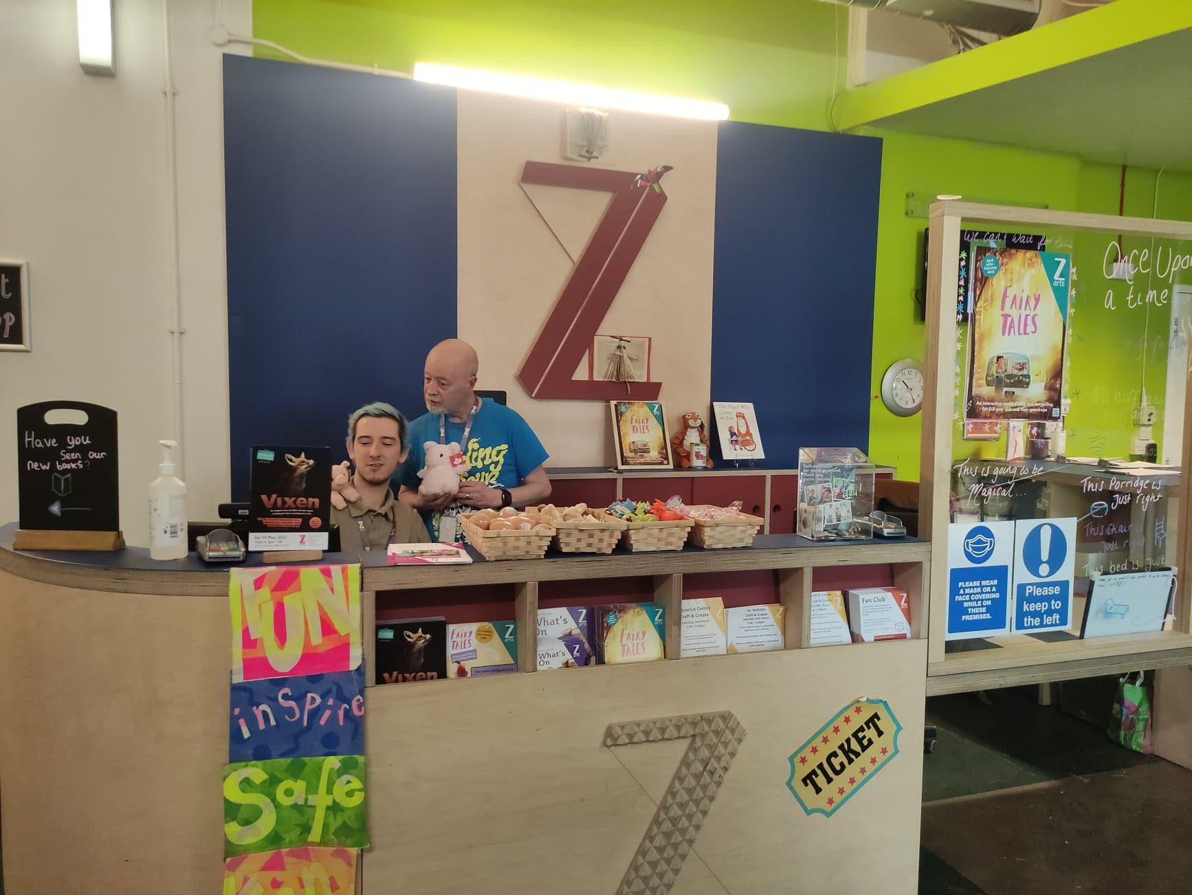
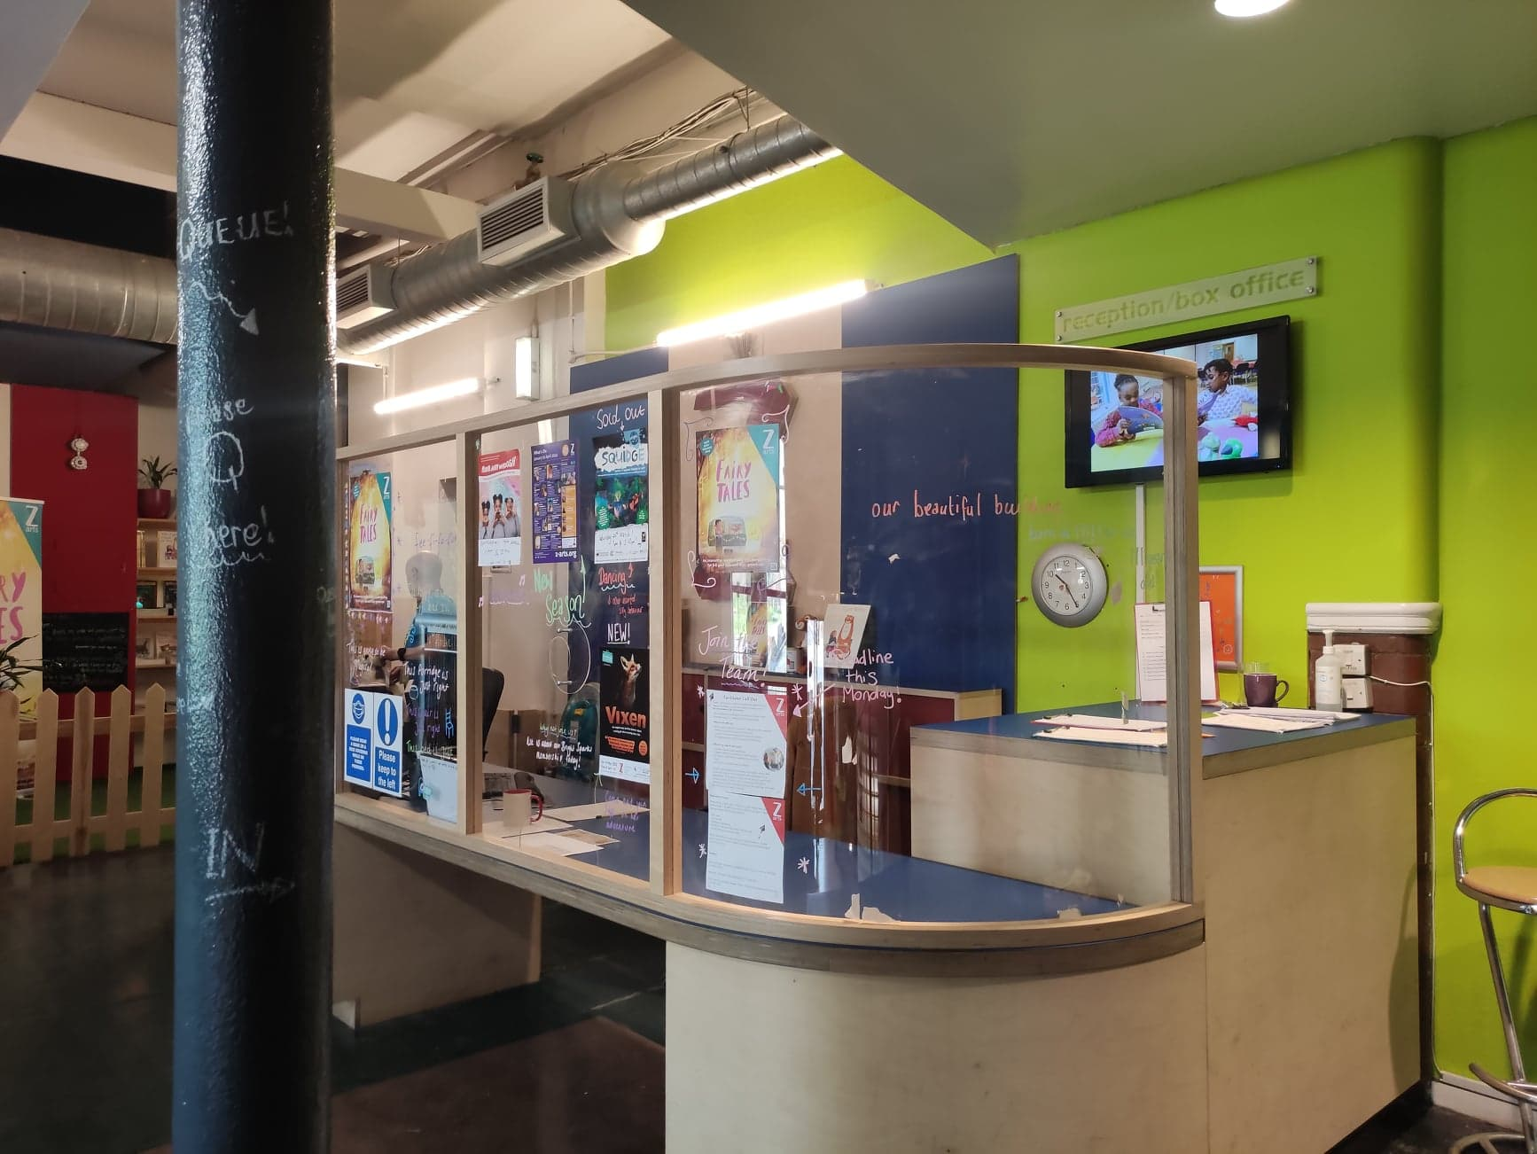
Box Office
This is what you will see as you climb the steps towards Box Office. In the photo we have Jack, one of our Deputy House Manager and Paul, our Box Office Supervisor. When you arrive, the person at the desk with help you get to the show!

Slide 5
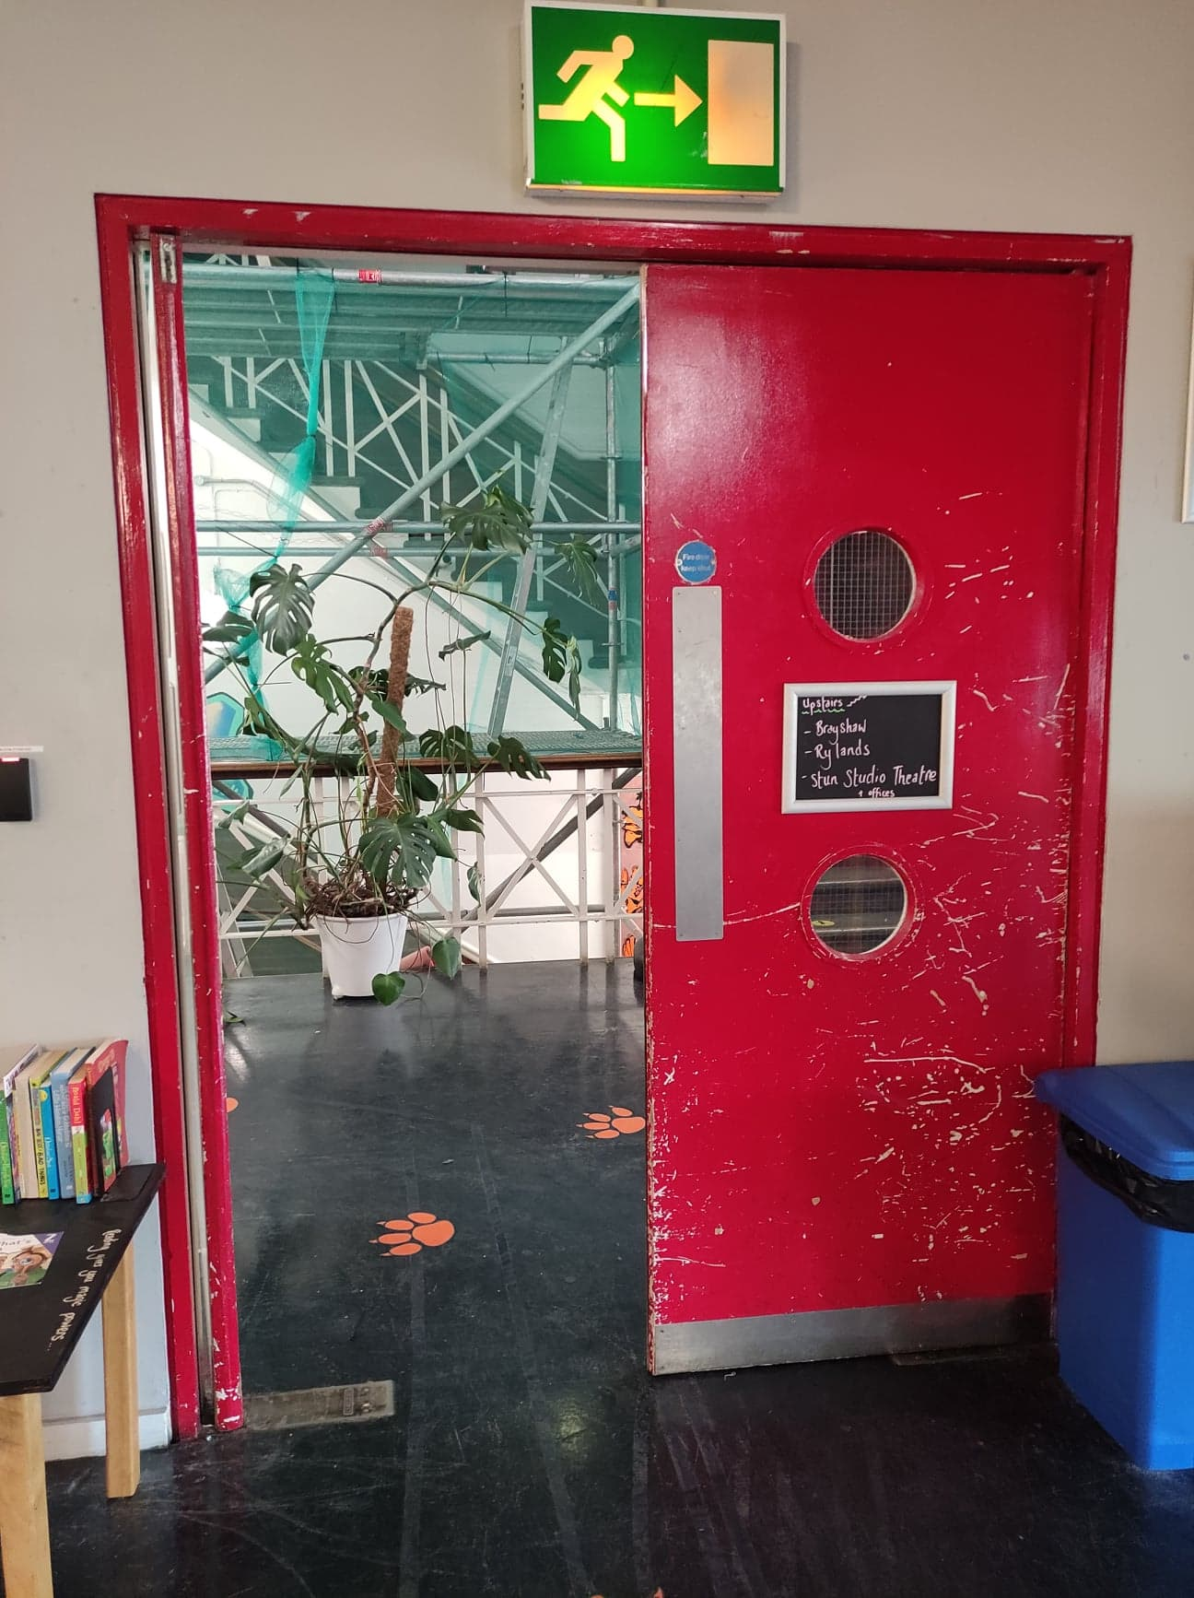
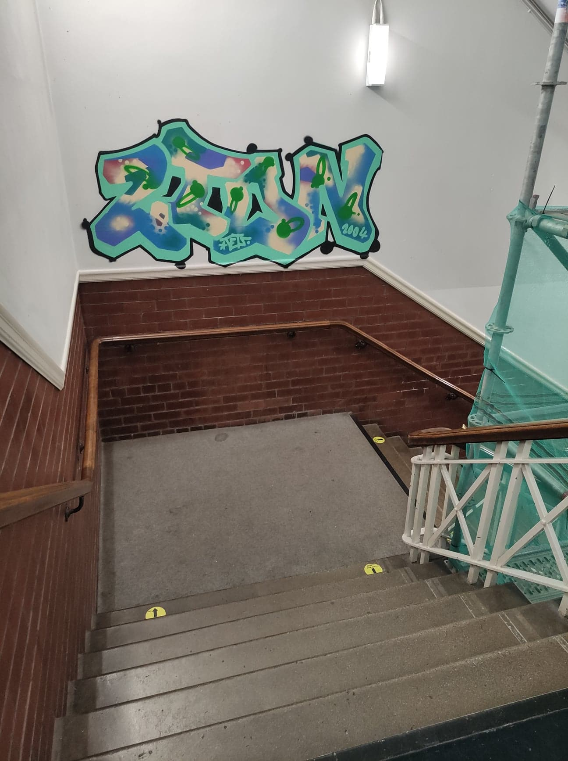
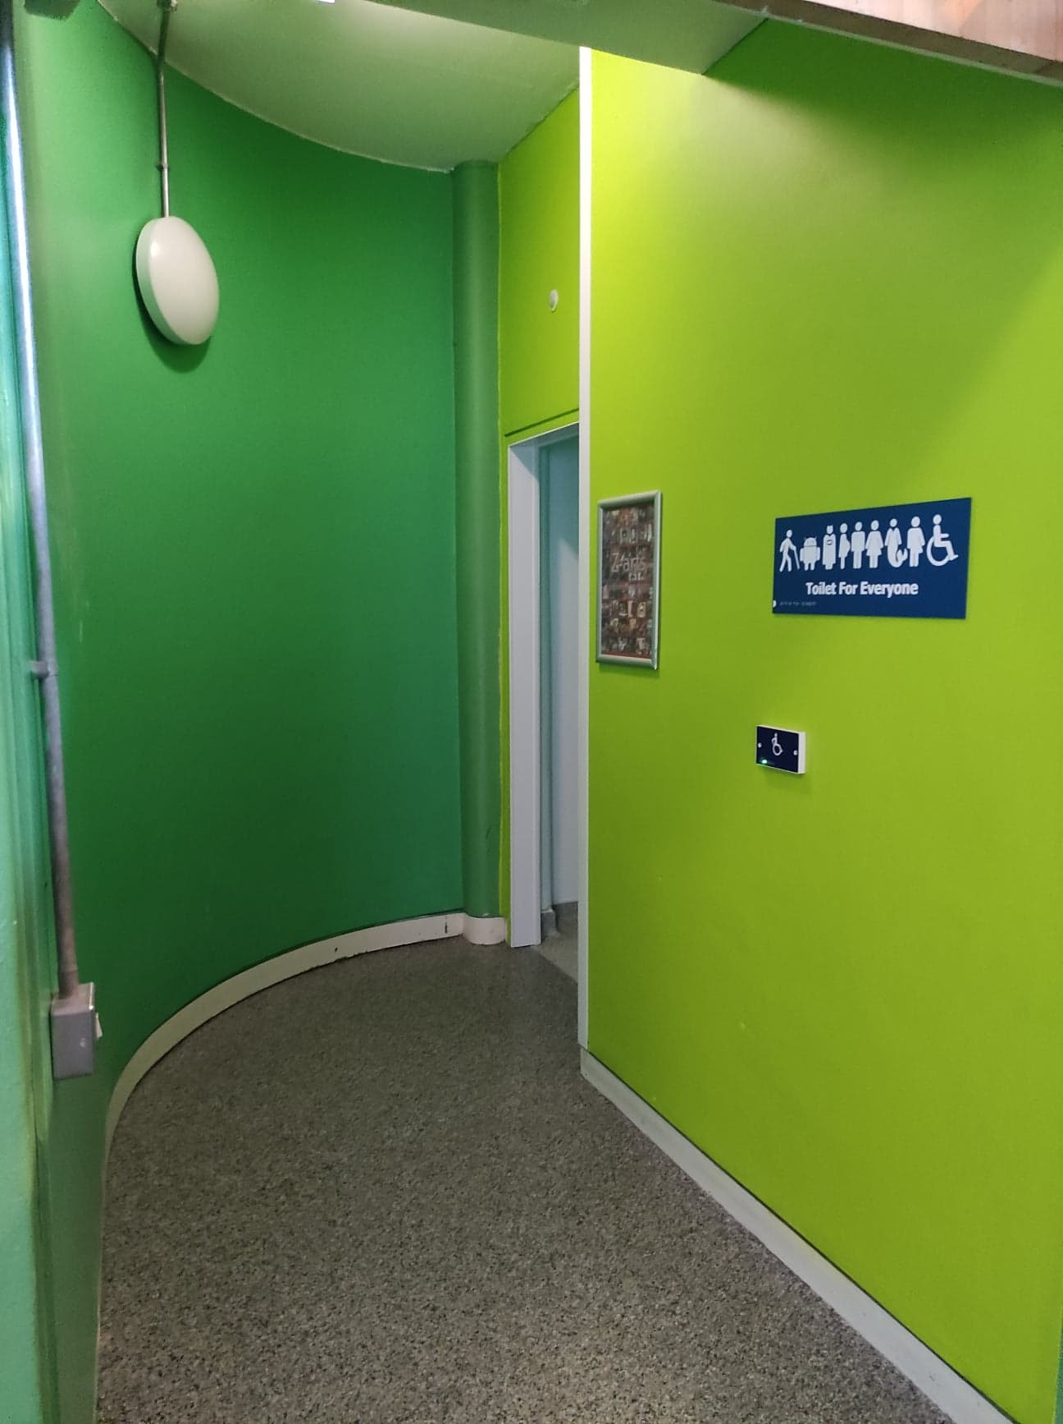
Family and Accessible Toilets
If you turn right when facing the box office desk, you will see a red door. If you walk through the red door and down the set of stairs our family and accessible toilets are on the left hand side.

Slide 6
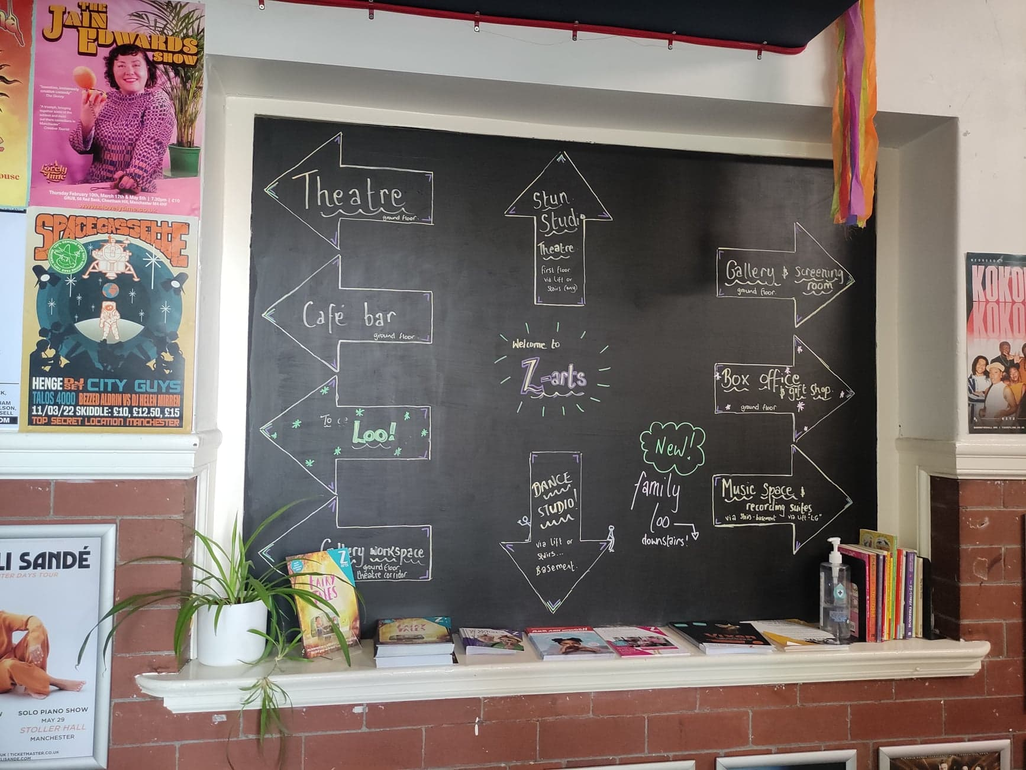
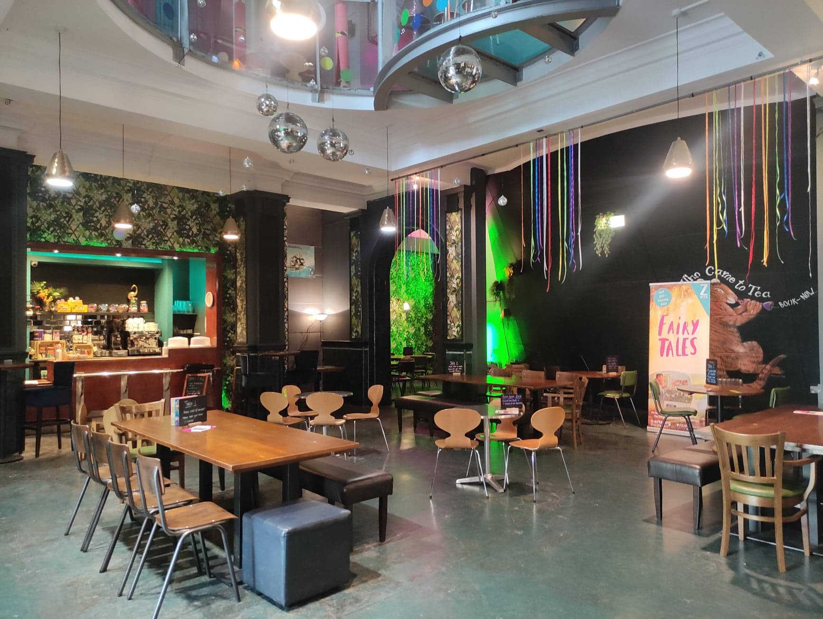
Z-café
If you look to your left when you’re standing facing the Box Office desk, there is a corridor with lots of posters. This takes you through to Z-café.
You can buy food and drink from the counter at Z-café. There are plenty of options, including vegan, vegetarian and halal choices.
There are male and female toilets and an accessible toilet in Z-café. They are on the left when you are facing the counter.
There is a second entrance and exit door located in the café next to the toilets.

Slide 7
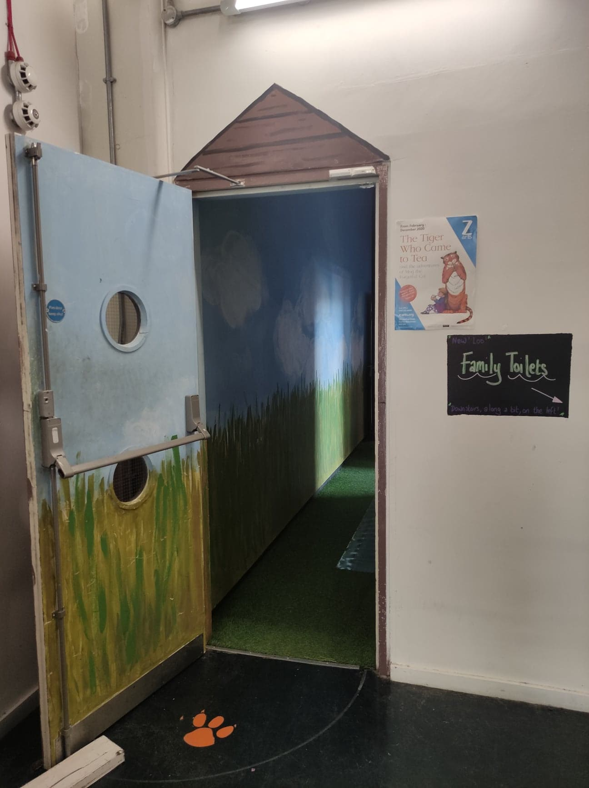
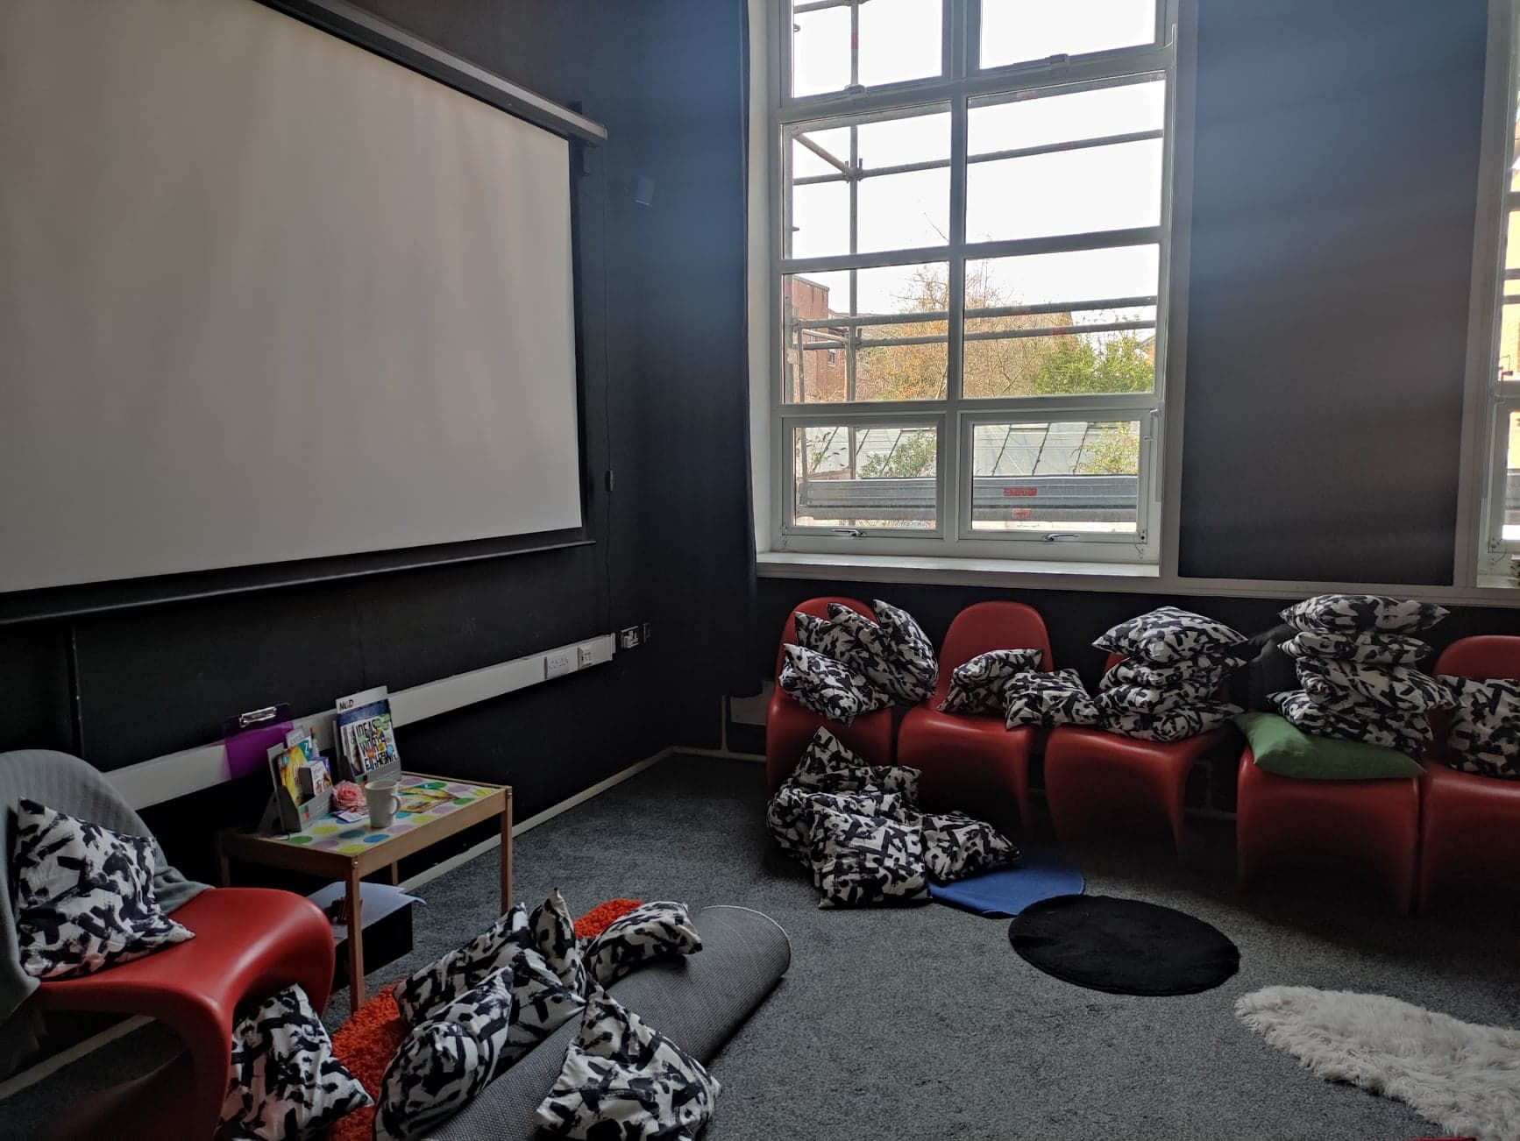
Fairy Tale Corridor
When it is time for you to go through to the Fairy Tales exhibition, one of our friendly Front of House team will come and collect you from the café or box office.
They will walk with you through the red door and turn left onto our Fairy tale corridor.
On the right you will see the screening room. This is a nice place to have some quiet time if you need to during the experience.

Slide 8
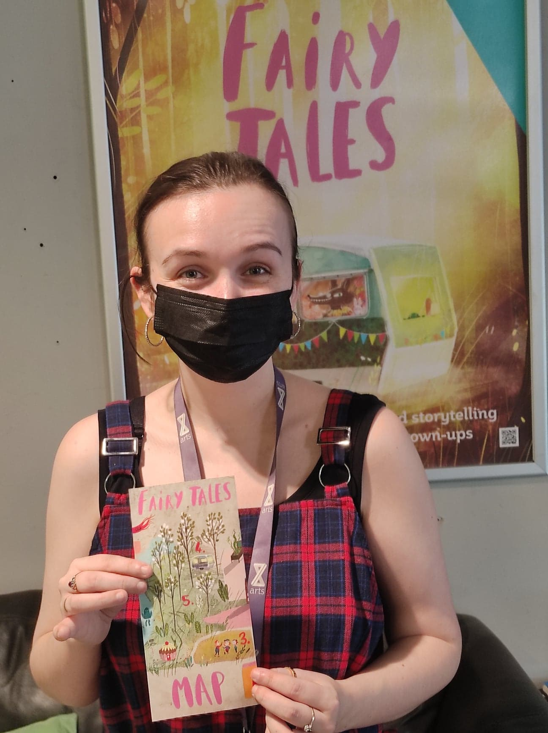
Your Story Explorer!
This is where the magic happens!
When you enter the exhibition, there will be a Story Explorer there to guide you.
Get comfy and relax. The show is about to start!
The experience will last for 50 minutes.

Slide 9
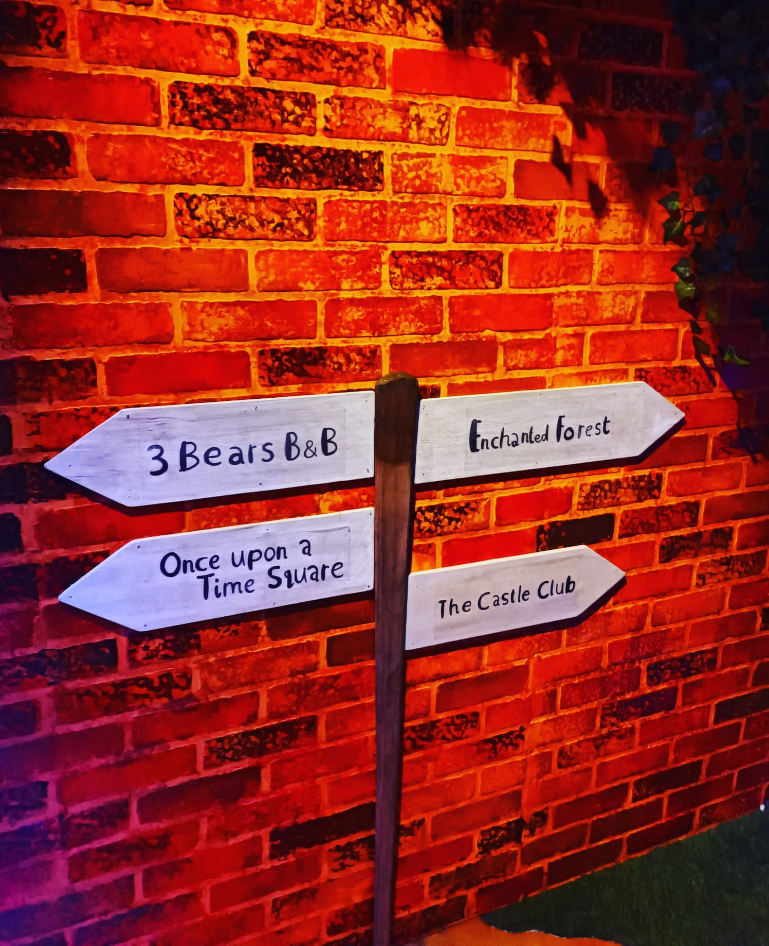
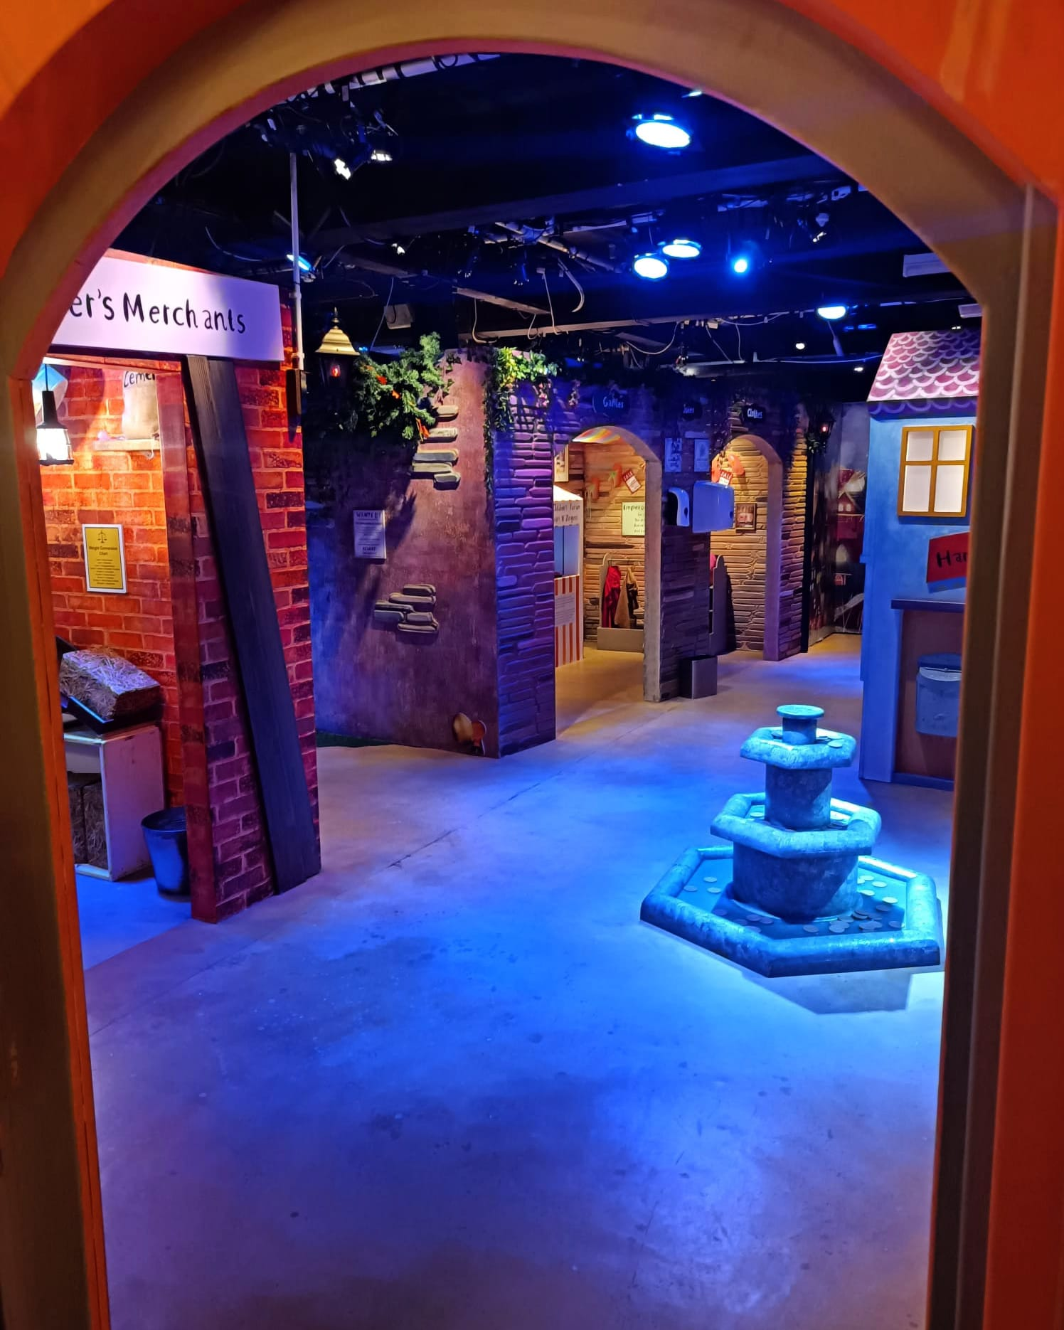
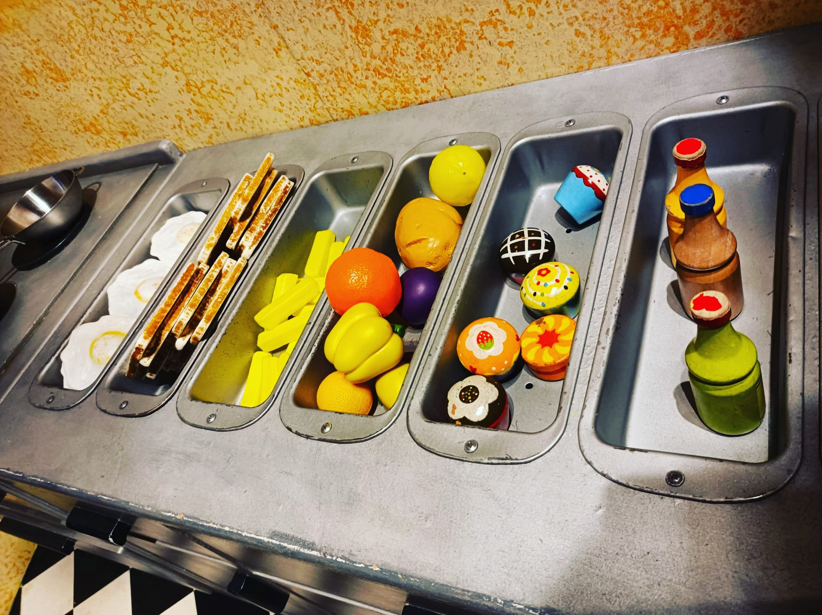
What to Expect
The Story Explorer will take you through to the exhibition. There is lots of things to play with and have fun.
There will be one point where you can hear the Giant’s Footsteps and if you press the buttons they will make a noise. There is a bubble machine which the Story Explorer will use and a smoke machine.
You can see videos of parts of the exhibition on our Facebook, Twitter and Instagram pages.

Slide 10
Do you have any other questions about the
show?
Please get in touch!
@z_arts_mcr @z.artsmcr @zartsmcr
Share what you liked about the show using the hashtag #MyCreativeFamily
We hope you enjoy the show!
Box Office: 0161 226 1912

