Slide 1

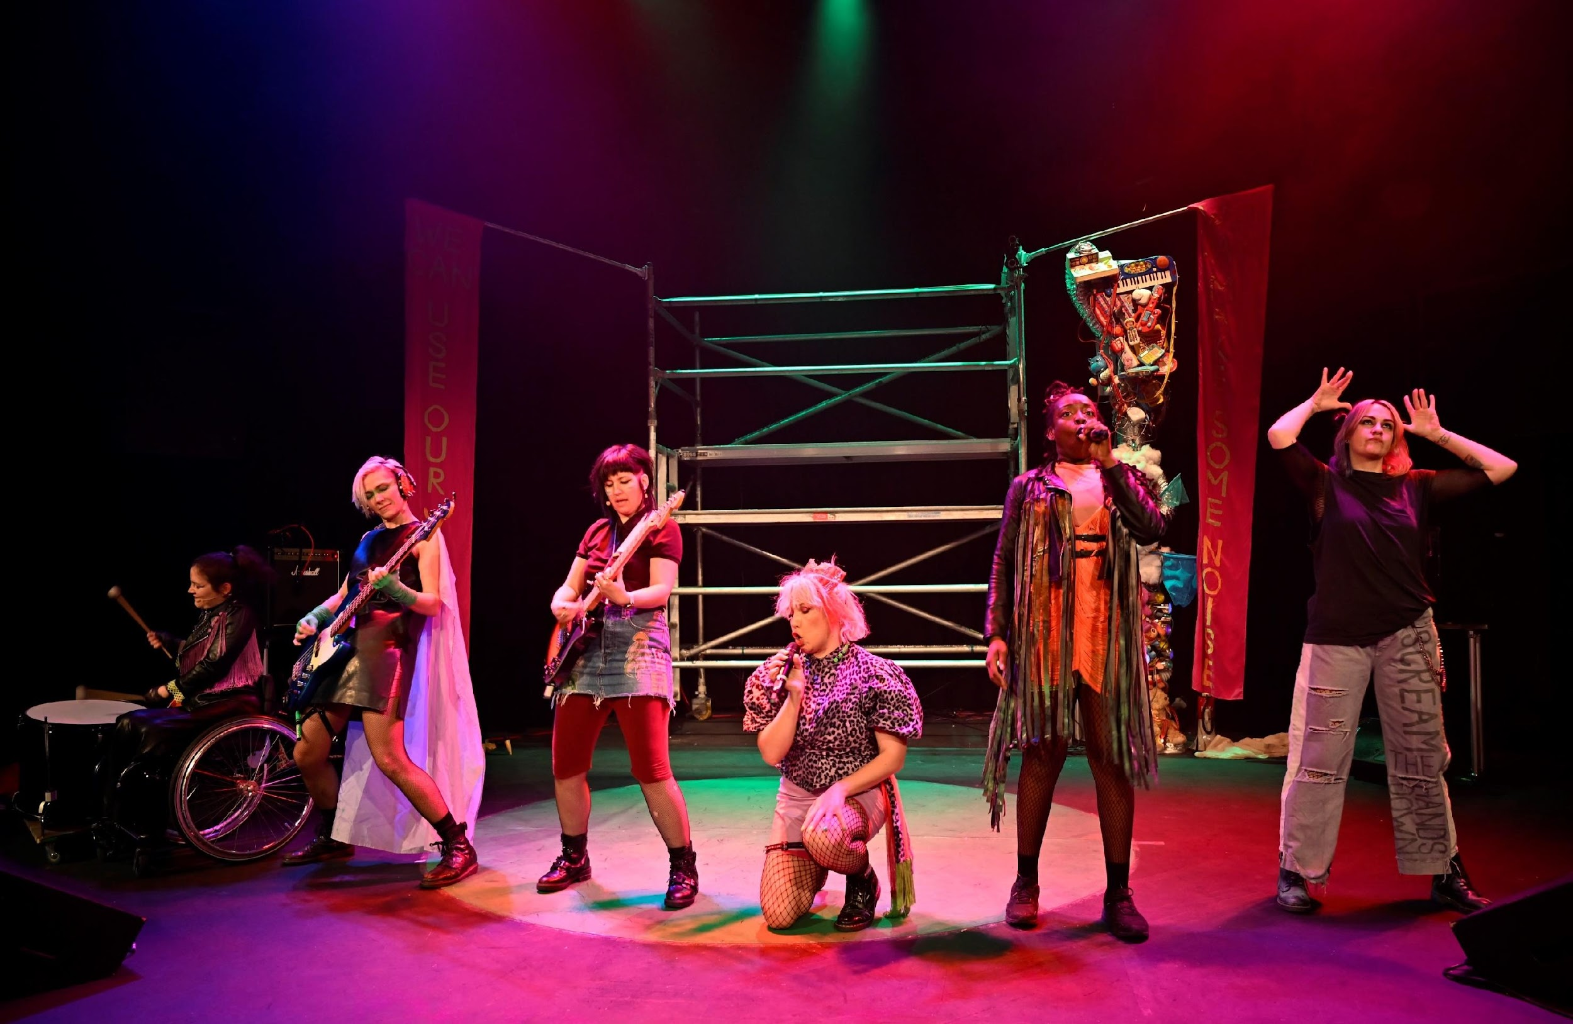
Pre-Show
Access
Information

Slide 2
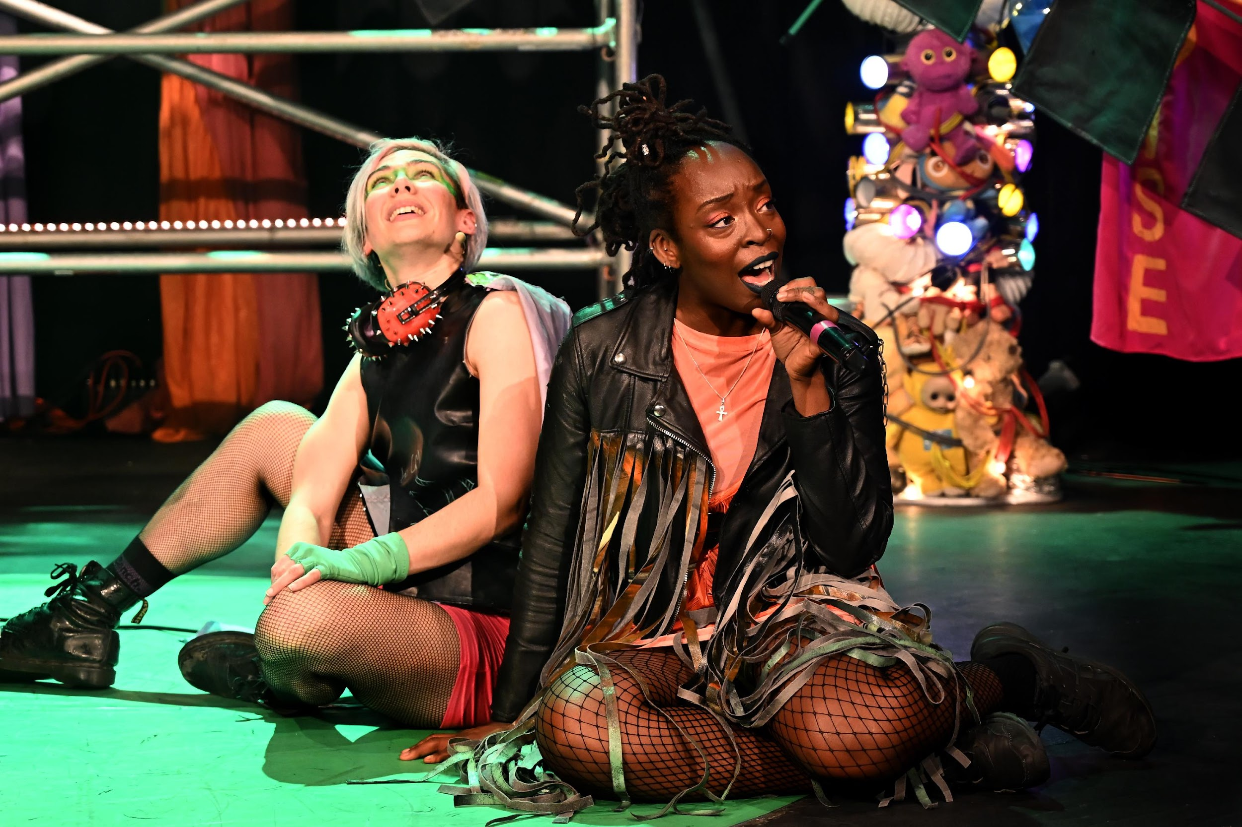
Welcome to Punk Alley!
Here are a few things that you can expect
in the show.
Photos ©Maisy Banks

Slide 3






This is a relaxed performance.
So you can get up, go to the loo, stim, make noise,
whatever you need to do to feel comfortable in the space.
The show will be 1 hour long. There is no interval.
There will be BSL interpretation throughout the show. Screens on stage will show the lyrics to the songs in written English.

Slide 4




We are Lazurr Tuts - a punk band!
In the show, we’ll be playing LIVE MUSIC. There will be LOUD NOISES from guitars, singing and speakers.
There will be ear defenders available for anyone who needs them. If you have your own, please use them!
There is also some audience interaction. Everyone is invited to join in creating songs, writing placards, and playing music. But you can participate, or not participate, in any way you choose.
There is no pressure.

Slide 5



At times there will be BRIGHT and FLASHING LIGHTS, and sometimes the stage will go dark (but not completely).
In the beginning of the show we will show you how loud we go, and how bright and dark it will be.
There will also be water-based haze on stage.

Slide 6


Punk Alley directly engages with children and asks for their thoughts, questions and ideas about the world around them.
Themes and issues that may arise in the show include Climate change, Disability, LGBTQIA+ identities, Race, Politics, Education, Family and friends.
There will also be lots of visually stimulating content. The show is a joyride of high energy music and dance for the whole family, and has a happy, empowering ending!

Slide 7
---------------------- Spoilers Below! ------------------------
In the final song ‘Foot Flowers’, there will be a flower petal drop, where colourful flowers will fall gently and quietly from up high onto the band onstage.
Towards the end of the show, a long sheet of paper will be printed from high up and lowered onto the stage. It makes whirring noises as it prints.
At the end of the show, we will invite the audience to join us outside the theatre, to post our gold envelope at the nearest post box! There is no pressure at all to join us and you are welcome to either watch from a distance, or leave the theatre and start your journey home.
If there is no post box nearby, we will post it in a postbag inside the theatre, and the band will take it to a post box after the show.

Slide 8

When you see this symbol on the screens, that means that in 5 seconds, the sound and light are going to be at their most intense.

Slide 9
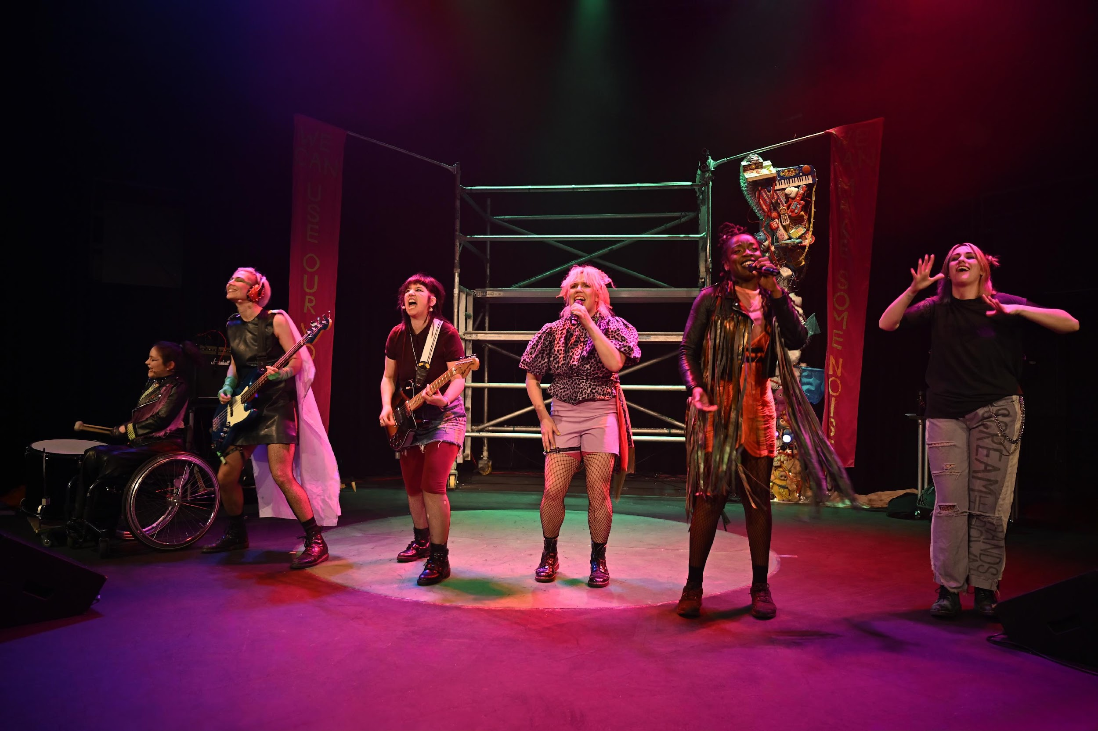

We’d also like to introduce you to the members of our band,
the Lazurr Tuts!

Slide 10
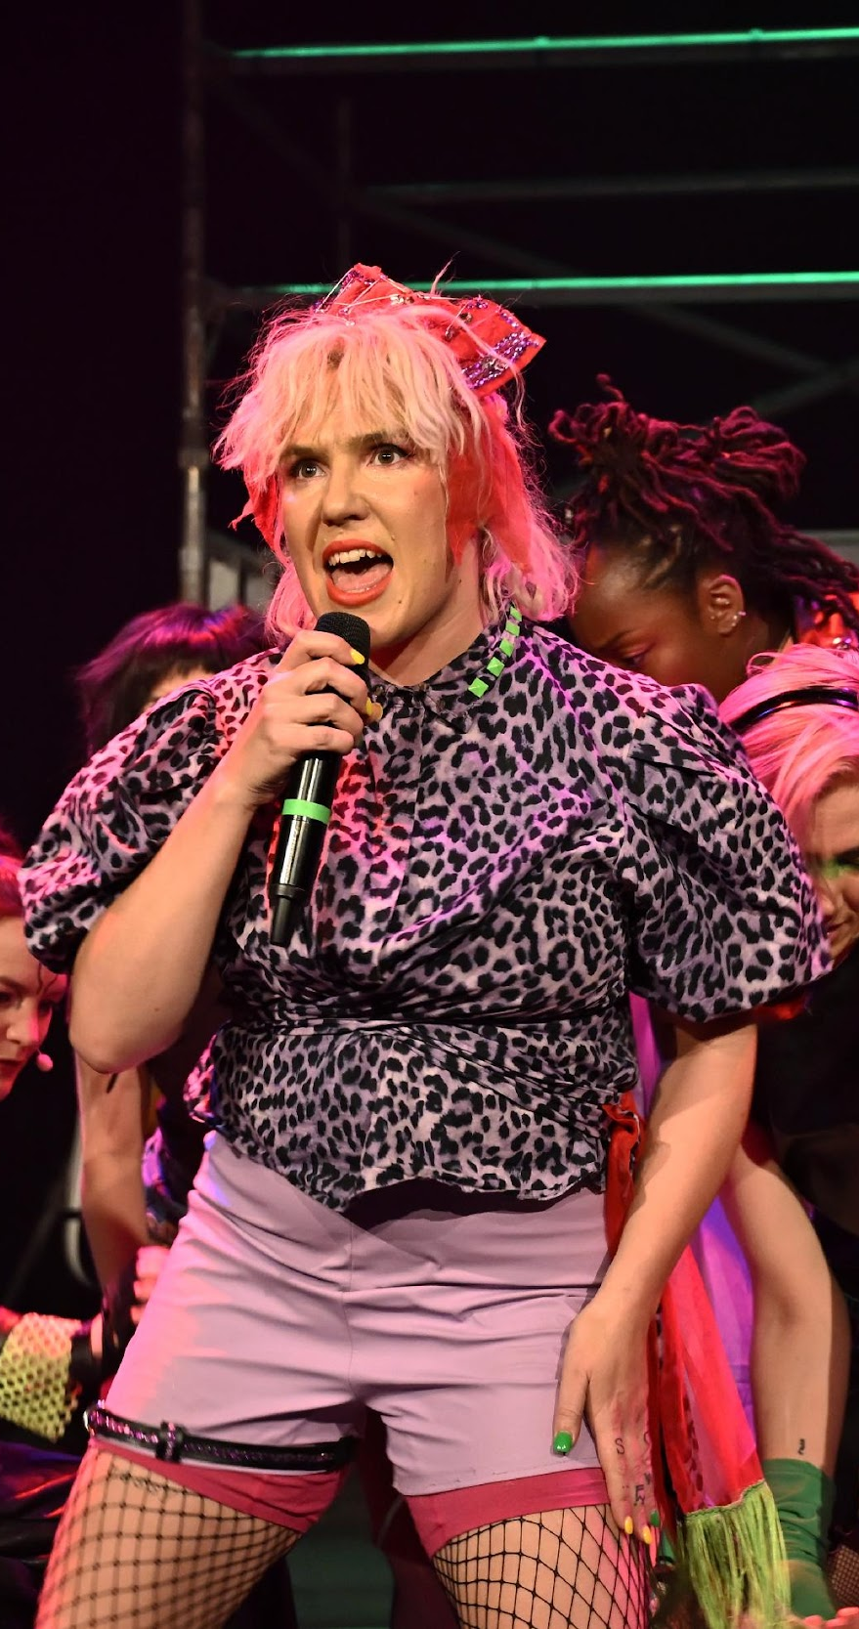
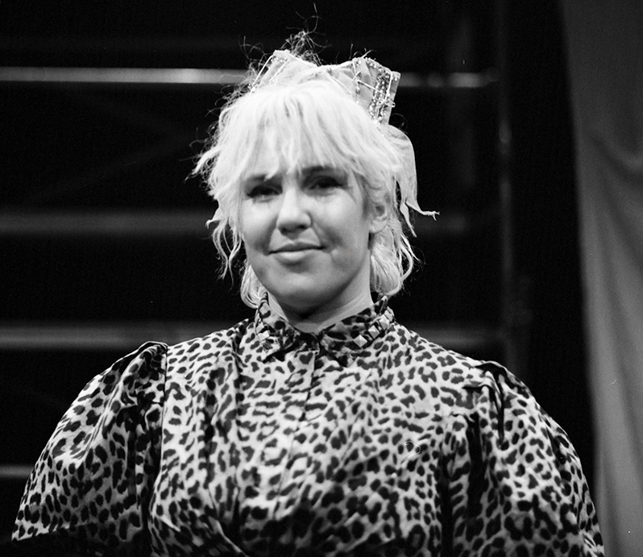
STARDUST
This is StarDust (she/her).
She’s one of the singers of the band.
When she’s on stage, it’s a big kerfuffle of energy and that’s why she’s got those big shoulder pads!
StarDust has blonde hair and she wears a purple leopard-print shirt, purple shorts, fishnet tights and black boots.

Slide 11
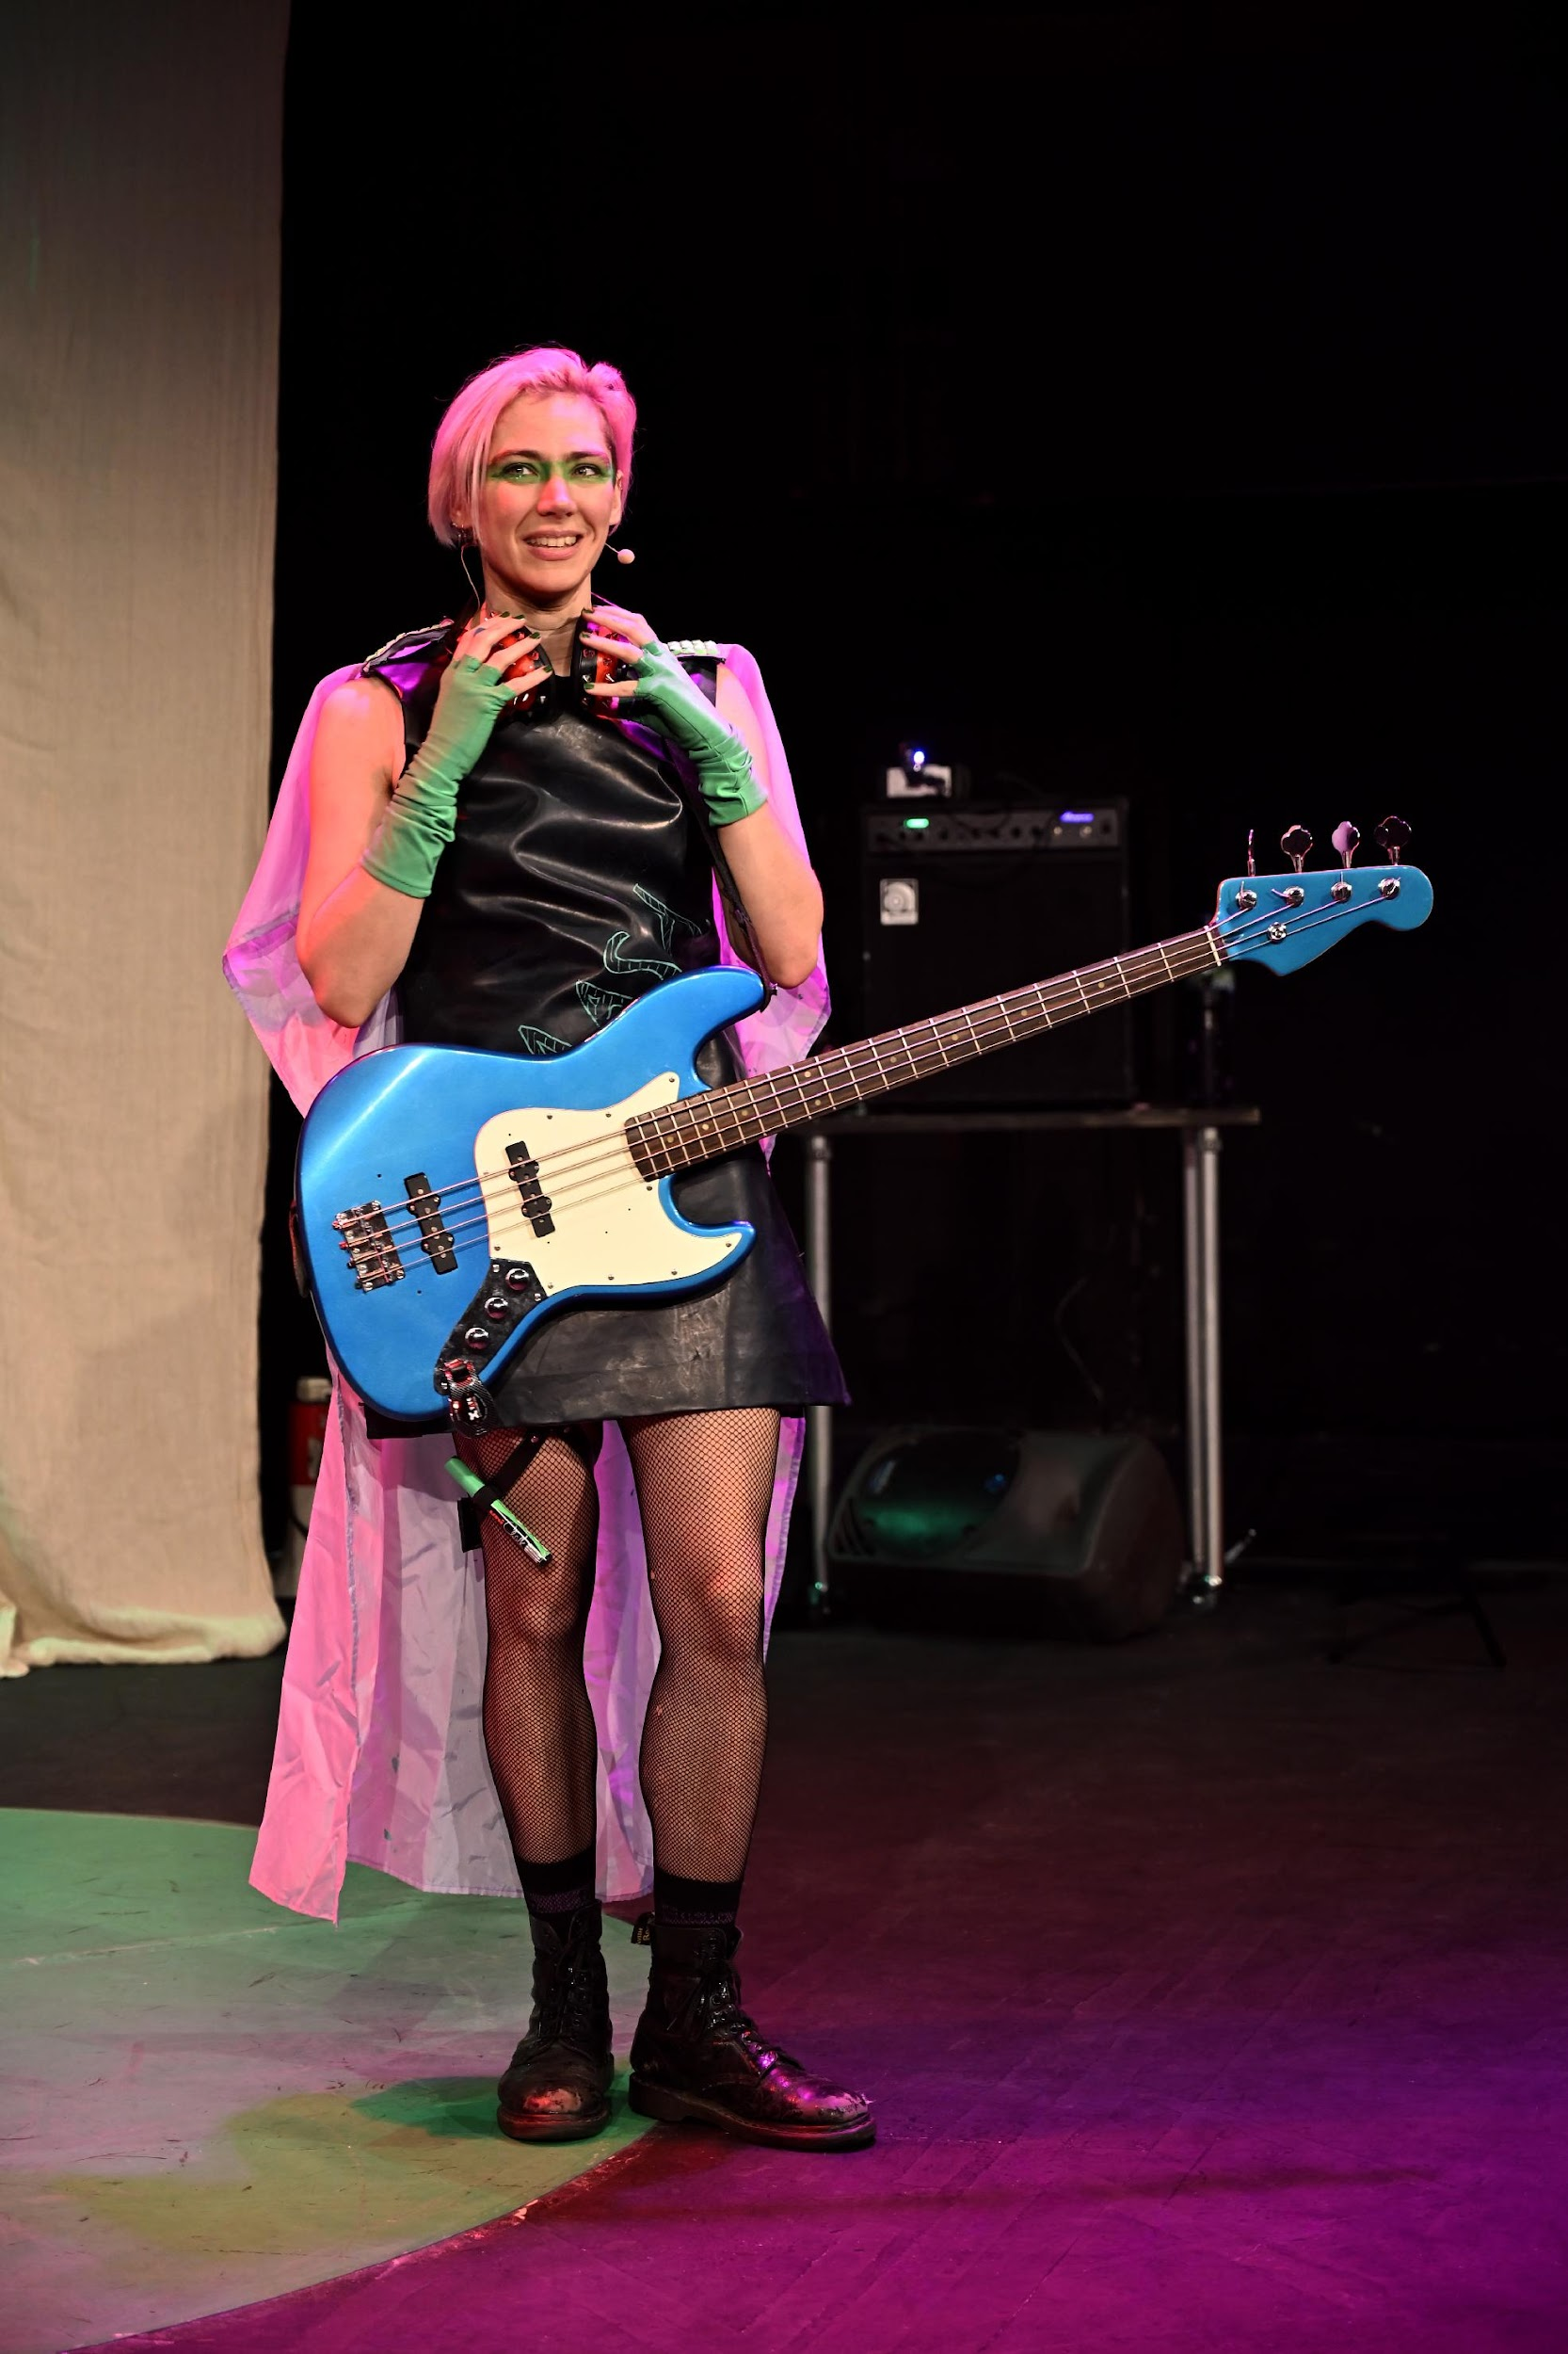
RAKE
This is Rake (they/them).
Rake is not a boy or girl.
They play bass and might be the tallest person in Punk Alley!
Rake wears a dress made of chalkboard material, a silky purple cape, netted tights and black boots.
They have pink hair and green eye makeup.

Slide 12
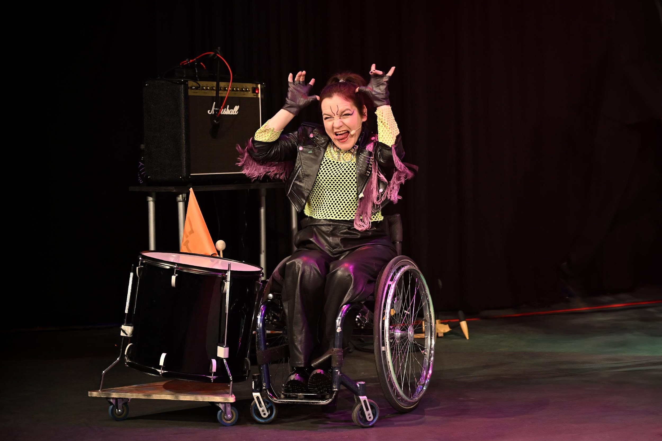
TINAMOU
This is Tinamou (she/her).
She plays drums in the band and keeps her tambourine in the back of her wheelchair so she’s always ready to jam.
Tina is also an inventor!
She has brown hair and wears a black leather jacket with purple fringe, a green netted shirt and black trousers.

Slide 13
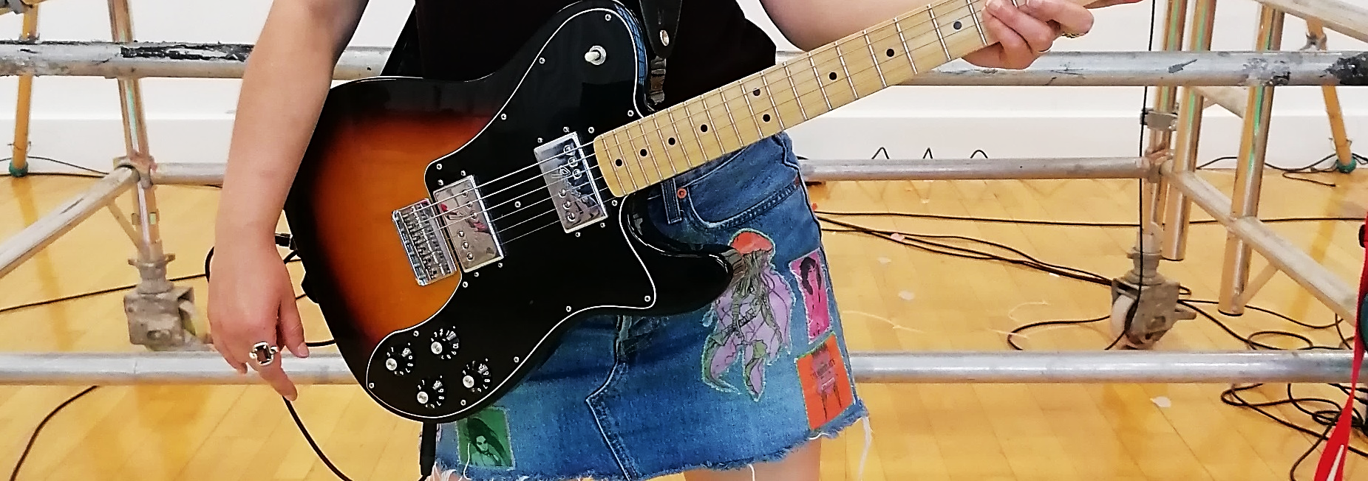
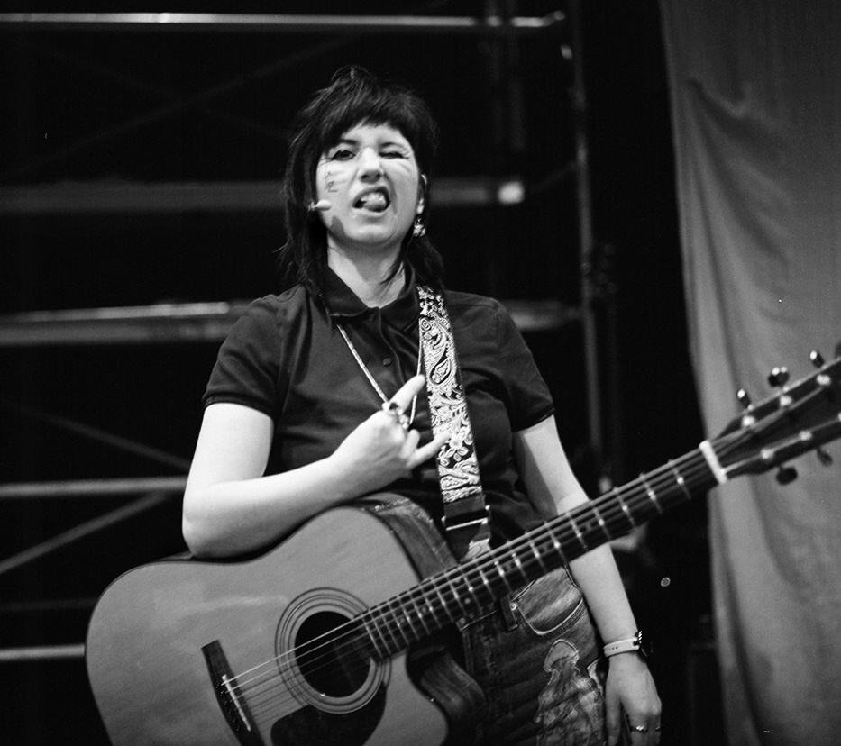
ZED
This is Zed (she/her).
Zed plays electric guitar!
She wears a denim skirt with patches on it with all her favourite causes and bands on - Bikini Kill, Kate Nash, and PJ Harvey.
Zed has black hair and also wears a burgundy polo shirt and black boots.

Slide 14
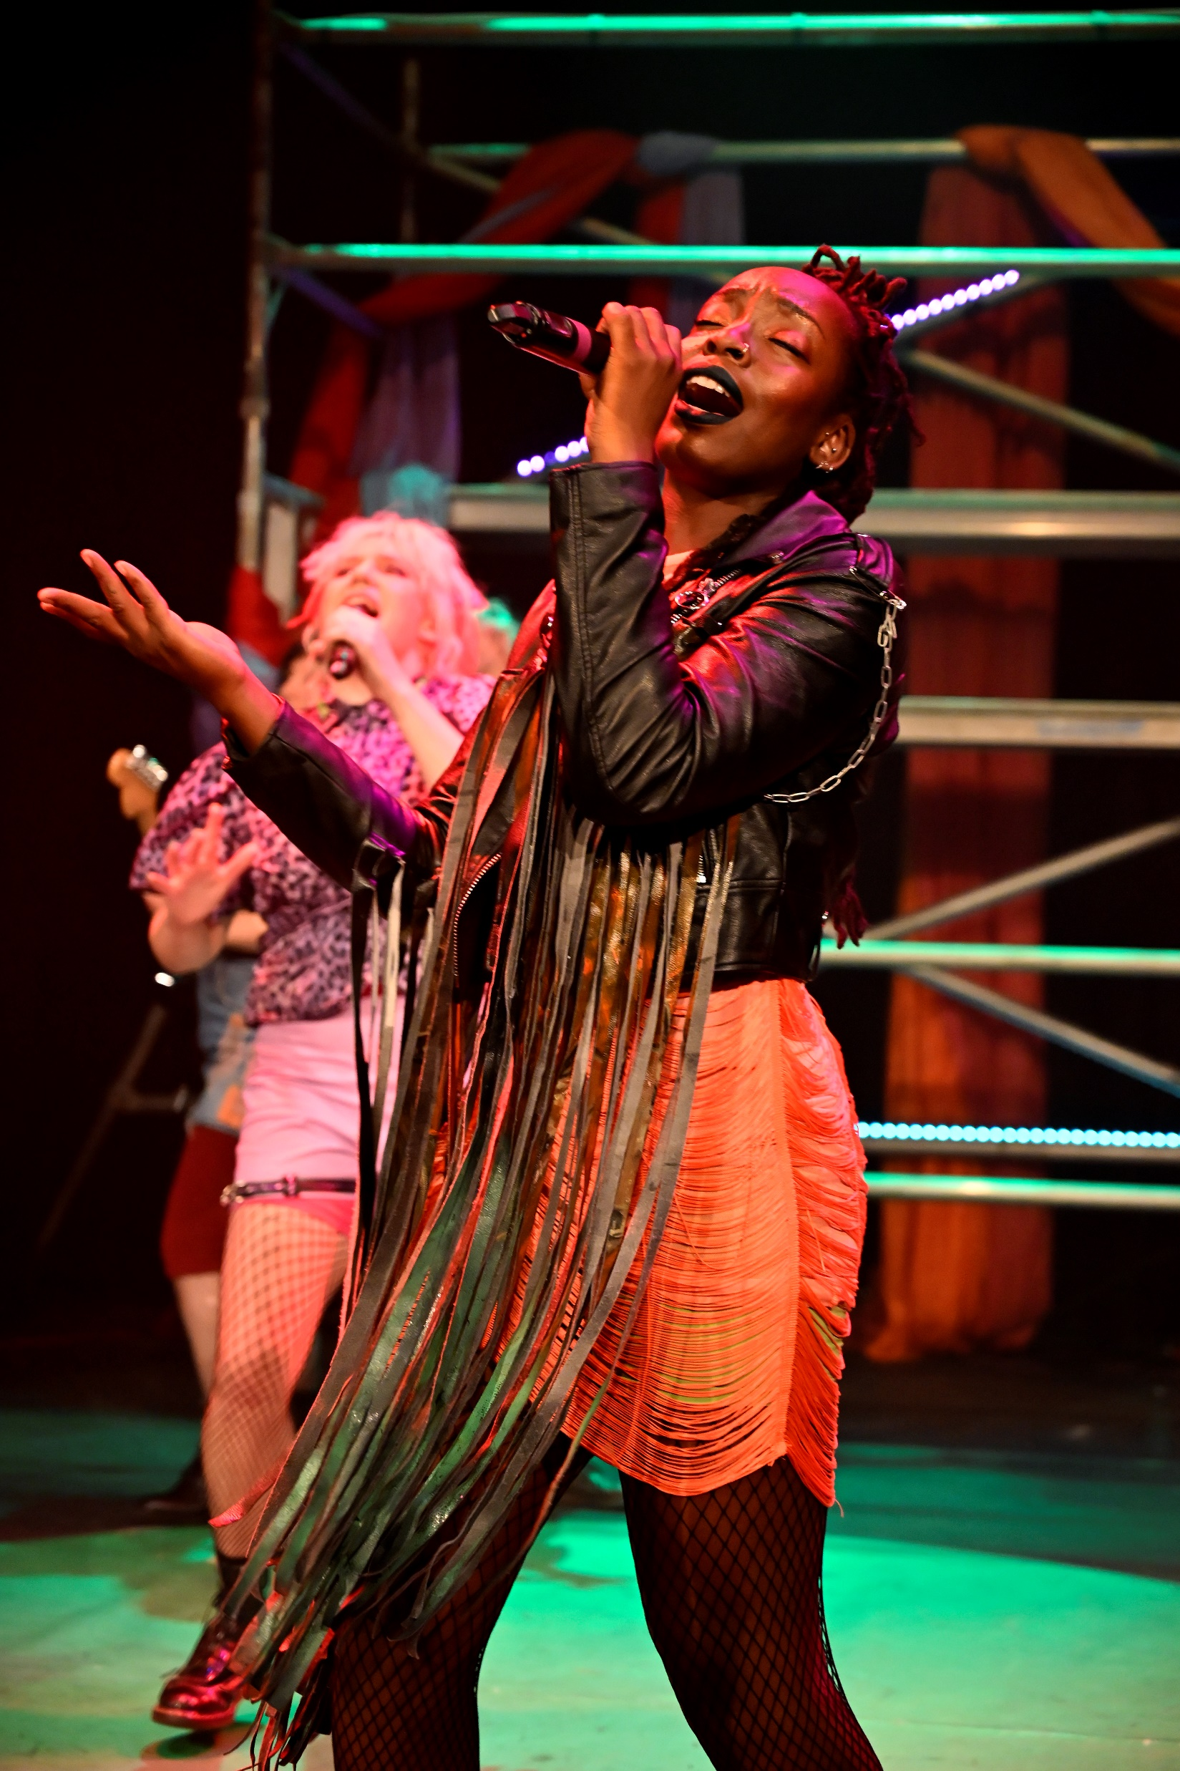
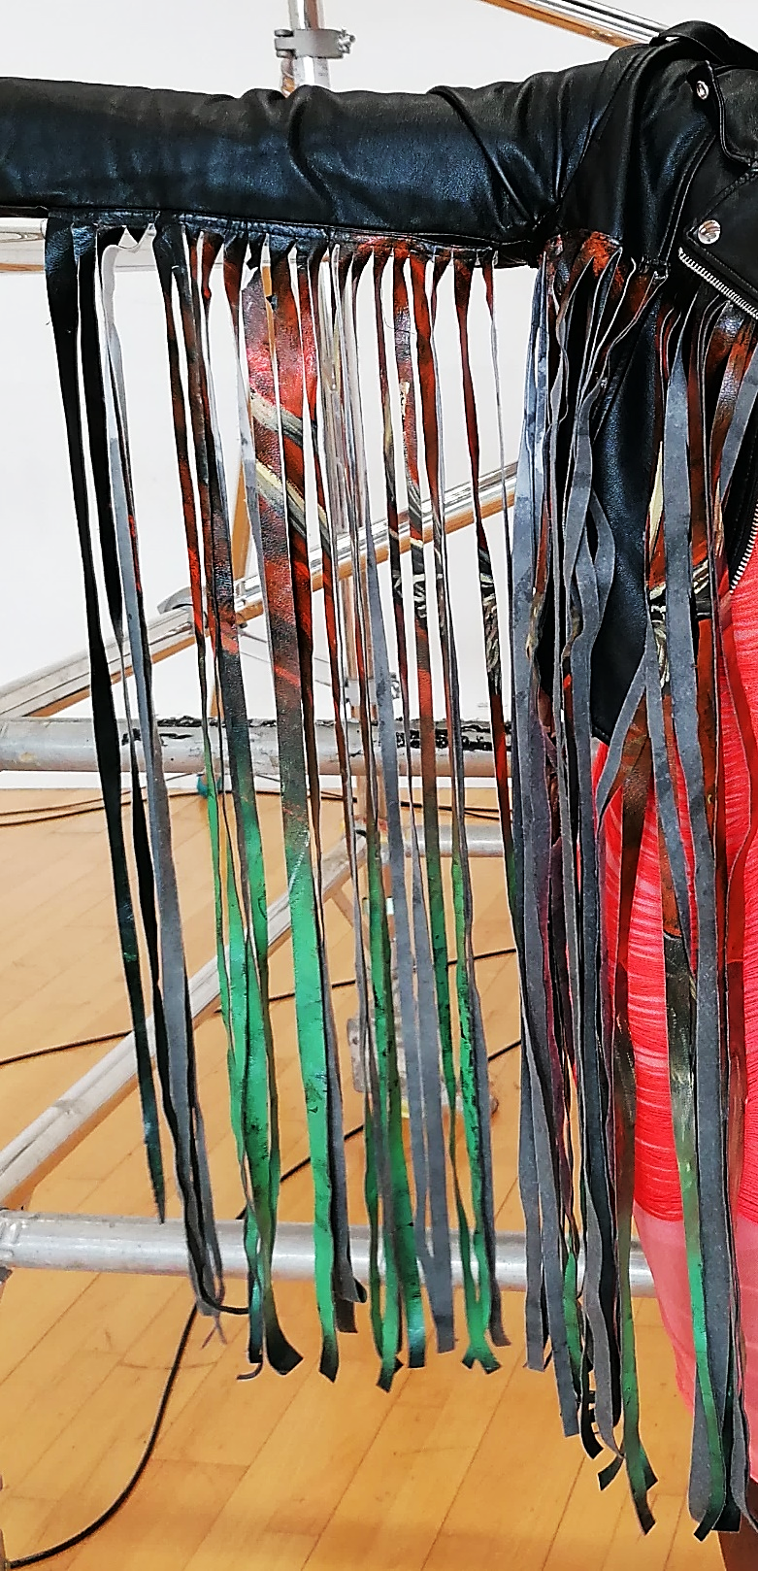
AKOMA
This is Akoma (she/her).
She is one of the singers of the band. Akoma’s very expressive and loves to dance.
She wears a black leather jacket with long fringes/tassels under her arms. She wears the jacket over an orange dress.
Akoma also wears netted tights, black boots and ties some of her hair up in buns, in a mohawk-style.

Slide 15
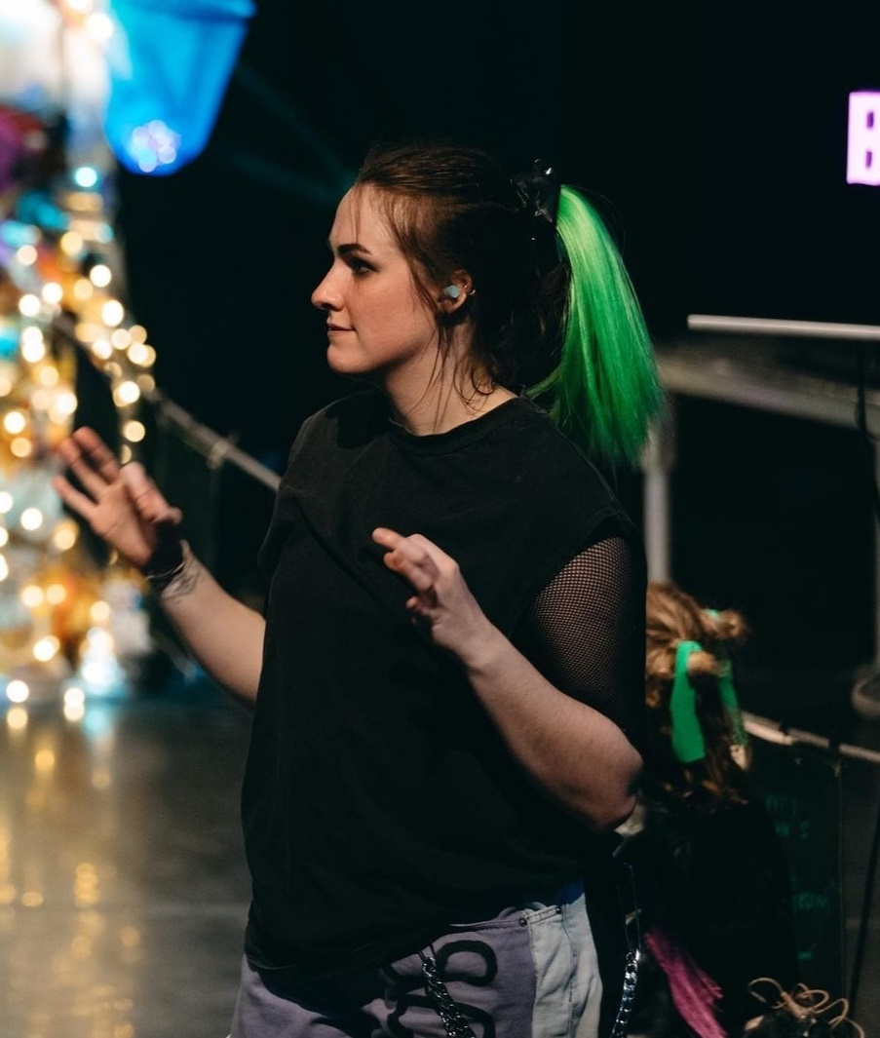
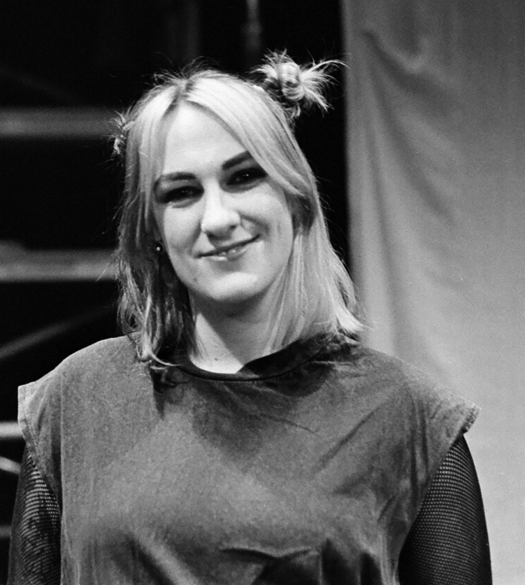
EMILIE
This is Emilie (she/her).
She is our sign language interpreter. She gets right in the middle of it all and she makes everything so much clearer.
Emilie wears a black t-shirt, with blue jeans that says ‘Scream the House Down’ on her left leg.
Emilie sometimes has black hair and a green ponytail.
She sometimes likes to dye her hair blonde too!

Slide 16
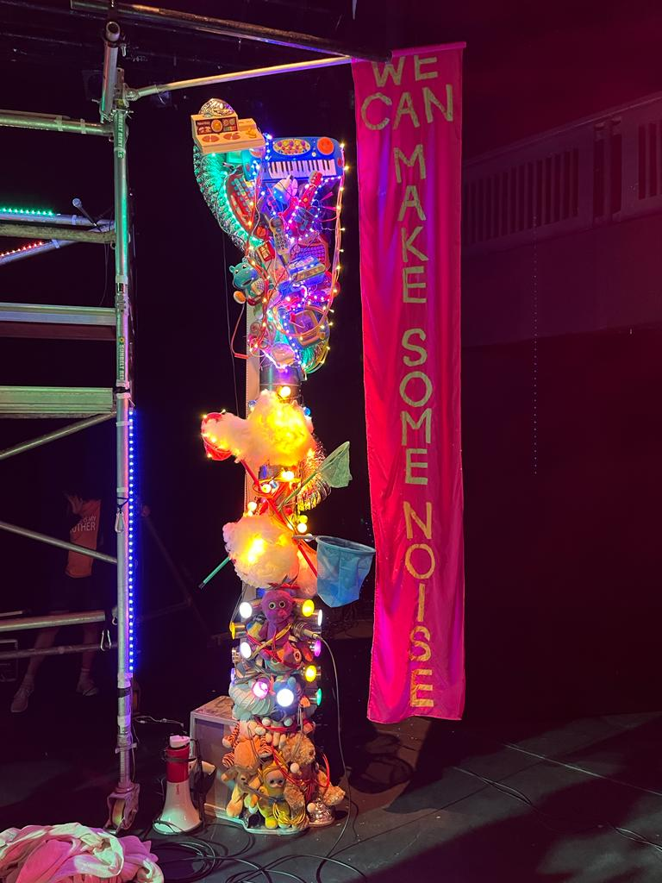
THE MAGIC BAROMETER
This is the Magic Barometer.
It was invented by Tina!
The Magic Barometer is very tall and is made of all sorts of interesting things – teddy bears, metal cans, nets, musical instruments, lights, wires and more. It makes sounds and turns on its lights when it’s excited and encourages the band throughout the show!

Slide 17
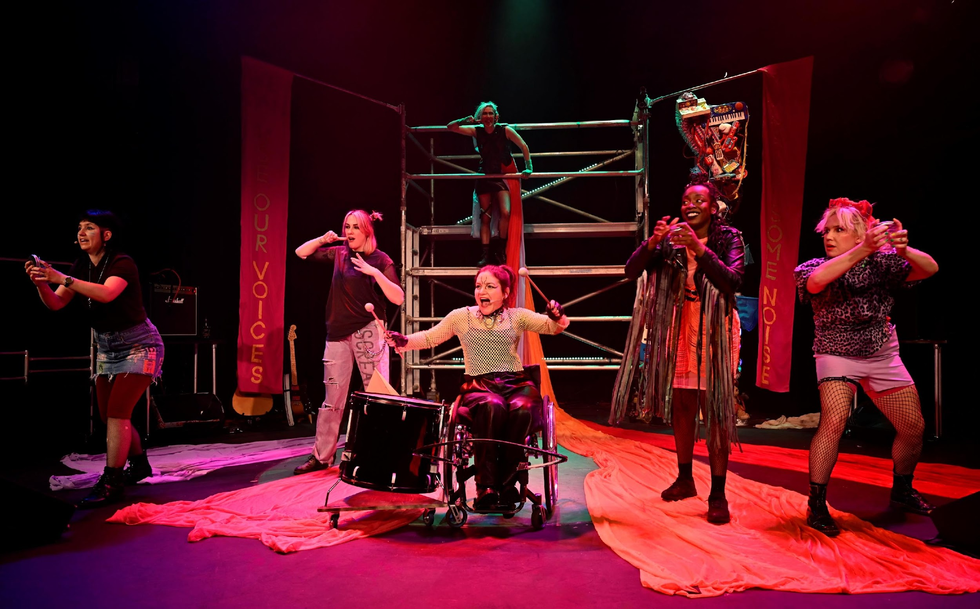
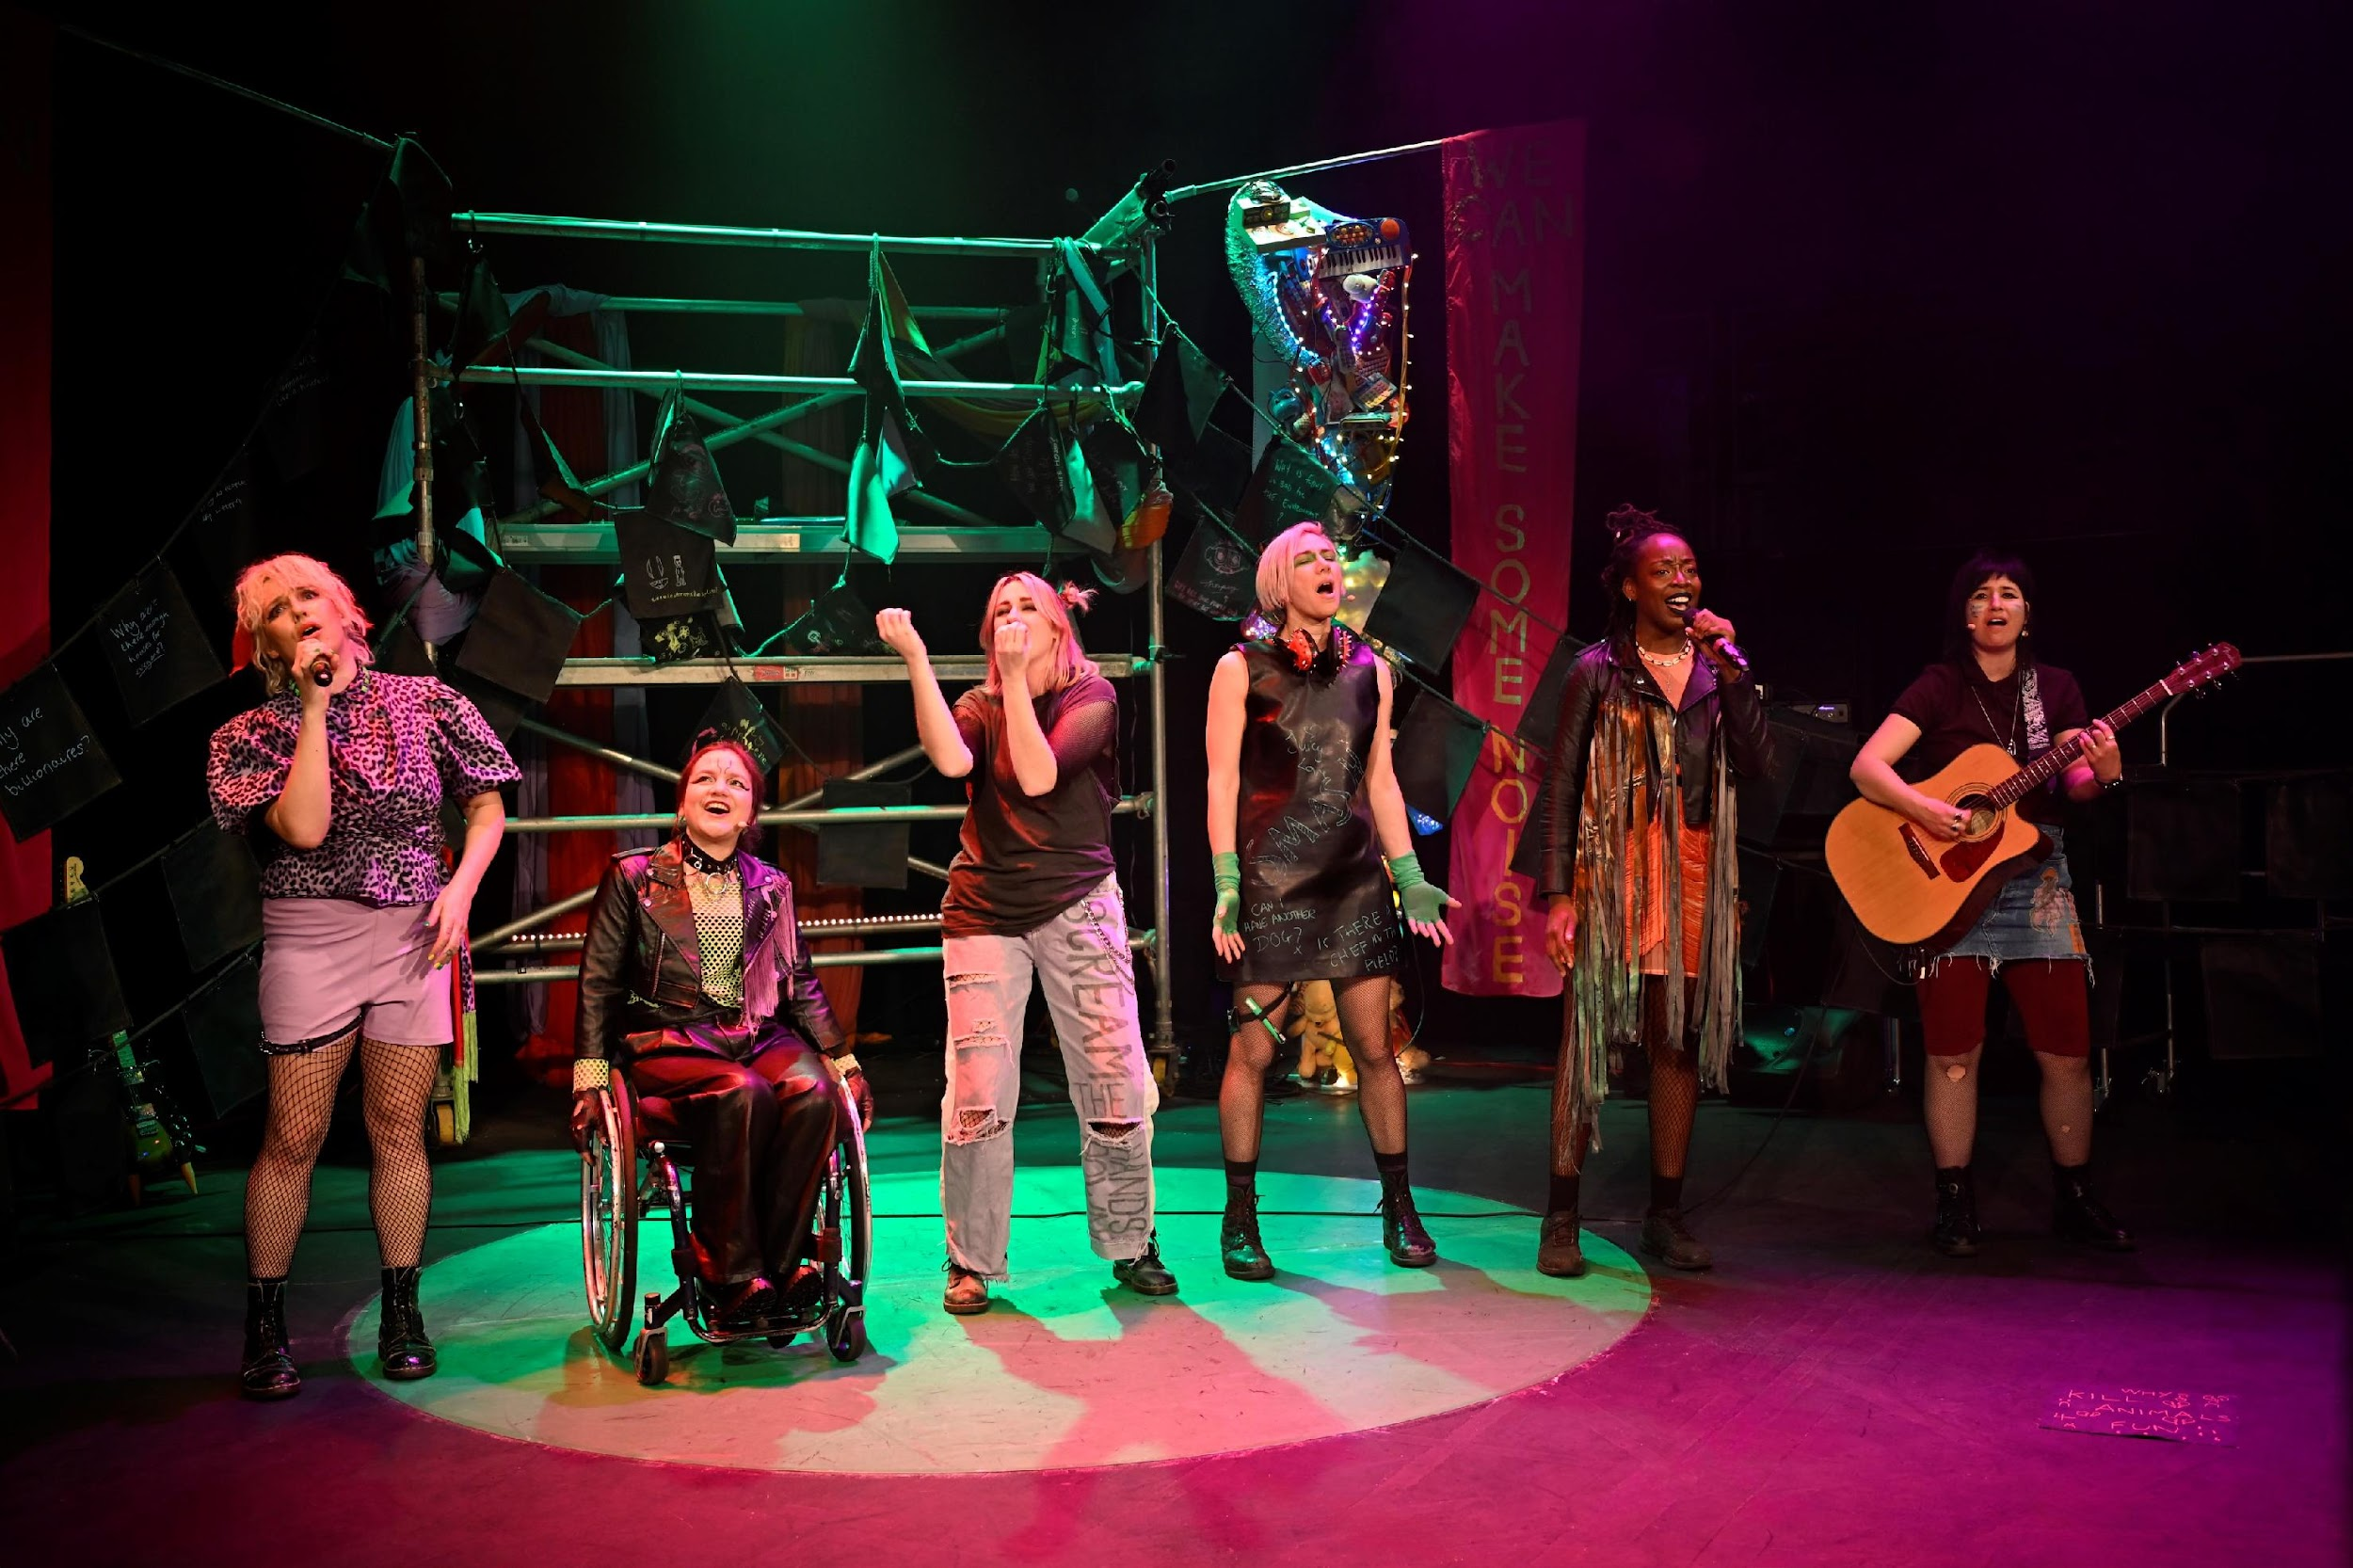
The Set
The centre of the stage has a big, very tall metal scaffold structure, which the band use to climb up and dance on.
Long pink banners can be hung from the scaffolding. The banners have ‘we can use our voices’ and ‘we can make some noise’ written in black text.
There is a big green circle on the floor – dance mat flooring - that the band can stand and dance on.

Slide 18
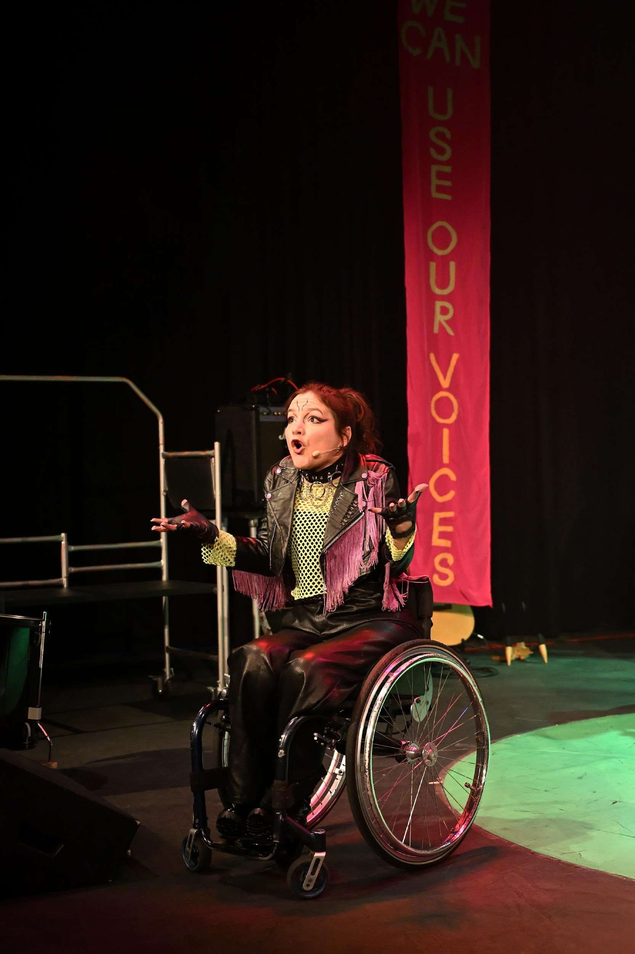
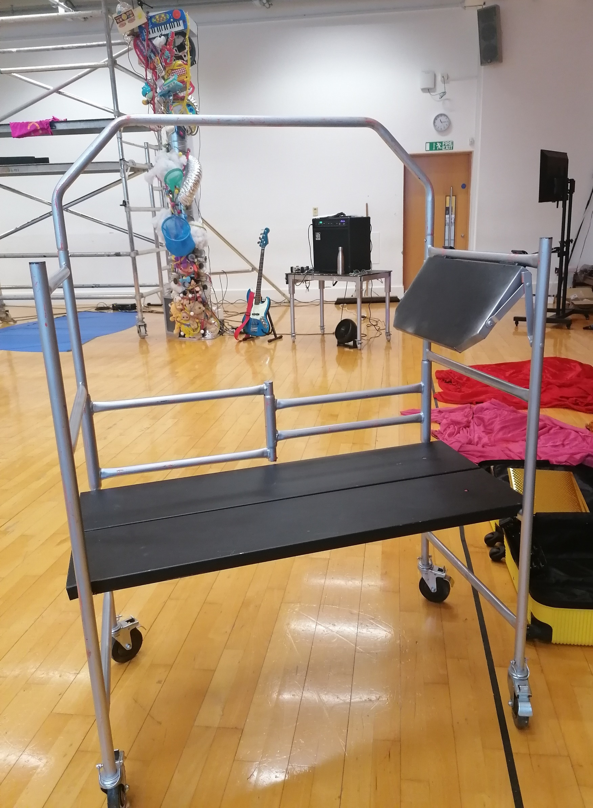
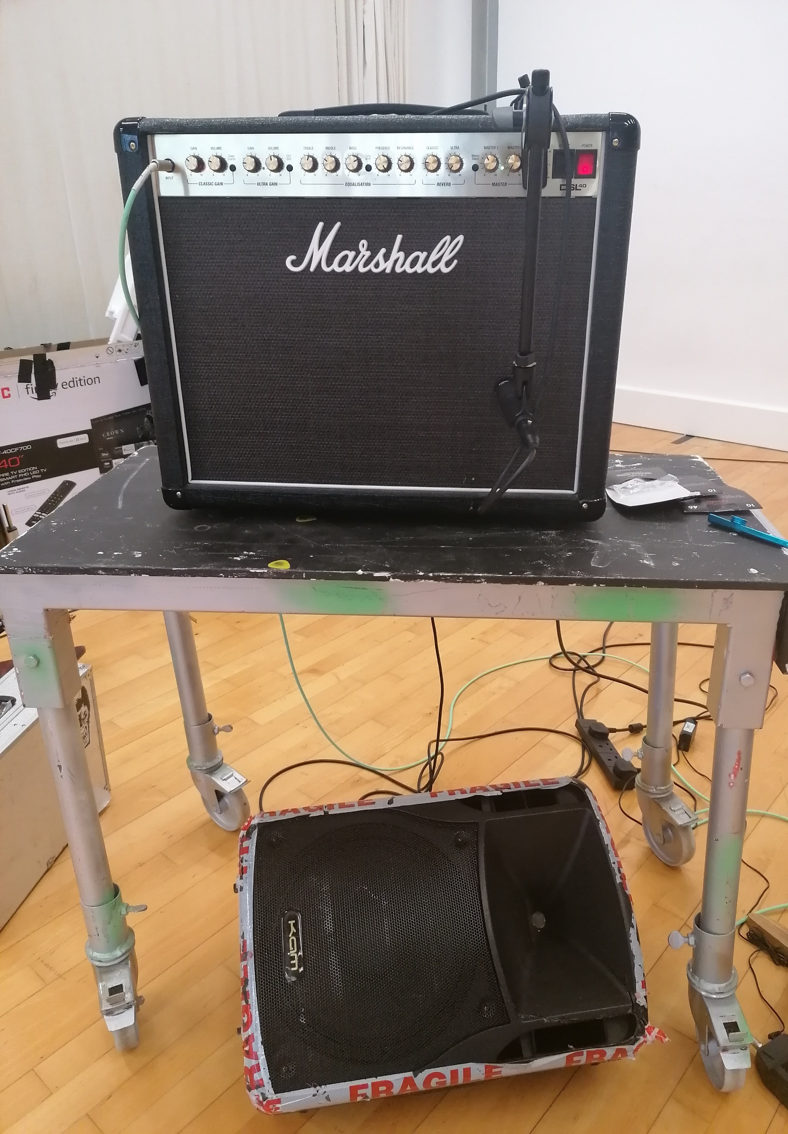
The Set
The Magic Barometer is to the right of the scaffolding.
There are two speakers on two black and silver tables on the left and right of the scaffolding. One of them is an amp that says ‘Marshall’ on the front in silver writing.
There are also two black and silver trolleys. At the beginning of the show, this holds some t-shirts and flags that we give out to the audience!
Then it gets cleared away.

Slide 19
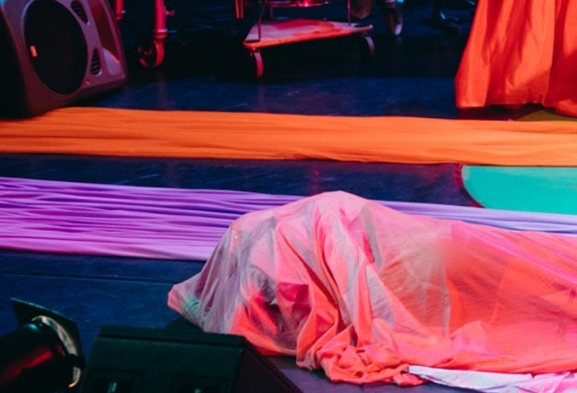
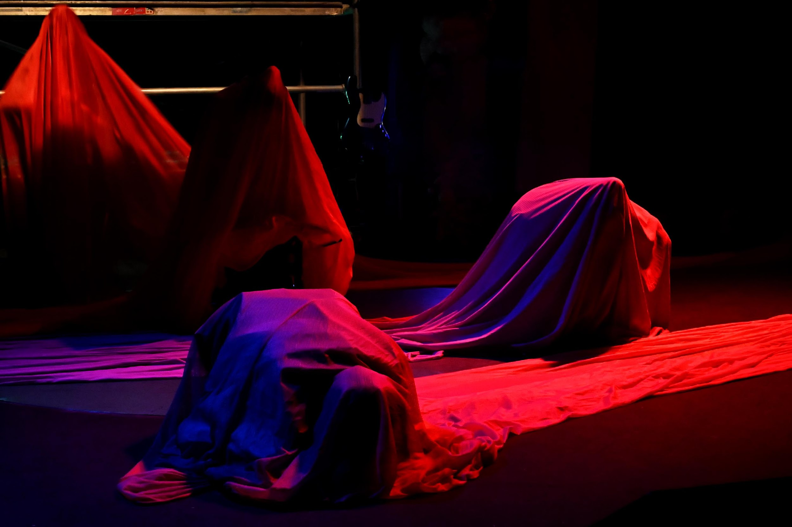
The Set
There are long purple, pink, orange, and red netted cloth on the sides of the stage.
The band hide under the cloth, stretch them across the stage and dance under them to turn into their inner Monsters!

Slide 20
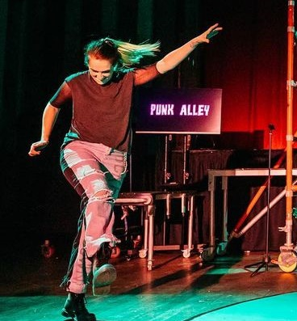

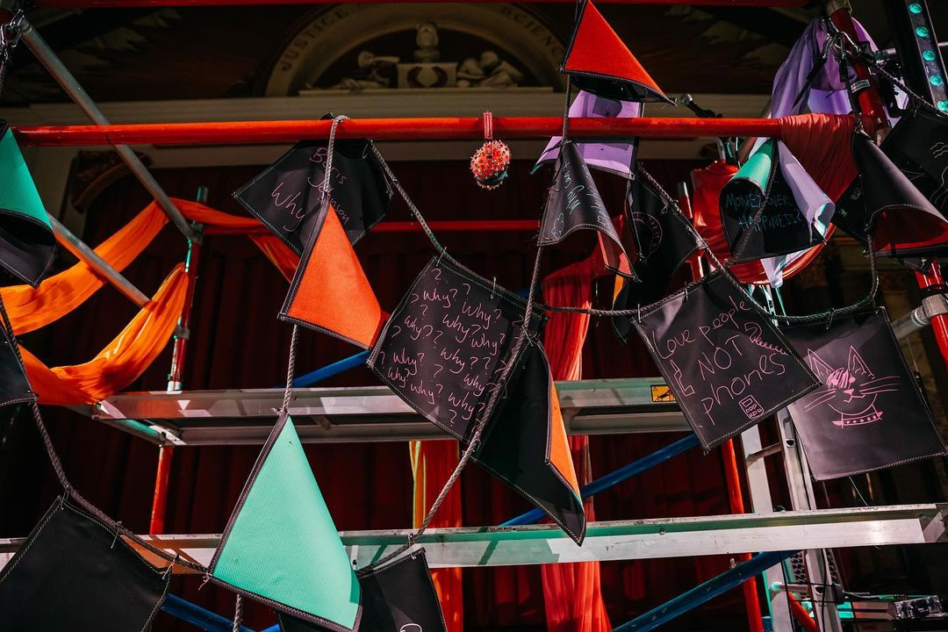
The Set
There are two TV screens on both sides of the stage. During the songs, you can see all the lyrics on screen! And this is where the rock hand symbol appears, so you know in 5 seconds, the sound and lighting will be at its most intense.
In front of your seats, there is a line of black flags/bunting made of chalkboard fabric that you can write and draw on.
During the show, all the flags get lifted carefully over your heads and gets draped all over the stage, from the scaffolding to the trolleys.

Slide 21

We’re so happy to have you here with us!
If you have any questions, please ask.
We hope you enjoy the show!

