Slide 1
SHOW TITLE HERE
INSERT IMAGE
HERE
VISUAL GUIDE

Slide 2
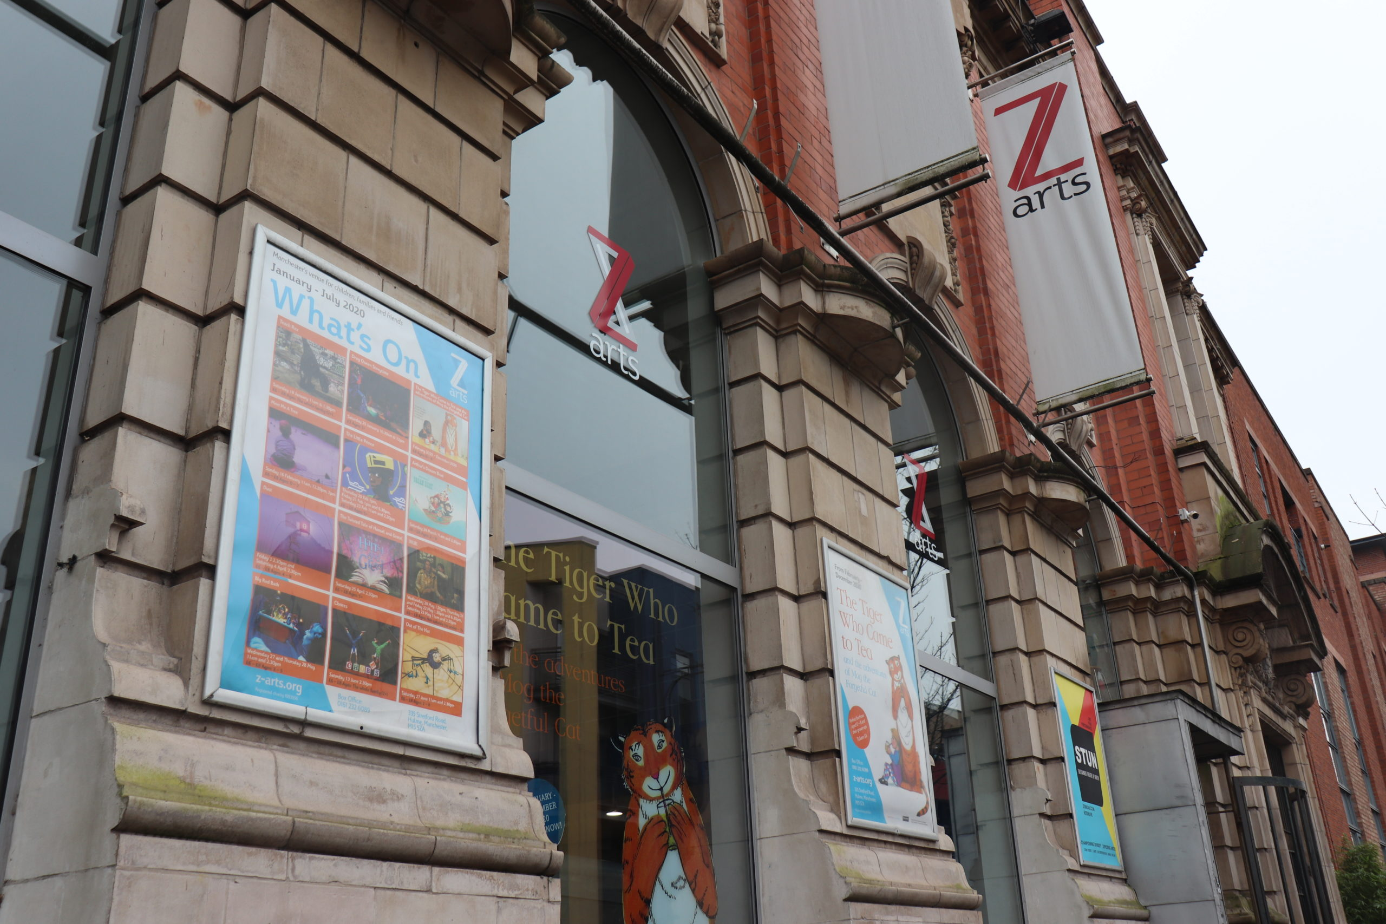
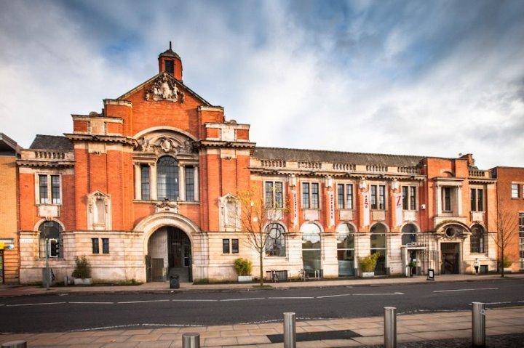
Getting to Z-arts
335 Stretford Road, Hulme, Manchester, M15 5ZA
Box Office: 0161 226 1912
Z-arts is directly opposite Hulme Park.

Slide 3
Entrance
When you enter Z-arts, you will see a sign, some plants, a fish tank and some steps. On your left, there is a
ramp. If you go up the ramp or up the steps, you will get to our Box Office desk.
Box Office
This is what you will see as you climb the steps towards Box Office. In the photo we have Emma, our House Manager and Luke, one of our Front of House Assistants. When you arrive, the person at the desk with help you get to the show!

Slide 4
Z-café
If you look to your left when you’re standing facing the Box Office desk, there is a corridor with lots of posters. This takes you through to Z-café.
You can buy food and drink from the counter at Z-café. There are plenty of options, including vegan, vegetarian and halal choices.
There are male and female toilets and an accessible toilet in Z-café. They are on the left when you are facing the counter.
There is a second entrance and exit door located in the café next to the toilets.

Slide 5
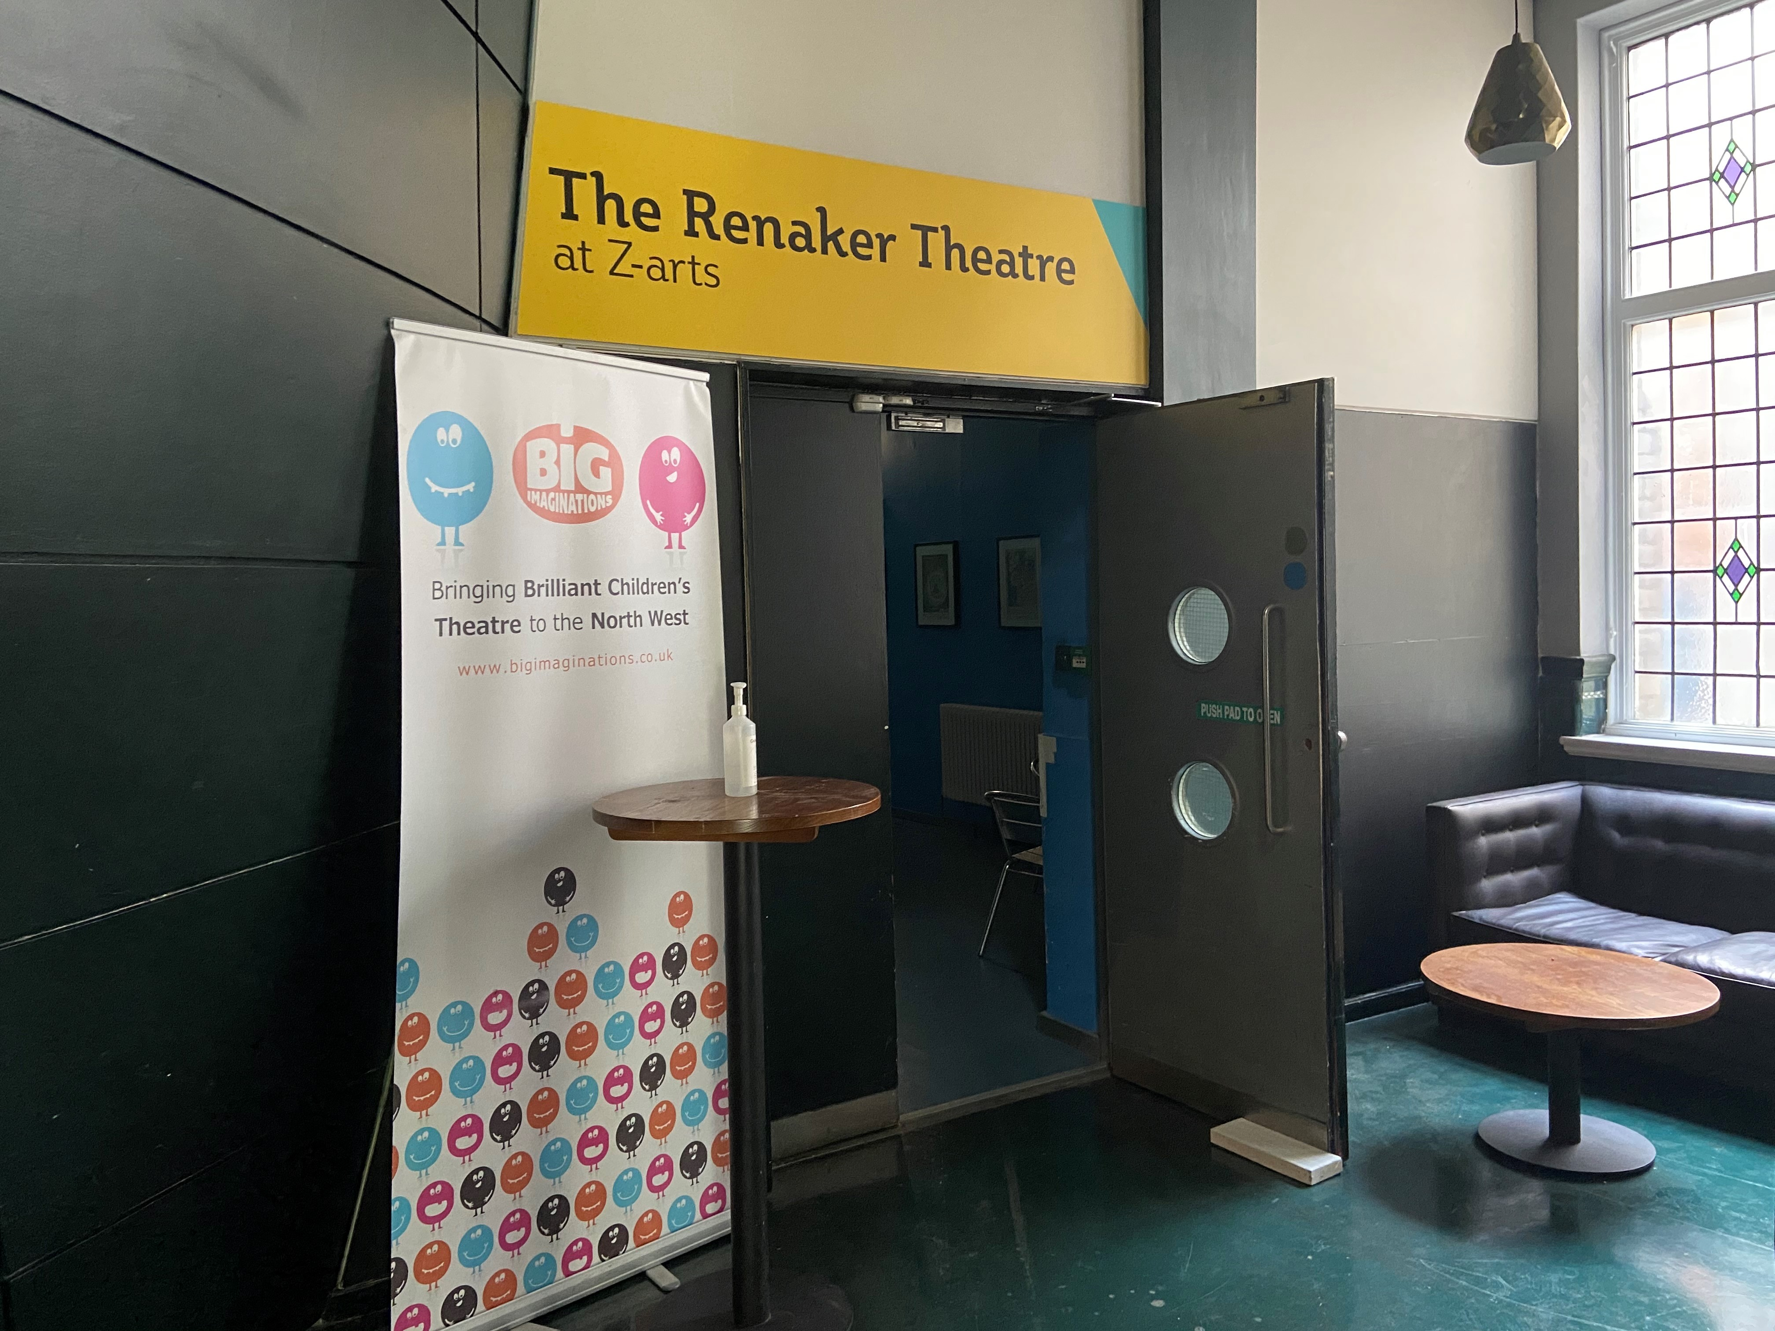
Theatre Corridor
In Z-café, next to the seating area, there is a black door with two windows.
When you go through that door, go down to the end of the corridor.
On your left is a door which takes you through to the theatre.
A Z-arts staff member will direct you to the theatre when the show is about to begin!

Slide 6
The Theatre
This is where the magic happens!
When you enter the theatre, there will be a Z-arts staff member there to guide you.
Get comfy and relax. The show is about to start!
INSERT IMAGE HERE
How long is the show?

Slide 7
What to Expect
Write a simple summary of the show here, including any important references such as strobe lighting, loud noises, etc.
Who are the characters we are going to meet?
Include images from the show.
If the company/artist has a trailer for the show, include a link to it!
What happens after the show? Is there an opportunity to meet the cast?
INSERT IMAGE HERE

Slide 8
Do you have any other questions about the
show?
Please get in touch!
@z_arts_mcr @z.artsmcr @zartsmcr
Share what you liked about the show using the hashtag #MyCreativeFamily
We hope you enjoy the show!
Box Office: 0161 226 1912

