Slide 1
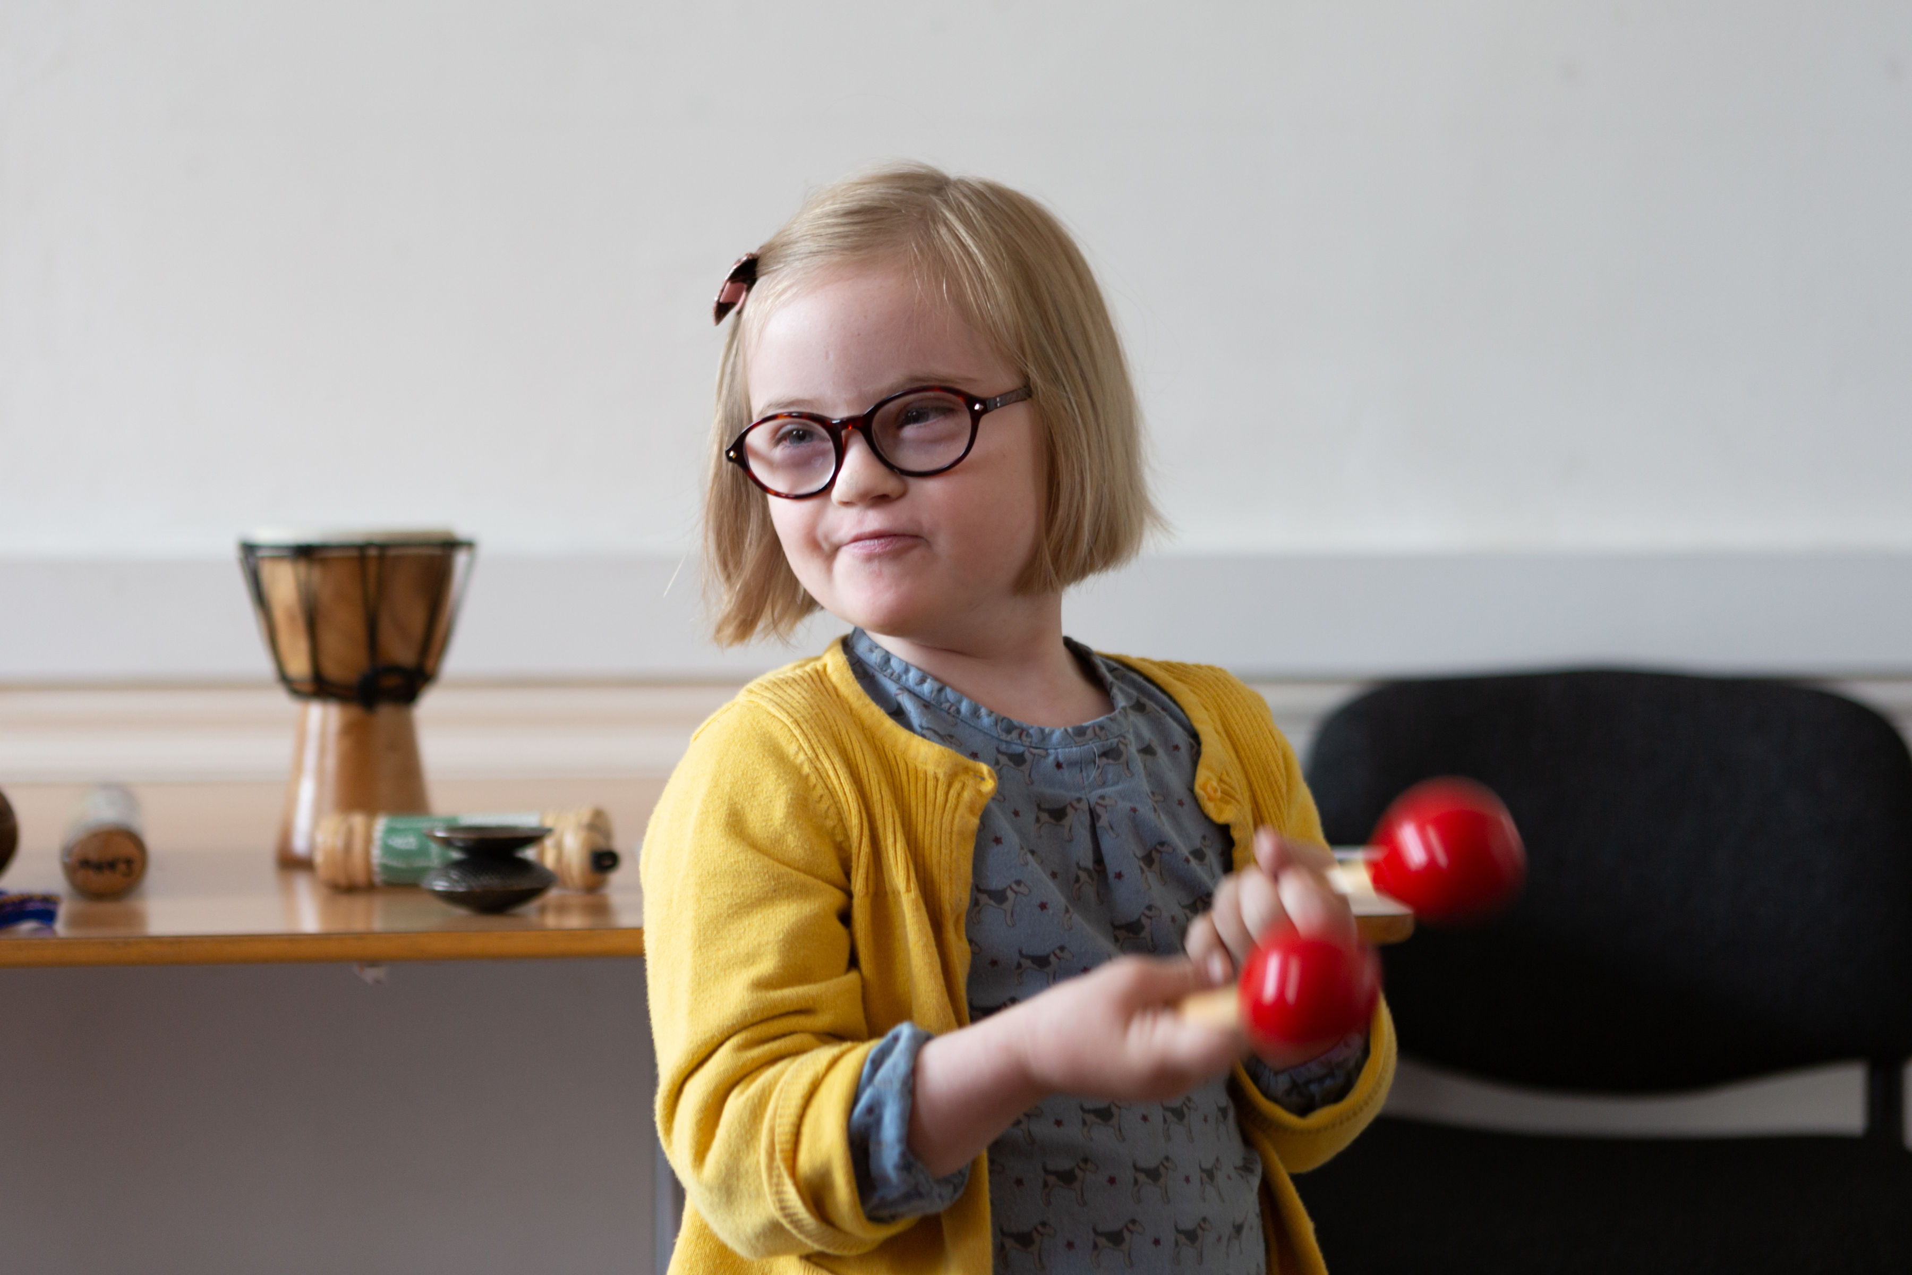
Z-ACCESS FAMILY FUN DAY
VISUAL GUIDE

Slide 2
What is a Visual Guide?
A visual guide gives you lots of information about Z-arts and the show you are going to see, using pictures and accessible text. They are suitable for anyone who would benefit from a clear and accessible introduction to Z-arts and the show.

Slide 3
What is a Z-access Family Fun Day?
Z-access is a safe and welcoming event, designed for families with disabilities and additional requirements.
We have drama, music, arts & crafts and creative play sessions, as well as a time-out space.
Alongside our trained staff and facilitators, a BSL interpreter will be at Z-access.

Slide 4
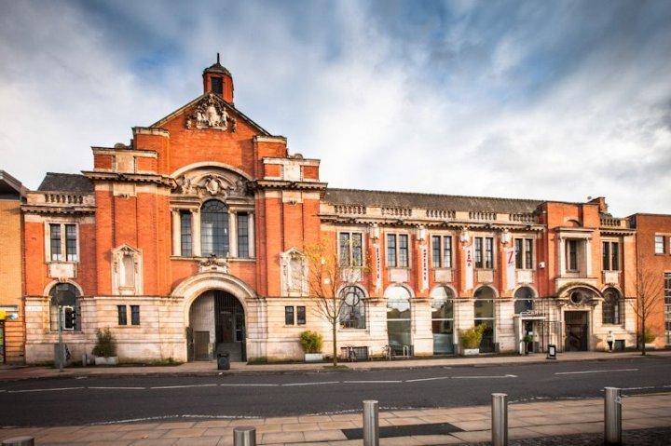
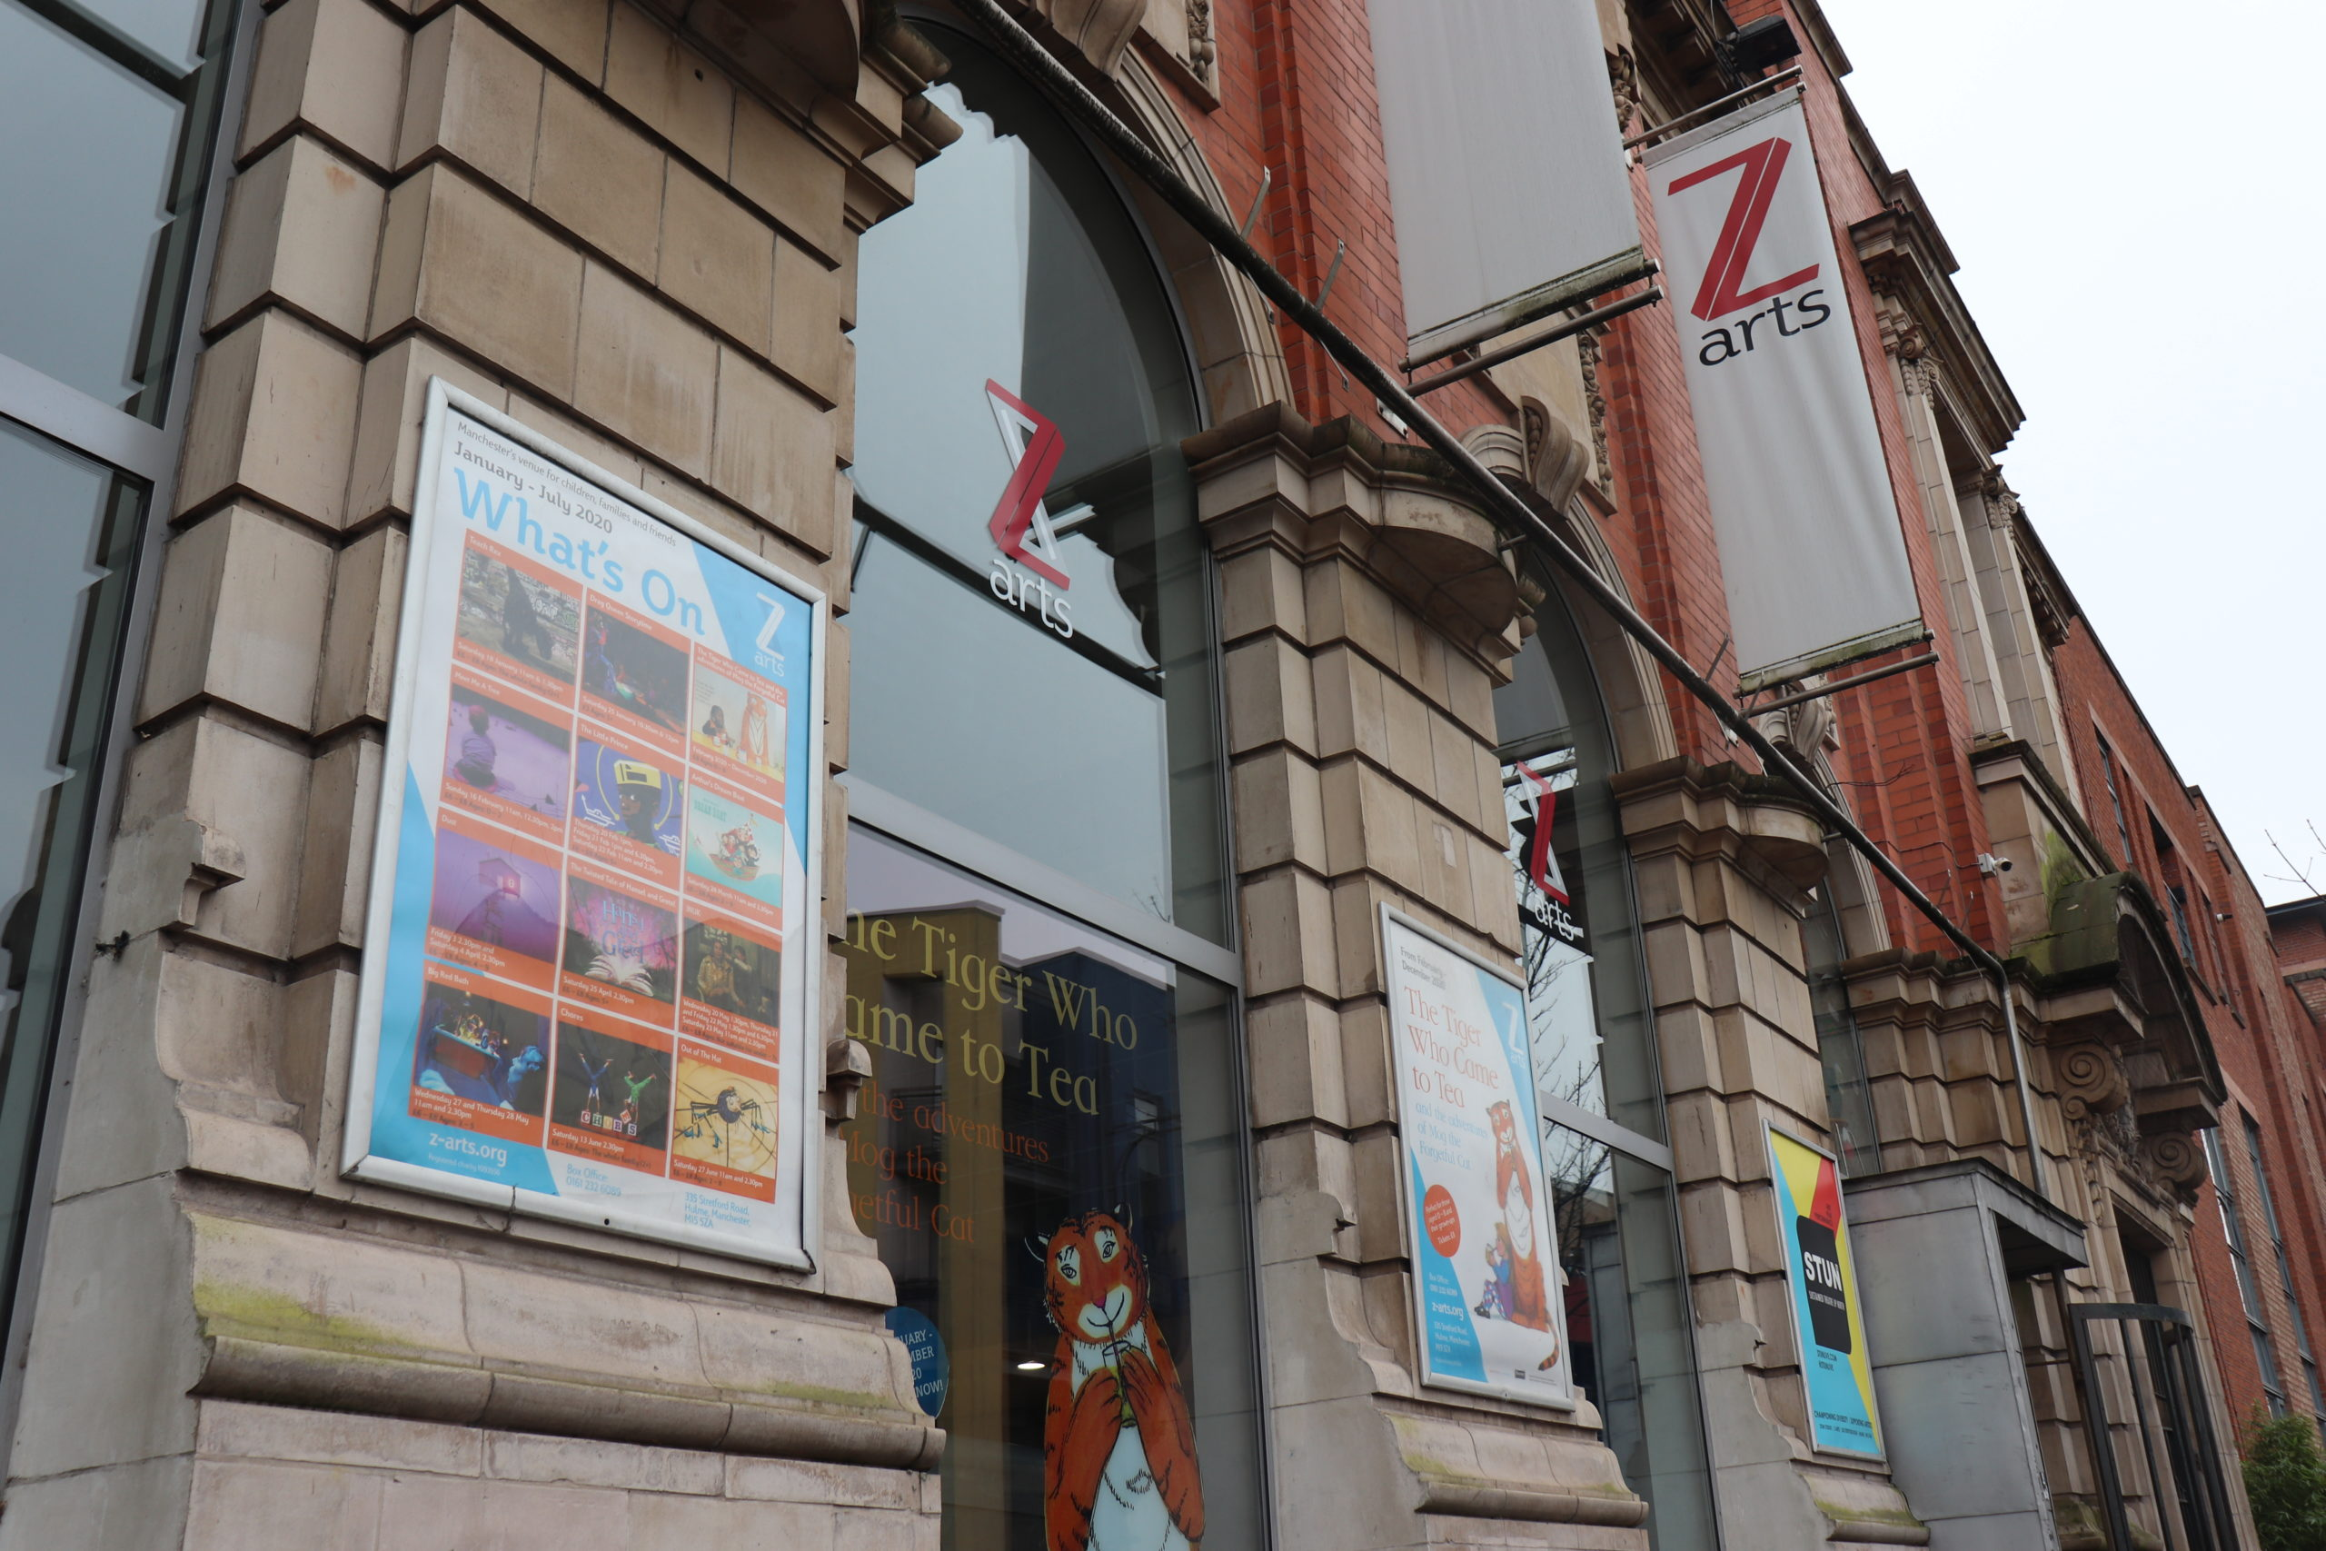
Getting to Z-arts
The address is: 335 Stretford Road, Hulme, Manchester, M15 5ZA
Do you want to talk to someone at Z-arts? Ring our friendly Box Office team on: 0161 226 1912
Z-arts is directly opposite Hulme Park.

Slide 5
Entrance
When you enter Z-arts, you will see a sign, some plants, a fish tank and some steps. On your left, there is a
ramp. If you go up the ramp or up the steps, you will get to our Box Office desk.
Box Office
This is what you will see as you climb the steps towards Box Office. In the photo we have Emma, our House Manager and Luke, one of our Front of House Assistants.

Slide 6
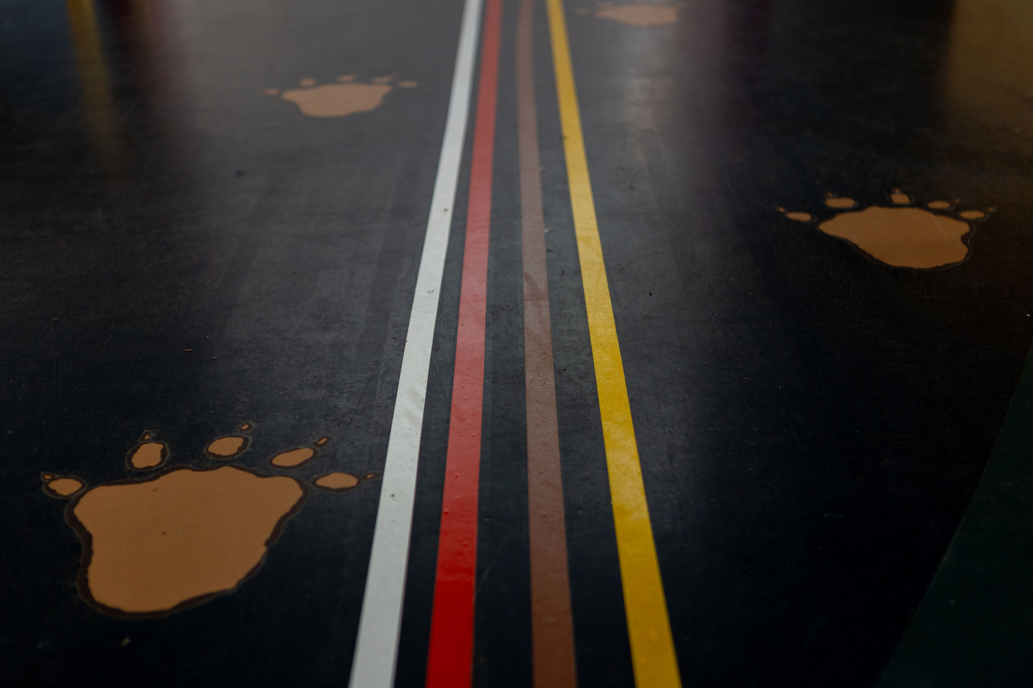
When you arrive, you will be given a map and a programme.
The programme will tell you what is happening in the building and which room each activity is in.
The map will show you where to go for each activity. We have coloured lines on the floor to help you find your way to each room.

Slide 7
You can drop into any of these activities between 11am-2pm:
Drama with Ged: learn new drama skills while having fun!
Music with Sarah: get your bodies moving, make some noise, and maybe even write your very own family song!
Arts & Crafts with Jo: Get creative with some fun arts & crafts activities.
Storytelling with Ilaria: share your favourite tale, chat about your favourite books, and make up your own story.
Dance with Josie: Move around the room, use your bodies and senses to have fun, express yourself, and maybe do a dance!

Slide 8
Food & Drink
If you look to your left when you’re standing facing the Box Office desk, there is a corridor with lots of posters. This takes you through to Z-café.
You can buy food and drink from the counter at Z-café. There are plenty of options, including vegan, vegetarian and halal choices.
There are male and female toilets and an accessible toilet in Z-café. They are on the left when you are facing the counter.
There is a second entrance and exit door located in the café next to the toilets.

Slide 9
Do you have any other questions about Z-access?
Please get in touch!
@z_arts_mcr @z.artsmcr @zartsmcr
Share what you liked about the event using the hashtag #MyCreativeFamily
We hope you enjoy Z-access!
Box Office: 0161 226 1912

