Slide 1


Artist Support

Slide 2
Z-arts Artist Development
Z-arts supports artists who are interested in making theatre for young audiences (0-13) or as creative facilitators.
Our artists development work has expanded dramatically since becoming an NPO, and we are creating a new structure which makes the offer more transparent to artists who want to work with us:
We can offer rehearsal space, but prefer to have some input as artistic advisors, especially from children.
We have two small strands of R&D budget – one for Z-arts, and another for Big Imaginations, which is allocated annually by committee.
We have a commission budget both for Z-arts and Big Imaginations
We also co-commission work.

Slide 3
Big Imaginations Commission
Criteria | Questions
Artists must respond to Creative Case for Diversity | How do you respond to each criteria priority?
Non-traditional venues - consider the diversity of audiences in Big Imaginations, including rural and non rural spaces. | Budget breakdown - and how will you use the £8k?
Environment and access - how would you make your work sustainable? Respond to Z-arts environmental policy. | How likely will it happen anyway?
Children as co-creators. | What sort of non traditional spaces might they be?
It needs to be made in the region.
Open to invitation from Big Imaginations members.
Regionally-based artists.

Slide 4
Supported Companies and Artists

Slide 5
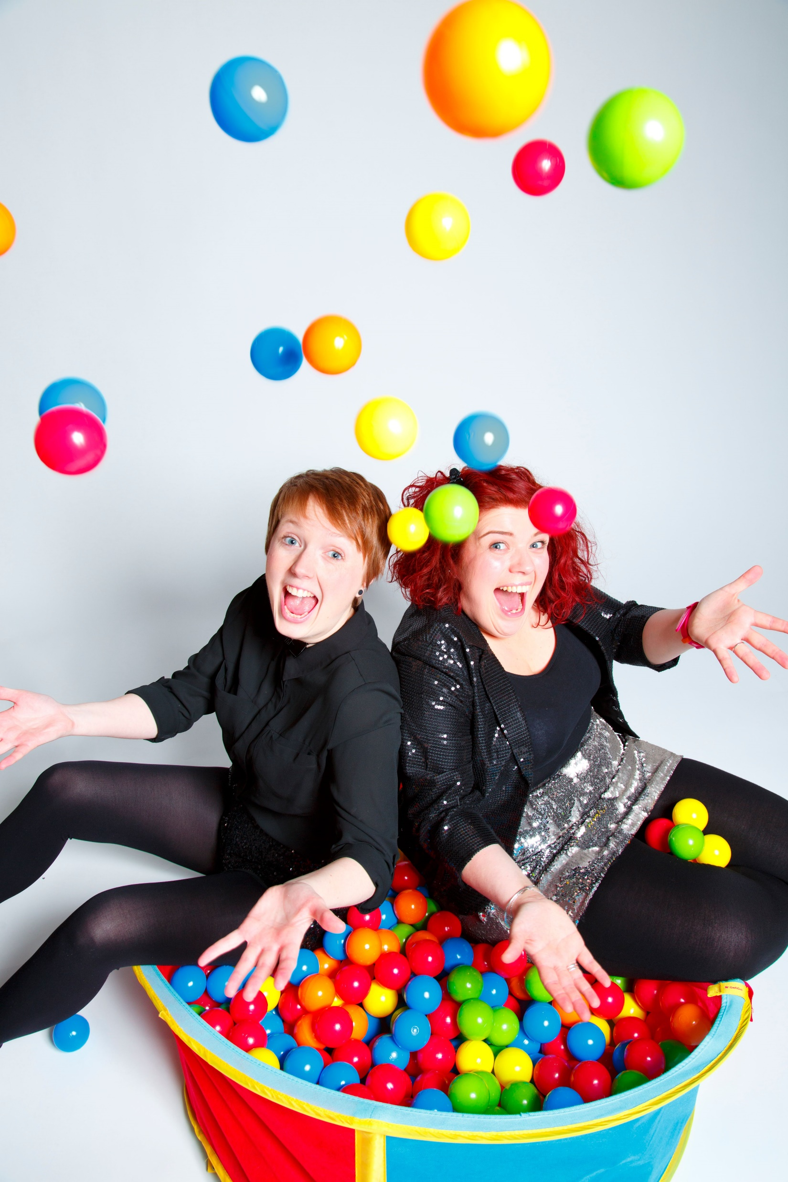
Art With Heart – STAN
Art With Heart are a Manchester company who made a big success with their last show, an autobiographical story about living with ADHD.
We love them as they have a real authenticity to their work, as well as humour, and artistic quality. So when they approached us for support to run a week’s R&D to develop a new show, STAN, about a friendship between a deaf girl and a hearing boy who was having problems at home (and Manchester Museum’s dinosaur, STAN), we wanted to support them.
“Z-arts and Big Imaginations have been incredibly supportive of our work from wellbeing events, theatre performances to creative participatory activities - they’ve supported us not only to make new work but helped us improve it for the audiences and young people we work with.”
STAN is going to be Z-arts main commission for 2021/ 2022.
Photo credit: Sam Ryley

Slide 6
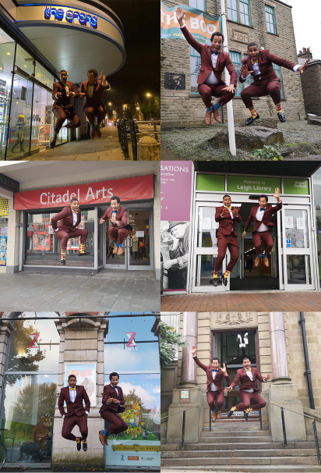
BonteHond
BonteHond makes bold, accessible theatre for young audiences
“In 2019, we performed iPet during Big Imaginations festival. Touring the North West and playing at the different venues was a great experience. We have a lot of fond memories of the different venues and lovely audiences we encountered on the tour. Working with Big Imaginations was a pleasure”

Slide 7
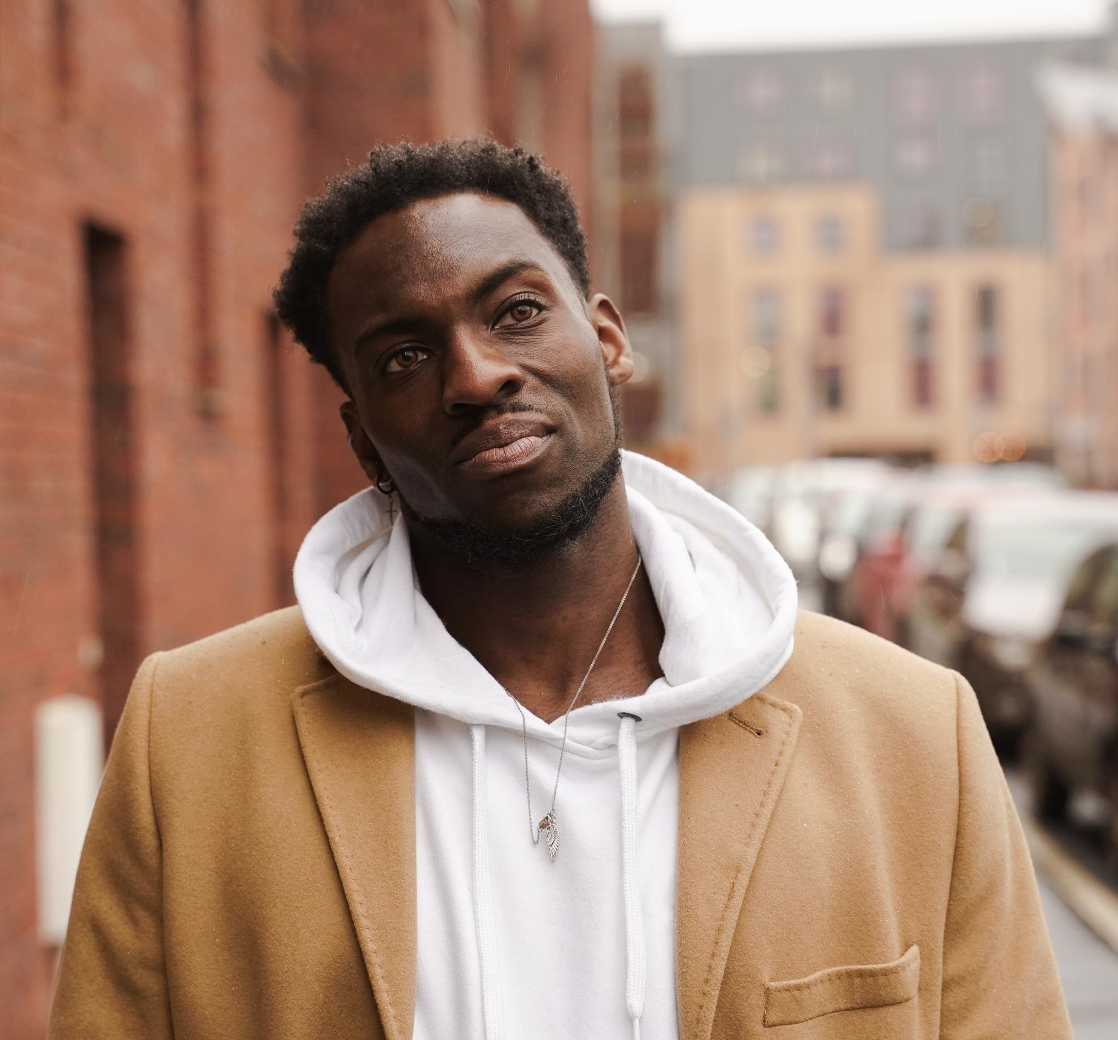
Chad Taylor
Manchester dance artist, who used to come to dance classes at Z-arts in his youth. Chad creates work that is exciting for a young audience, and we are excited to be supporting him.
Lost Online
Homemakers co commission with Z-arts, Home Mcr and STUN during COVID19 Summer 20.
When I Hear Music
Now supported via Spark Arts in Leicester. We came in as collaborator when he wanted to test some work with children in schools. His engagement with the children was very high.
Z-arts, STUN and Big Imaginations have co commissioned this work through this stage of development and Chad created a piece of digital filmed work for sharing with young people and programmers. We are excited about what the future holds for Chad and Z-arts working together.
“Working with Z-arts & Big Imaginations has been a great experience. The support has been great from creative support to supplying the project with staff and space.”

Slide 8
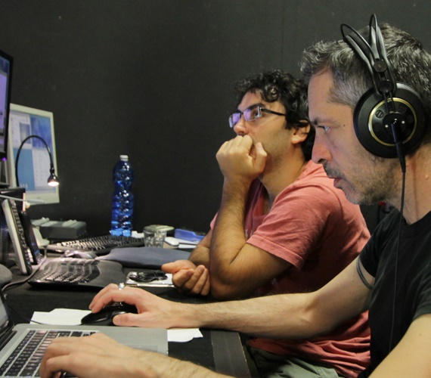
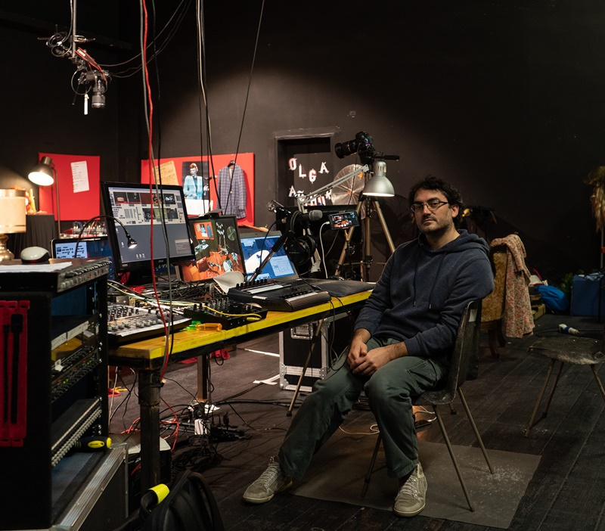
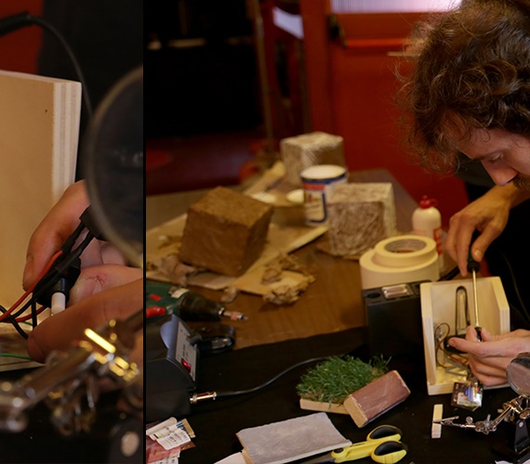
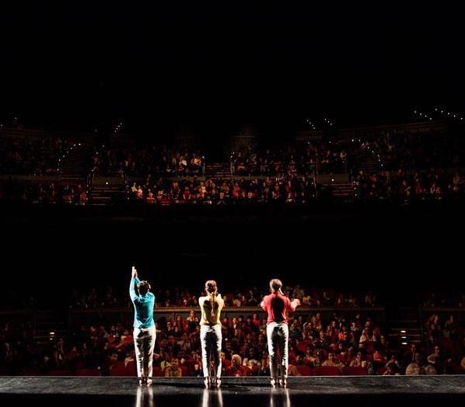
COMPAGNIA TPO
"It has been a pleasure to be part of Big Imagination festival, this gave us the possibility to let our performance for kids MINI have a tour in UK! A BIG kiss to all the staff and thanks to the festival which give a chance for kids’ IMAGINATION to be improved.”

Slide 9
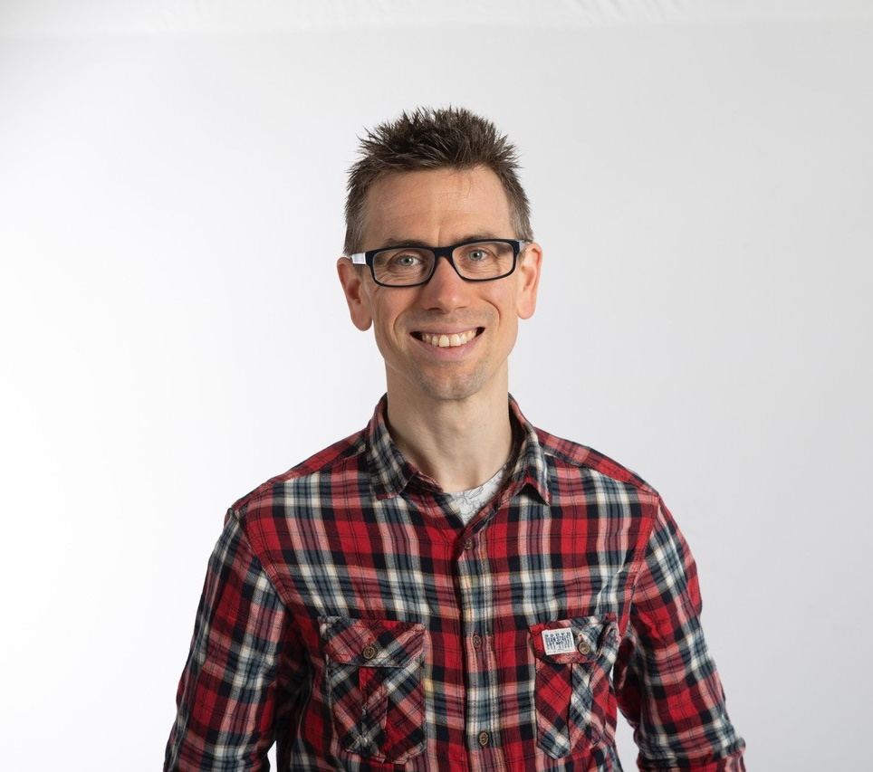
Daniel Bye
Dan is supported through our Big Imaginations Artists Imagination Fund. He is starting to develop a new piece called So Unfair.
“Z-arts and Big Imaginations are a dream organisation for an artist to work with. They’re incredibly generous, supportive and back you completely. I’m enormously proud of the ongoing work with them and incredibly excited about what it’ll turn into.”

Slide 10
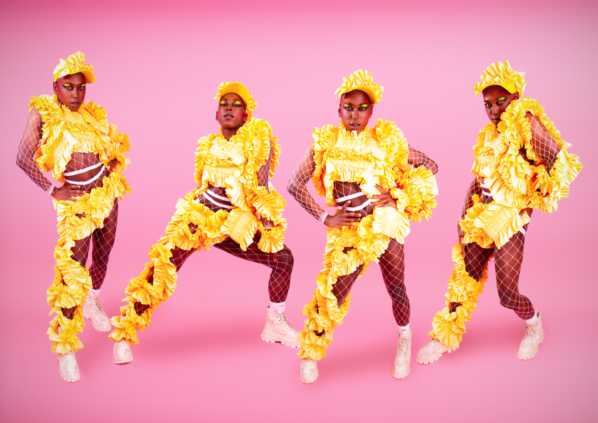
Darren Pritchard – Family Vogue Ball
Darren has been a Z-arts artist since 2000. Founder of UK’s Black Pride Vogue Ball’s, which are a success across the land, and director of rent Party which was made in STUN and went on to be Sheffield Crucible’s alternative Christmas Show.
We challenged Darren to think about taking the style of his work and turning it into a child/family-friendly show. After a couple of R&D periods, we have landed on the Family Vogue Ball, which will be a celebration of uniqueness including a history of vogue balls, aimed at children and their families, with lots of participation and mazing dancing and costumes – to be programmed as our 21st birthday party in 2021.
Photo credit: Fake Trash

Slide 11
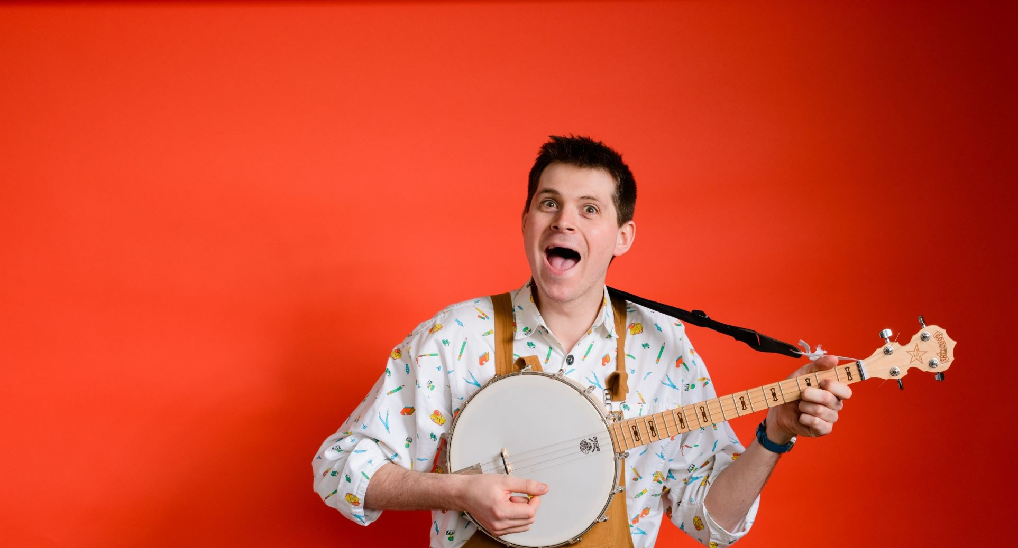
David Gibb
“Big Imaginations and Z-arts have supported my work from the very start. When I took my first tentative steps into the world of children's theatre, I knew very little about the process of producing and touring a theatre show. Being part of the Big Imaginations scheme gave me the opportunity to form relationships with a whole host of venues who would never have discovered my work otherwise. Many of these relationships are still ongoing almost six years later, and it is through these relationships that I have gained the confidence, experience and opportunity to develop my work and form my own theatre company (www.littleseedsmusic.co.uk), which now tours and develops shows for families across the UK."

Slide 12
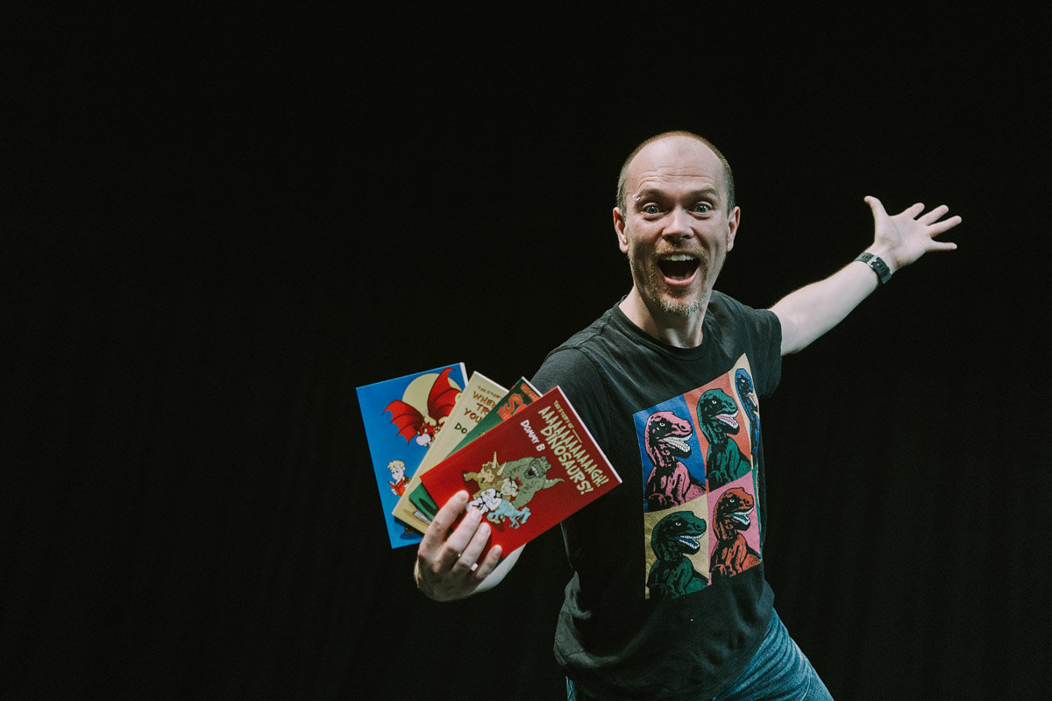
Dommy B
“Big Imaginations and Z-arts do a stunning job, bringing high quality art to young people, many of whom may not have experienced this kind of awesome work before. Well organised, accessible and with great attention to producing excellent, immersive experiences, it is a joyful responsibility and a real honour to be a part of the Big Imaginations family.”

Slide 13
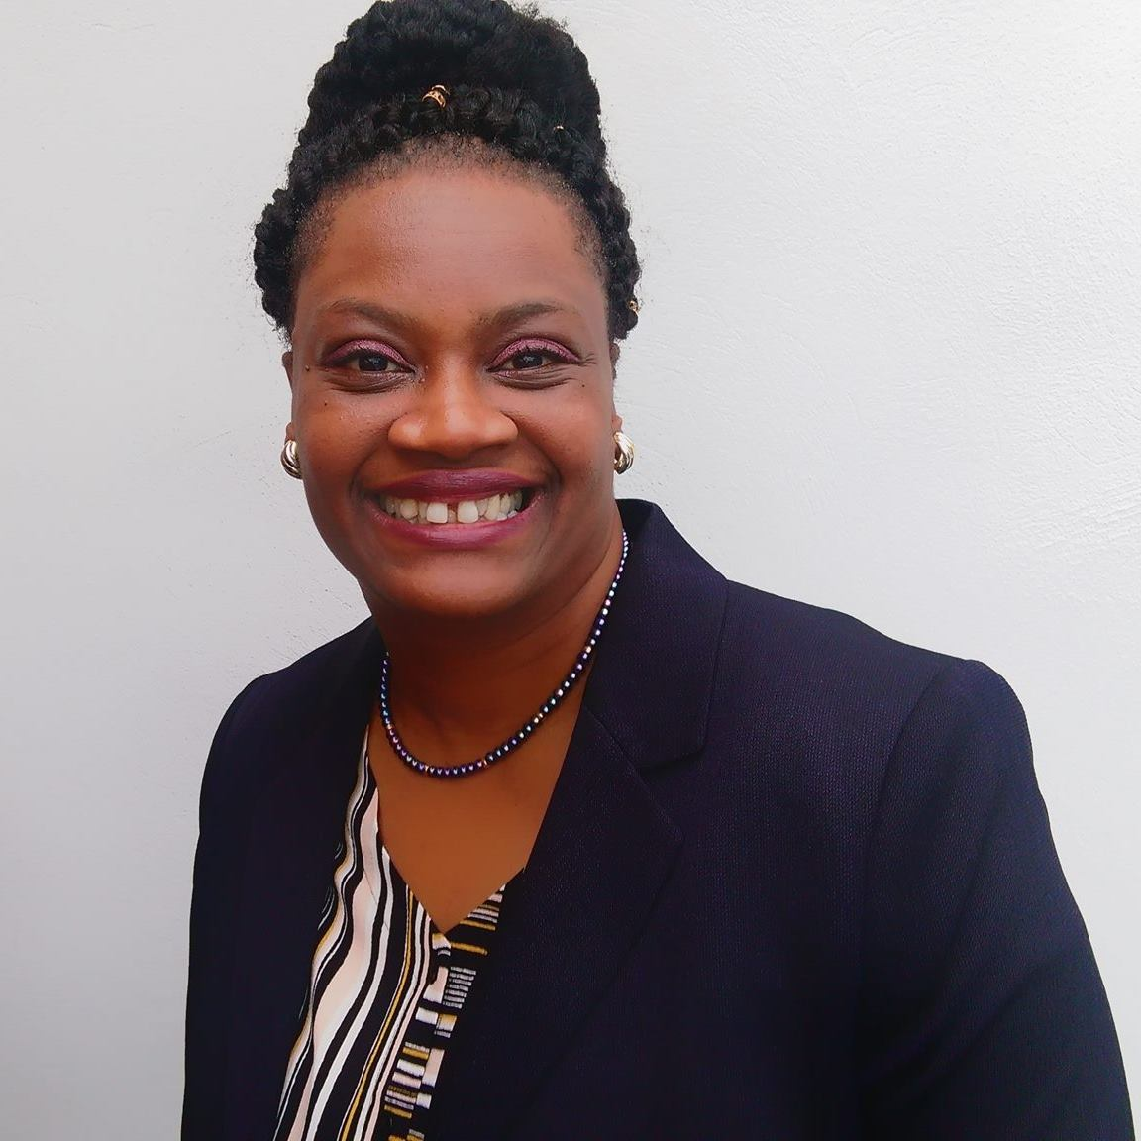
Elayne Ogbeta
“It has been a fascinating journey so far working with Z-arts from my initial meeting with Liz and Zoe during artist lab week in July 2017, up until the present date.
Having my play explored has been invaluable to me. Throughout this journey, I have learned a lot about the industry, the hard work that happens behind the scenes to make theatre for children. I have developed more confidence in my writing, I have gained valuable insight with working with theatre professionals and learned how to apply for a grant from the Arts Council.
We are still in the process of moving the play from page to stage. All the team has been amazing, supportive, and encouraging. And I am grateful for this opportunity that Z-arts and Half-Moon have given me.”

Slide 14
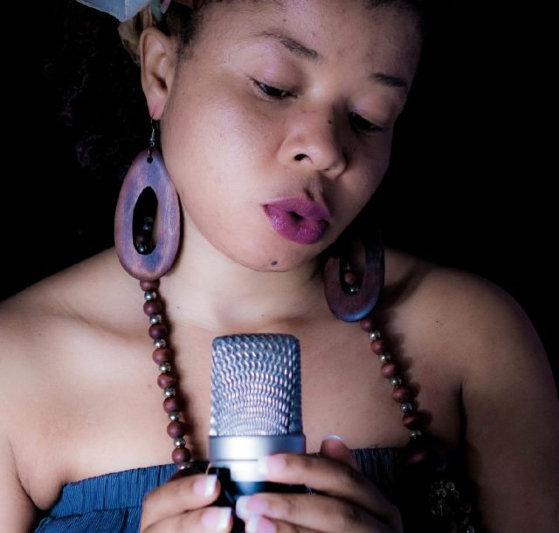
Emmanuela Yogolelo
We are supporting Emmanuela through GM Artist Hub as a Reboot Artist.
This includes mentoring and also supporting her professional development. Step one of this was organising a storytelling masterclass with Jan Blake.

Slide 15
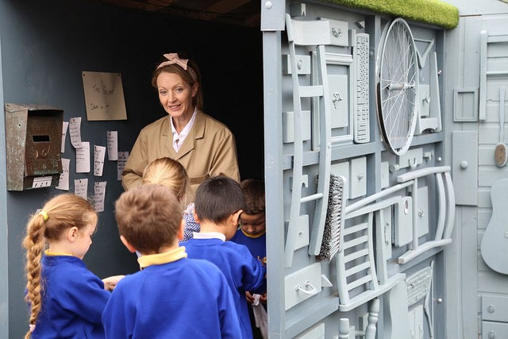
Filament Theatre
Filament are supported through our Big Imaginations Artist Imagination Fund.
“The R&D funding we received from Big Imaginations not only helped us to get a project we were passionate about off the ground it also made us feel trusted and respected as artists. Securing R&D funding can be tricky. As artists you know that keeping your creative process open to new ideas and stories will result in a more authentic and interesting project, yet often funders need to know about specific outcomes. Big Imaginations trusted us as artists to know how best to use the creative time their funding afforded us in order to serve our ideas and our participant’s ideas and needs.”

Slide 16
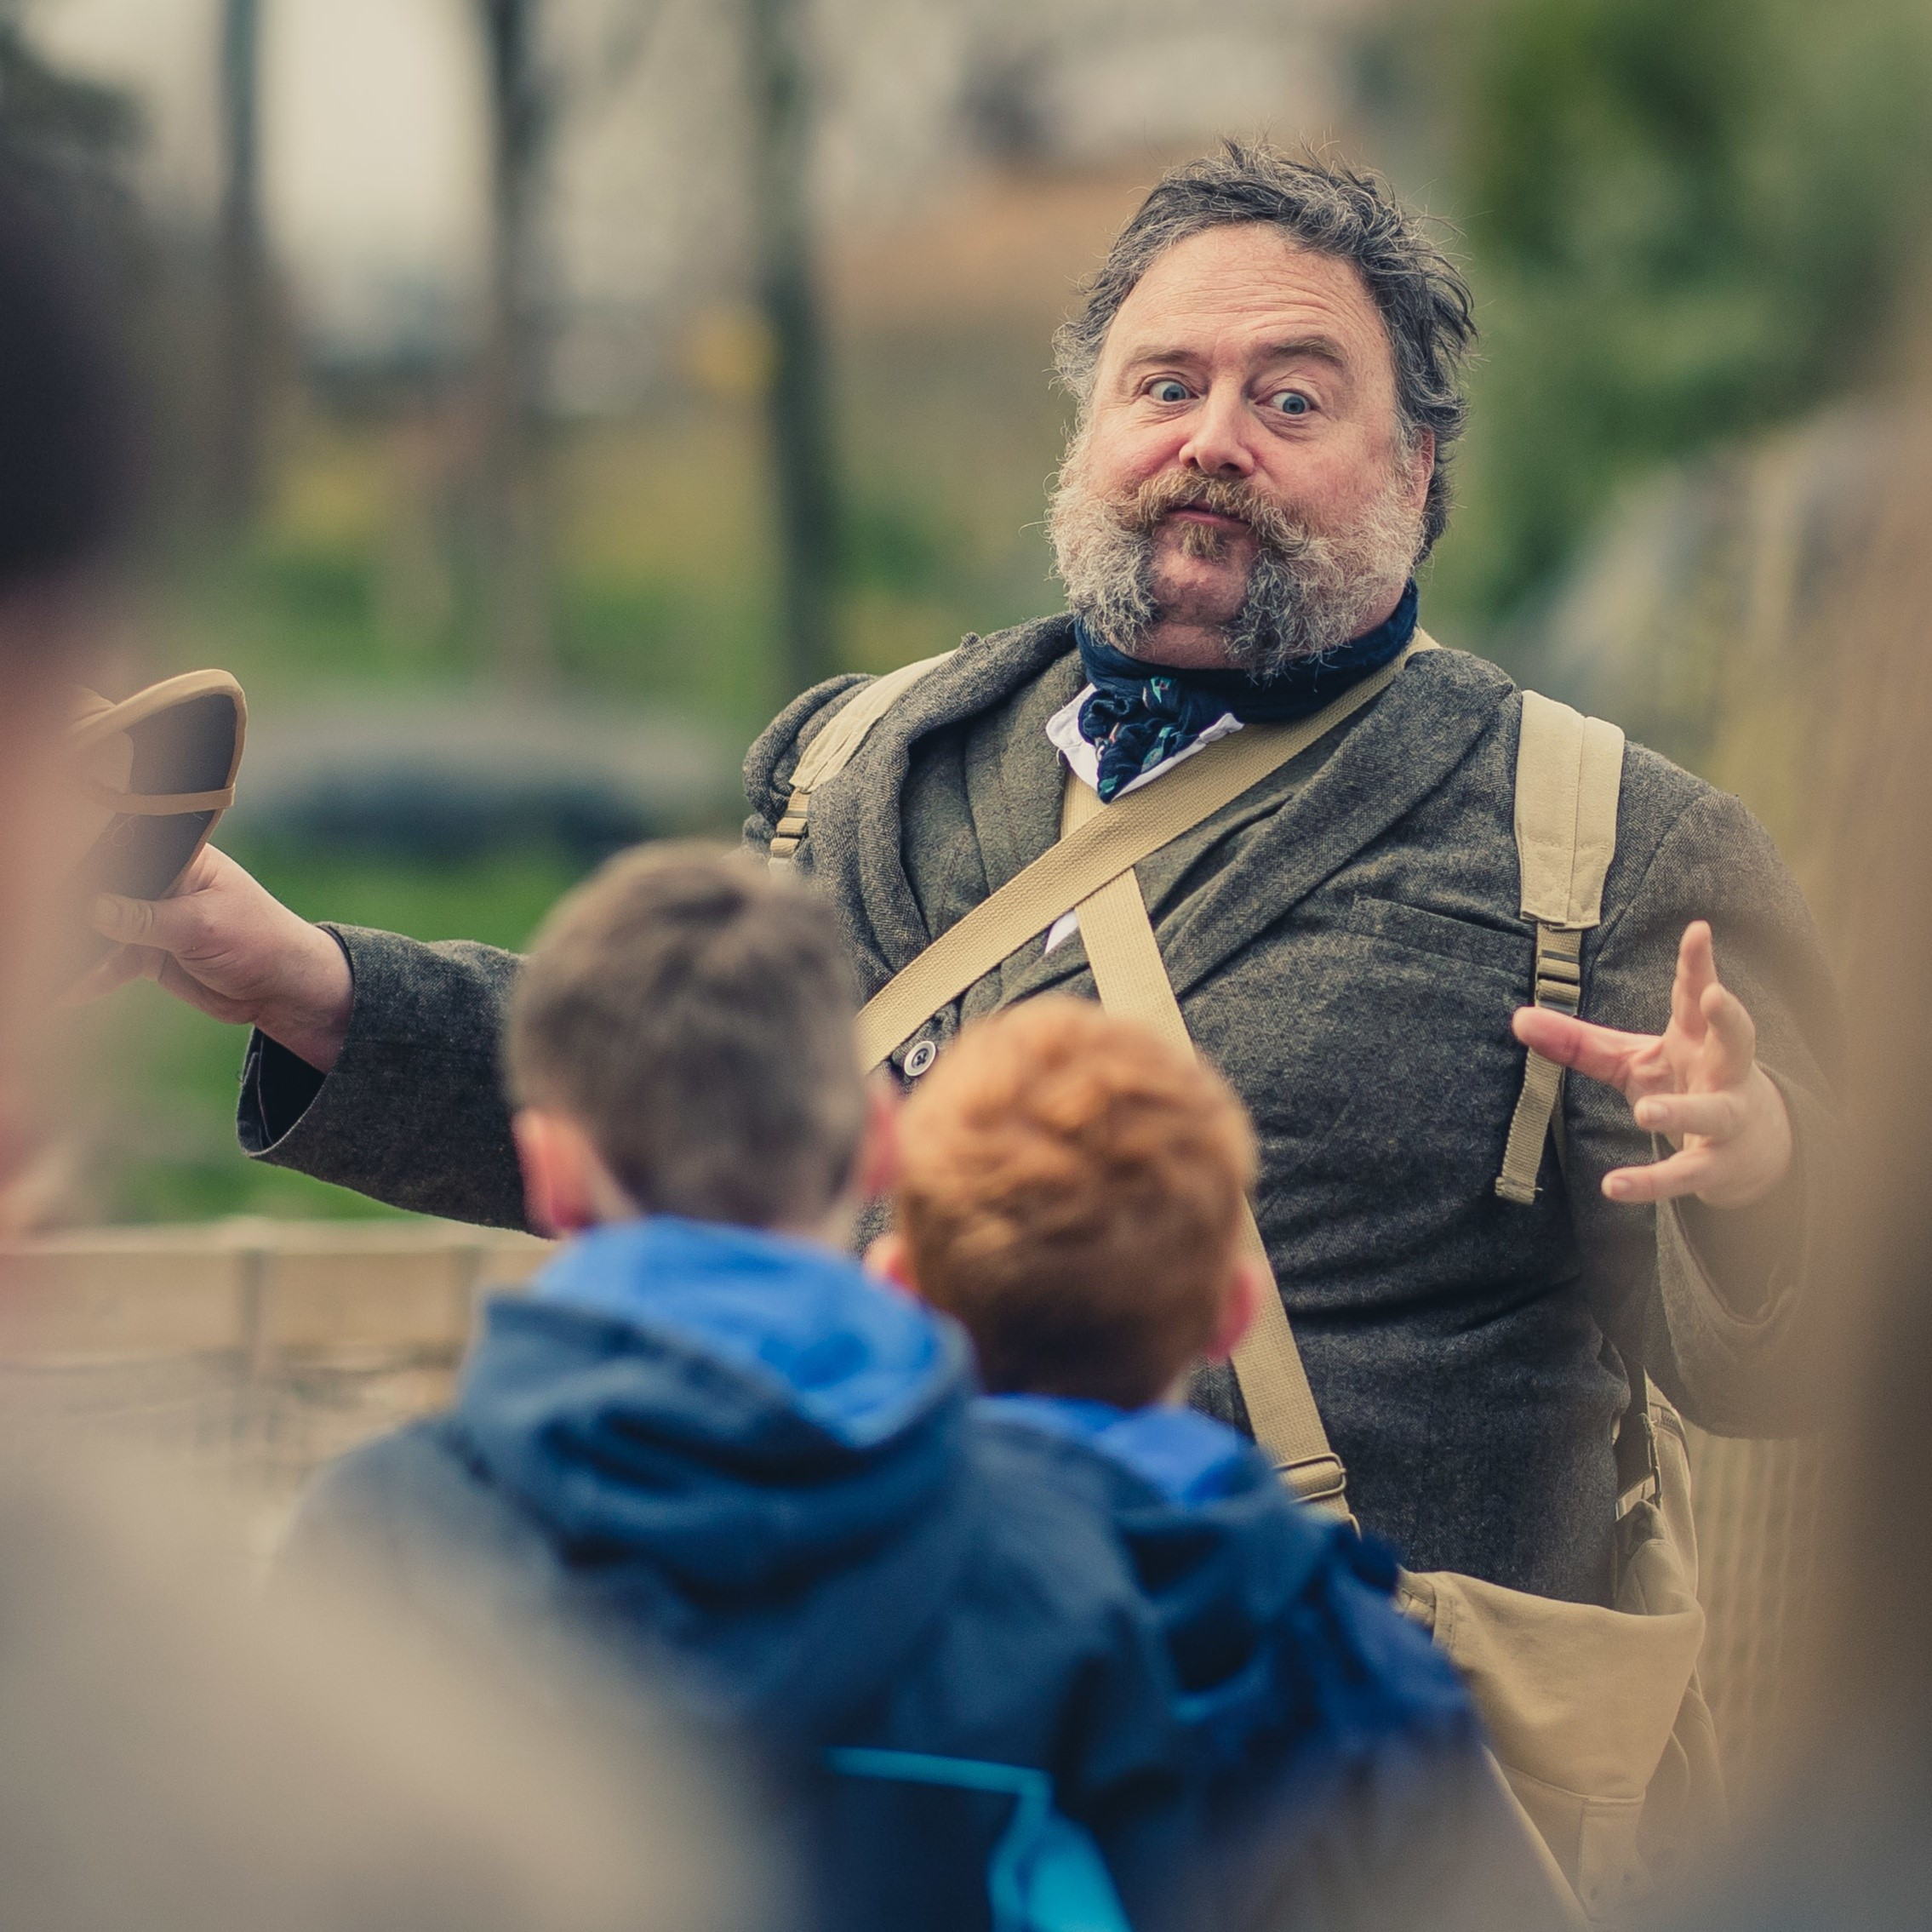
Gav Cross
“At a ripe old age, it was a dream come true to be invited to tour with the Big Imaginations festival with my own show, “Traditional Tales with a Twist”. Having mostly worked in schools and one-off festival performances.
From theatres to libraries, schools and next door to brilliant community cafes, what a pleasure it was to tour our wonderful and varied spaces across the North West and laugh along with the giggling faces of families and friends. It has given me a taste to tell more stories to more people in all the creative corners available! Thank you Big Imaginations! You are an inspiration."

Slide 17
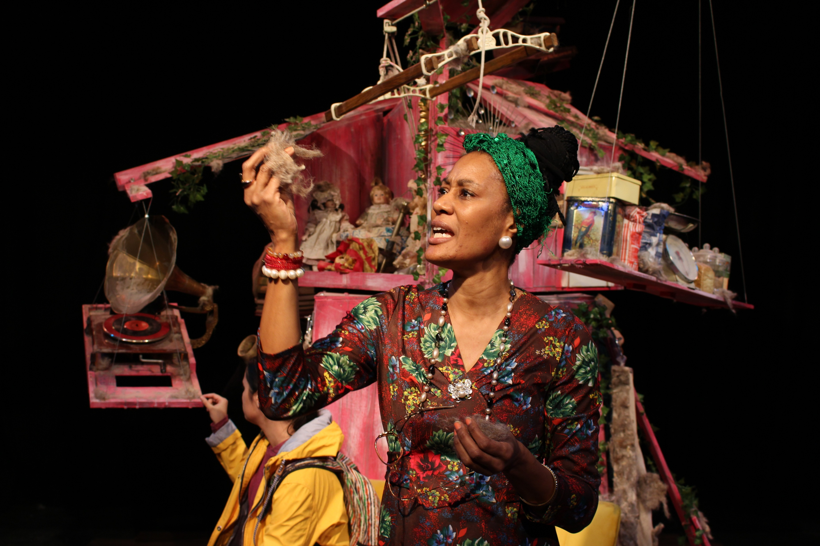
HALF MOON THEARE - DUST
Dust was a joyous reminder about just how playful the world can be, by award-winning children’s author Laura Dockrill, with music by Hugo White of The Maccabees. It was our first co-commission with Half Moon Theatre.
The day before Dust was due to open in March 2020, the country went into lockdown because of COVID-19 and the entire UK tour was cancelled.
Half Moon was awarded a grant by The National Lottery Community Fund, distributed by City Bridge Trust through the London Community Response Fund, to create a new film of the production for families to watch at home. This was presented as part of the Big Imaginations Digital Festival in February 2021.
“A captivating, imaginative production that uses tiny particles to make big things possible... An utterly enjoyable production.”
★★★★ Everything Theatre

Slide 18
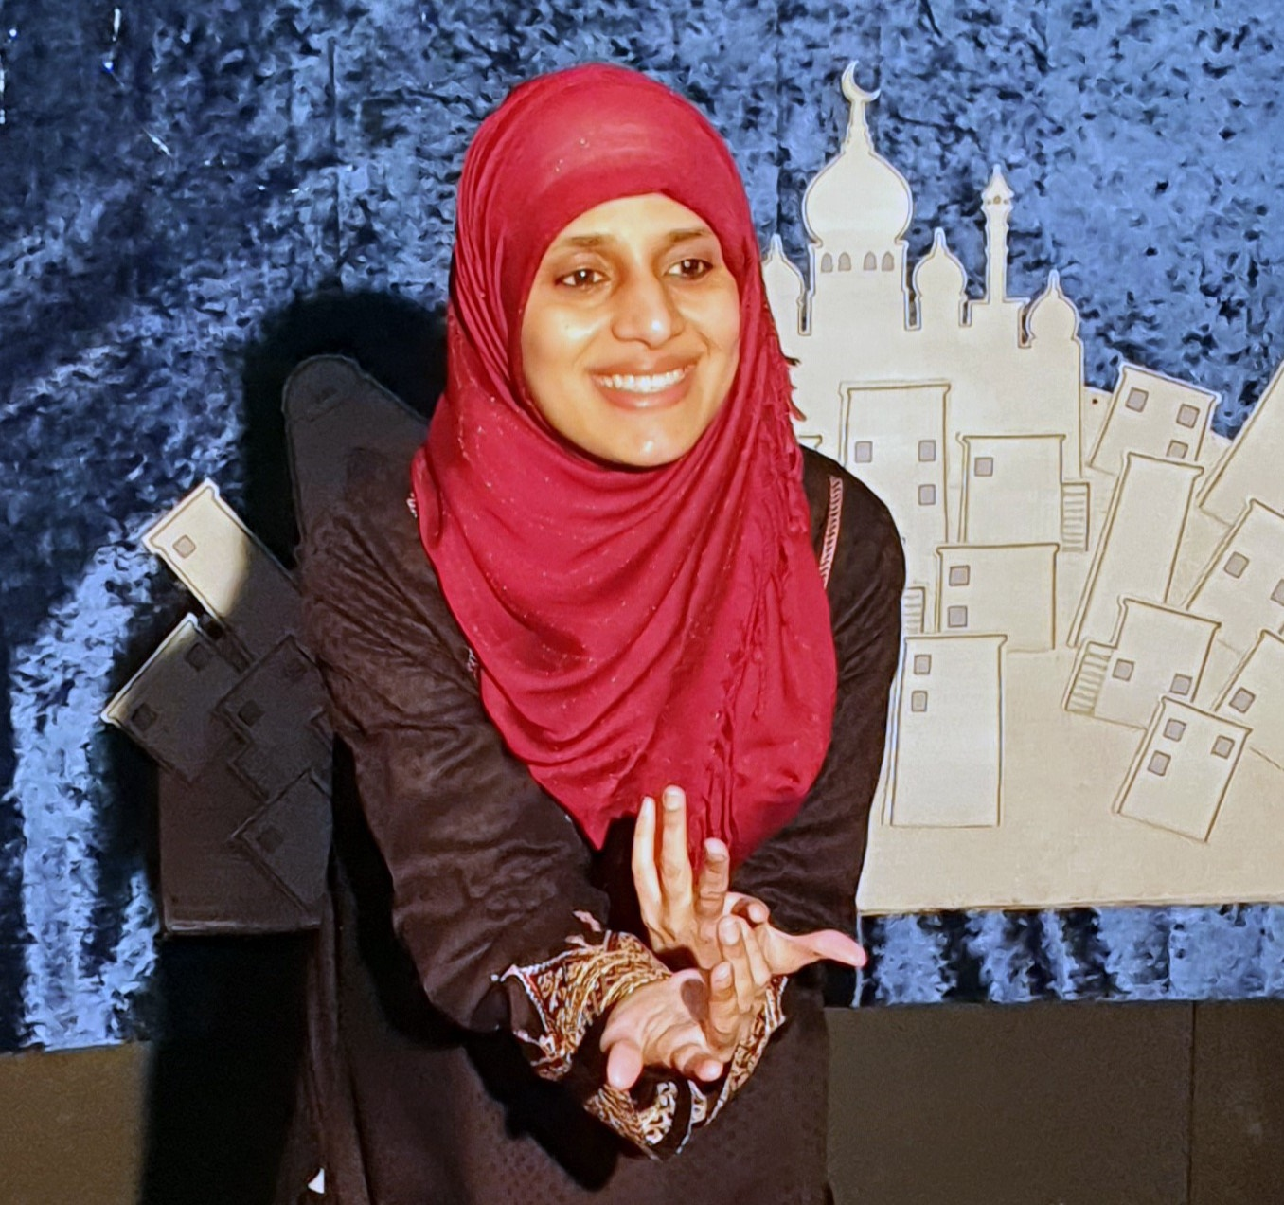
“Big Imaginations has helped me to continue my journey as it would have been difficult in current circumstances to get funds for my production. The continuity of support that I received from Big Imaginations has allowed me to carry on the vital work of sharing muslim stories to the audiences which is a far reaching and influential work to be carried forward. Thank you for this amazing opportunity, it has open up a pathway for me to share and connect with so many people.”
Hina Quereshi
An emerging artist who wants to develop an interactive storytelling piece. Big Imaginations and The Boo are supporting her to take those next steps.

Slide 19
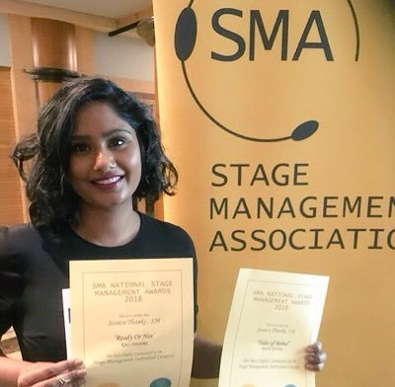
Jessica Thanki
Jessica is a brilliant stage manager who has taken a step change in her career and is wanting to make theatre as a director. Z-arts and The Lowry are co commissioning her with her project that has completed a short phase of R&D.
“I’m so excited to be supported by The Lowry and Z-arts to create my first project which I started during the pandemic. The project looks at the themes of 'What is scary?' and how being scared and scaring can be fun. The project includes hearing and deaf actors as I want to explore the skill we have as humans to find other means of communicating when language is a barrier. Language has been a barrier to my parents as English is not their first language but also to me as a working class minority. By exploring non verbal story telling techniques, I hope to create a more accessible and inclusive project.”

Slide 20
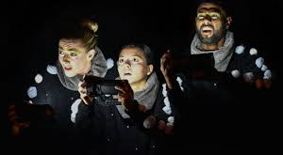
Knotted Project and Hawk Dance
We have supported this collaboration between these two exciting companies for the two previous shows: Chit Chat Chalk Show and Outside The Igloo and now with their newest R&D 'Reflections of ME'

Slide 21
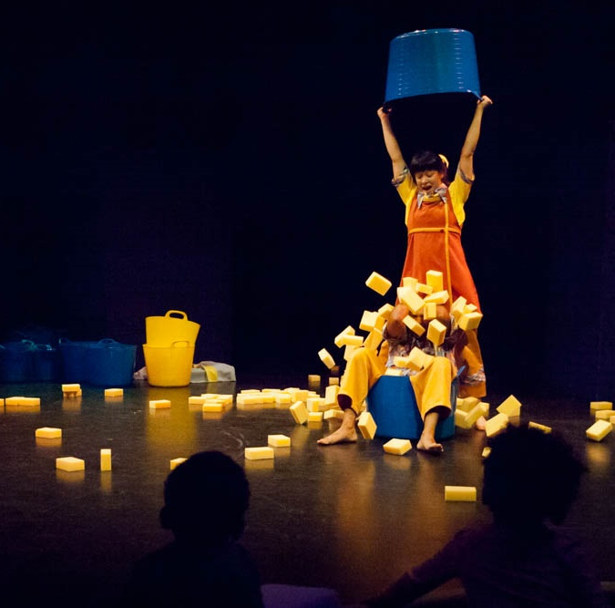
Liz Clark - SPONGE
“Working with the Big Imagination consortium has meant that our work for very young children and their families has been commissioned, supported and toured nationally and internationally. We have reached more families with our blend of performance and play than ever before. We are so grateful for all that we achieved during this collaboration with the consortium, to the advice and support we received to their commitment to showing and sharing our work through their partnership working. As a group they are truly committed to supporting and touring high quality, affordable children’s theatre and this makes them a joy to work with. Their work is fundamental to the touring infrastructure for children’s theatre in the UK. ”

Slide 22
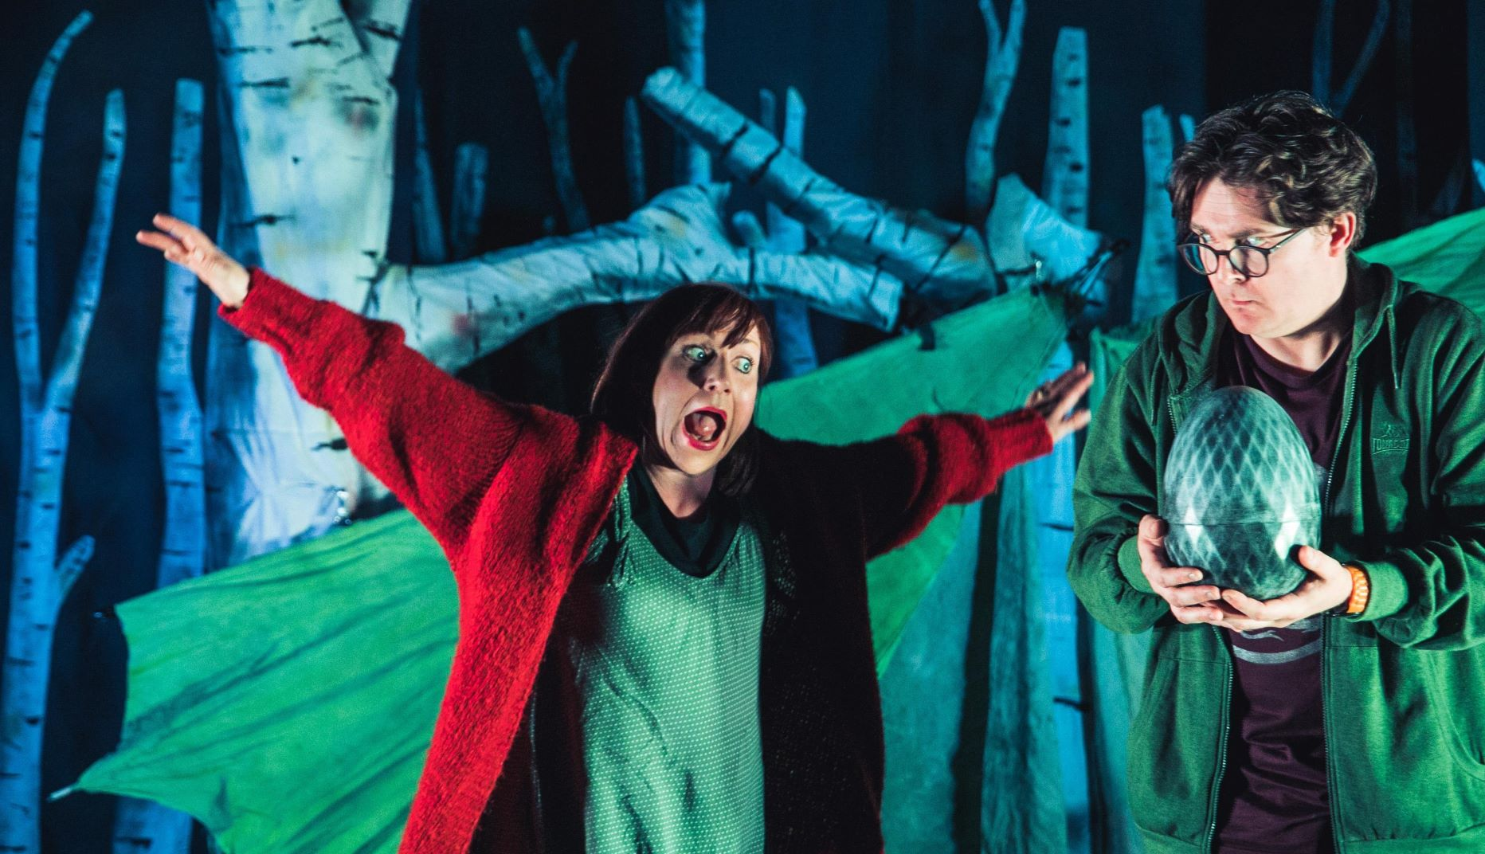
Lucy Fiori
“I was privileged enough to tour for the first ever Big Imaginations festival with a show called Spooky Tales. At the launch there was an amazing buzz and the team even provided cupcakes with images of the shows on offer! I was super impressed and since then Big Imaginations hasn't disappointed and have gone from strength to strength! The work they host is innovative but its the support and passion for children's work and the support they give artists which stands out. I'm currently about to feature on The Big Imaginations menu with a show called When Another Dragon Roars which is a collaboration between myself Petite Ullaloom and Altered scale puppetry theatre and the support from zoe and the Big Imaginations team through Covid-19 has been so invaluable. Big up Big Imaginations!”

Slide 23
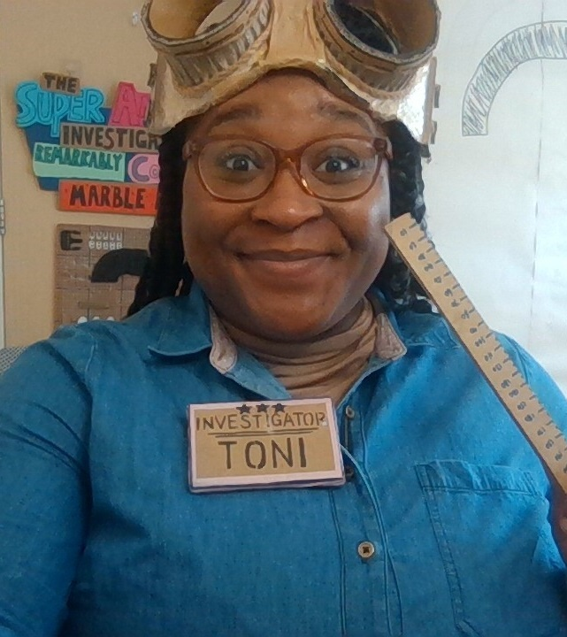
One Tenth Human – Curious Investigators
The project that was selected for the Big Imaginations 2020/2021 commission was 'Curious Investigators' by Sarah Punshon, One Tenth Human.
We continued to support the artist and the work during COVID and the outcomes have been incredible, the digital show that was created as a first stage of the project has been a joy and enjoyed by audiences digitally all over the North.
It was presented as part of the Big Imaginations Digital Festival in February 2020.
Photo shows Toni-Dee Paul, design by Samuel Wilde

Slide 24
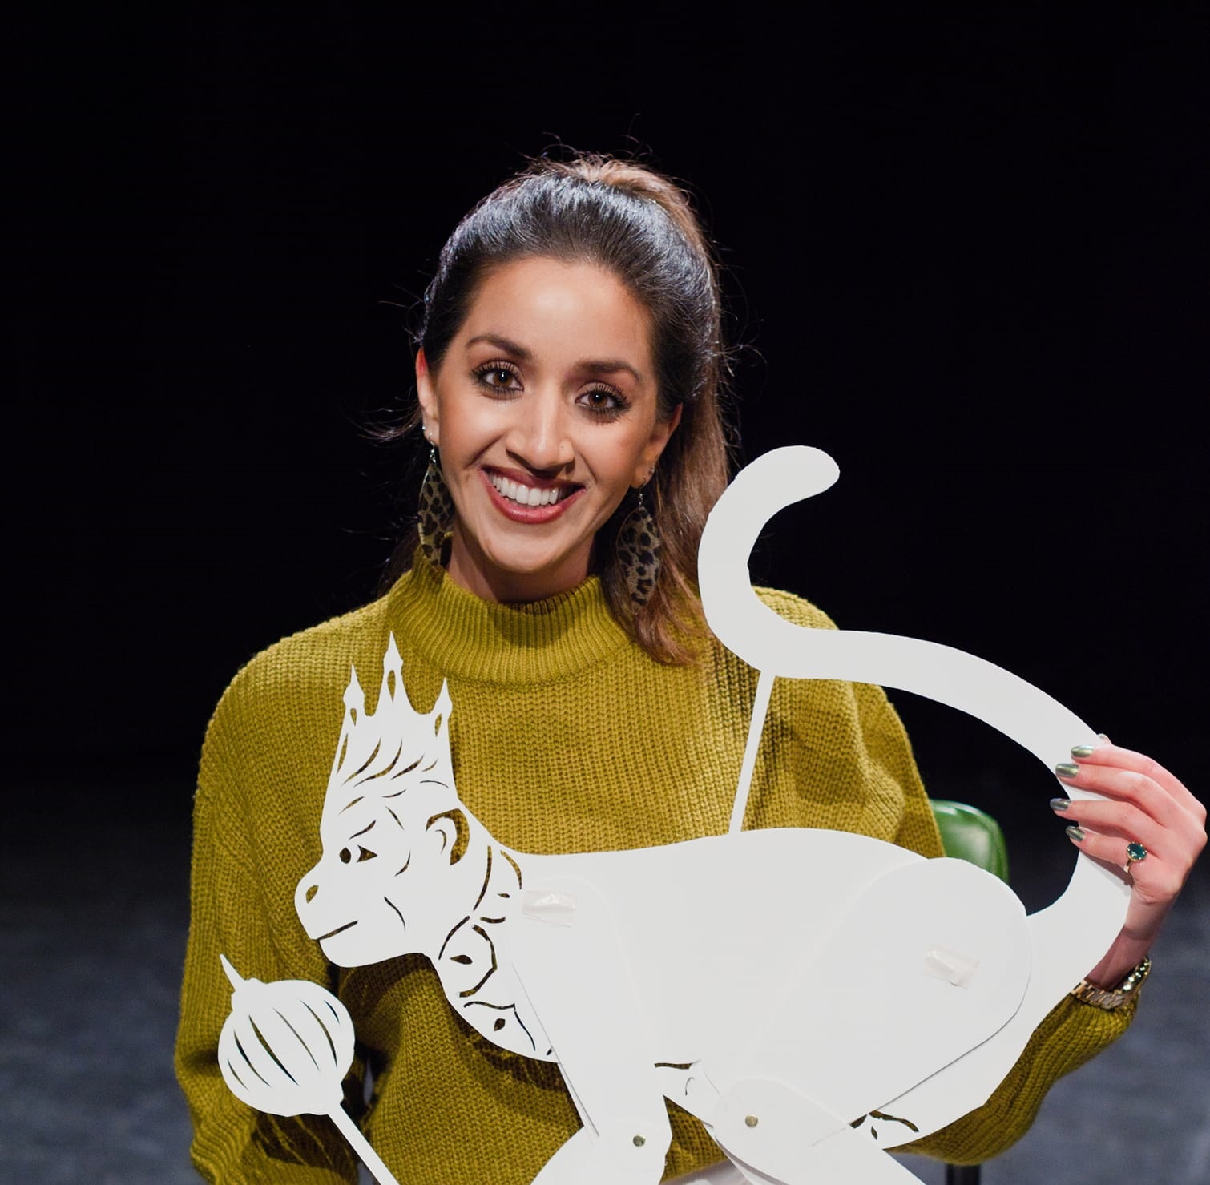
Ria Meera Munshi – Sita and Sue
Ria is an artist that we have been looking at how we work together for a few years now and this delightful project is just the one. Ria is developing her skills as a writer and director, Z-arts has supported with mentoring, support with putting together a creative team and feedback at all stages.
"The support from Z-Arts which I have received as an artist, as well as my company Ri Ri's Dance Academy, has been invaluable as it allows us to create work for children ready for audiences that we will want to bring back into those safe spaces, once lockdown is over."

Slide 25
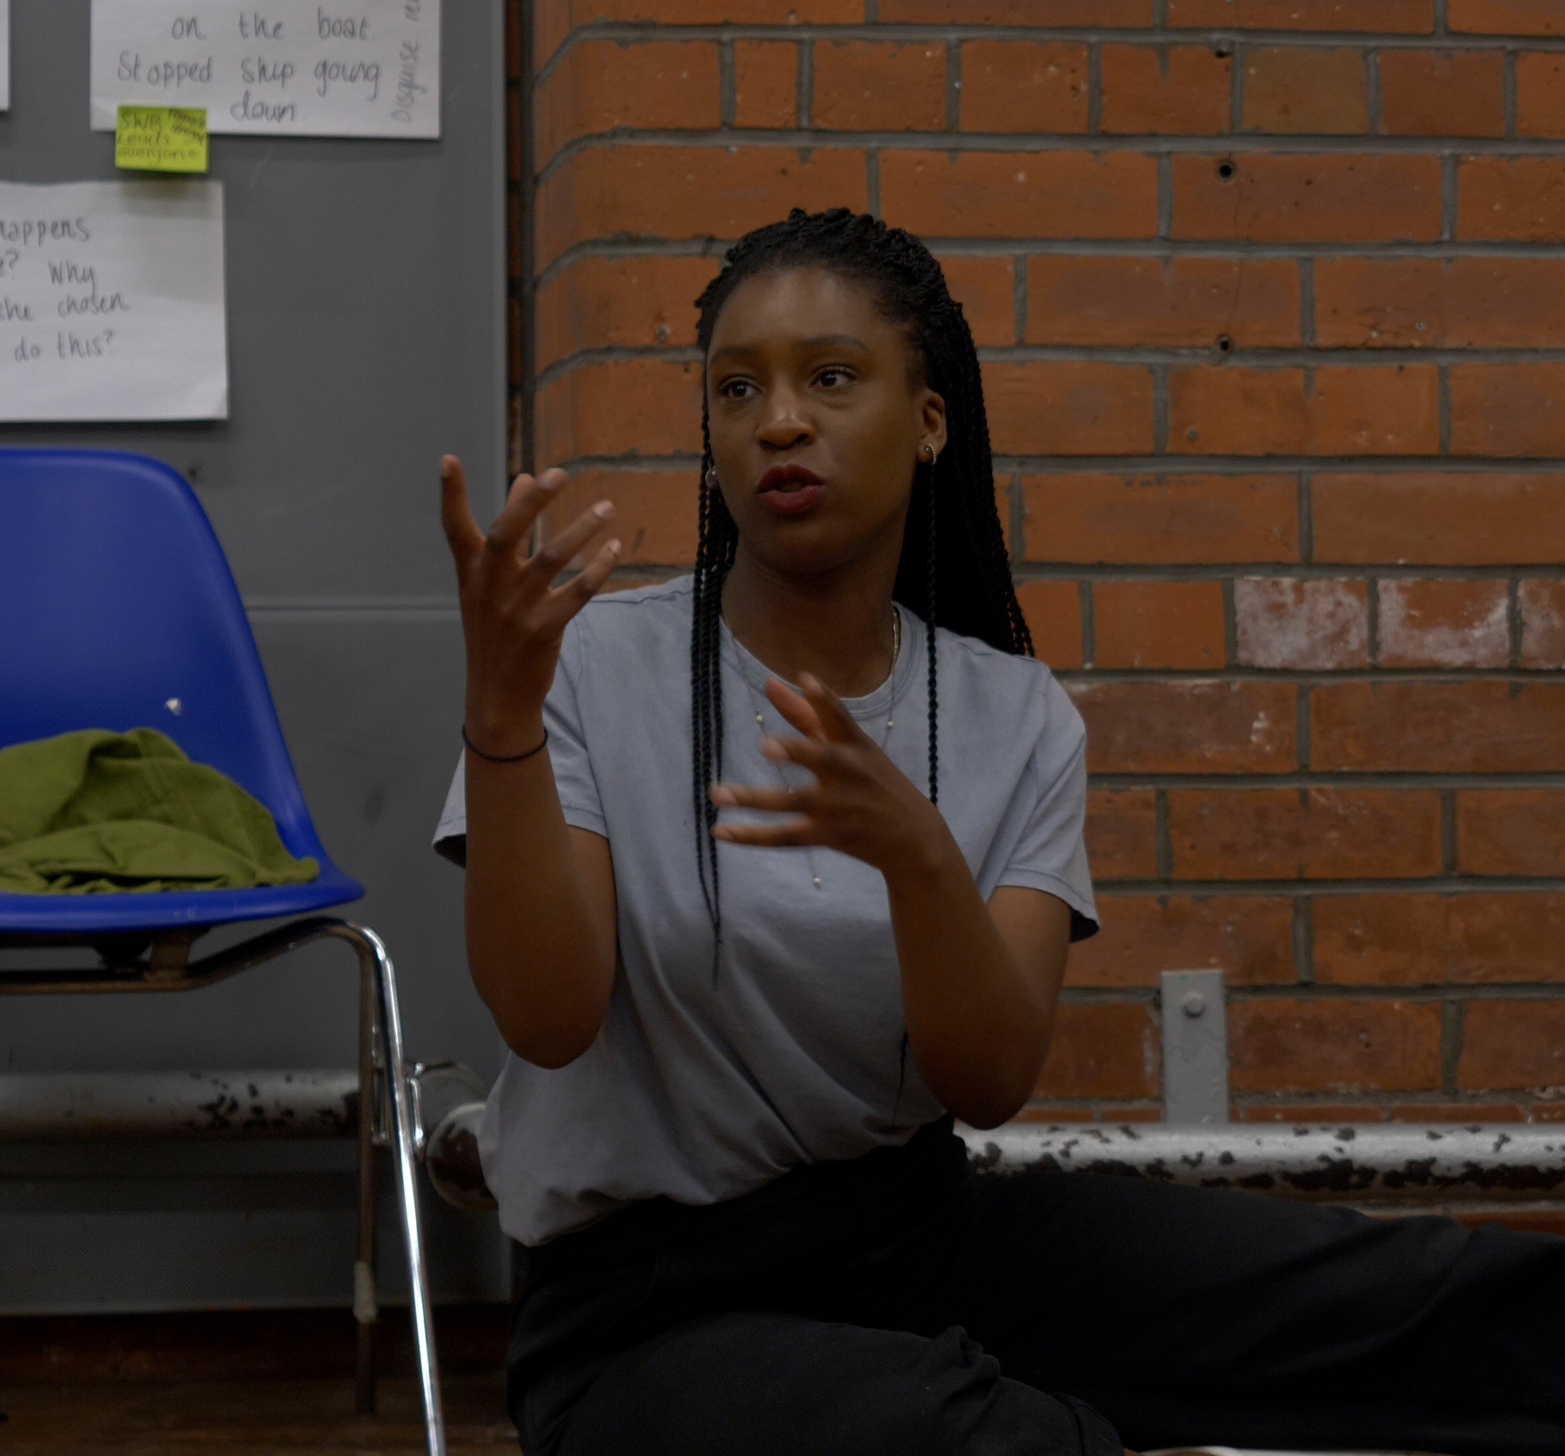
Ros Norford – Aleiah's Adventure
Ros is an artist that we supported in different ways for some time now, through both participation and now programming and artis development.
We supported through all of lockdown with some commissioning money and mentoring support. We supported alongside STUN the first R&D phase for Aleiah's Adventure.
Ros has now been successful with ACE funding and we are supporting her with the creative team and shaping of the project.
“Working with Z-arts and Big Imaginations has been a huge help for me in becoming the artist I want to be. Their support has enabled me to learn so much as they've challenged me to take my work to the next level by connecting me to some brilliant opportunities.”

Slide 26
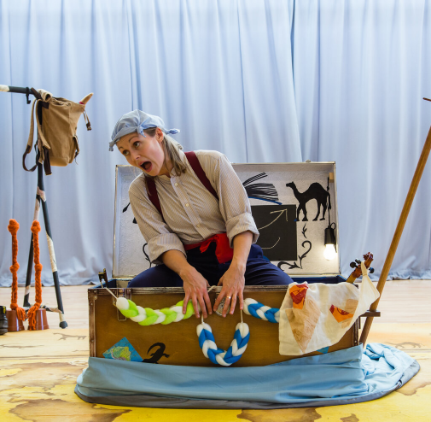
Sophia Hatfield
Sophia is an artist that is making high quality work for non-traditional spaces and she is making great relationships with lots of the Big Imaginations organisations.
Sophia's newest project 'Fables At The Kitchen Table' is being supported by Big Imaginations and Z-arts are supporting with advice and mentoring.

Slide 27
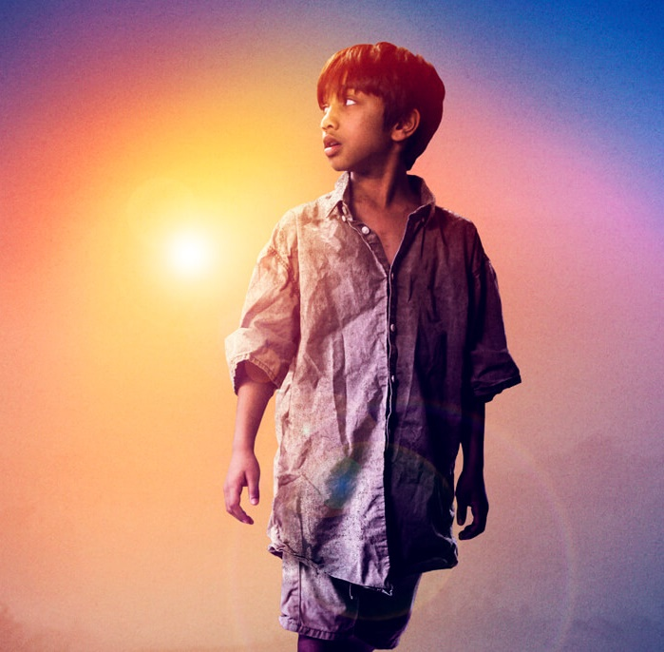
Sudha Bhuchar – Artichoke Hearts
“Z-arts was a key partner for Bhuchar Boulevard's revival of my play Child of the Divide, which marked the 70th anniversary of the partition of India and launched the company. I felt anchored and supported by their collaborative approach which permeated all aspects of the project and enabled the show to be at the heart of the Big Imaginations festival that year and tour to all the consortium venues. From investing money and resources, Liz O'Neill and her team were passionate about the play and found so many other ways to elevate the work- through engaging schools in their own response pieces, commissioning the education resource pack to their warm hospitality for the company. Z-arts has continued to support me as an artist and care about my future journey through seed support for my next family project, Sita Brahmachari's award winning debut novel Artichoke Hearts. For a freelance artist like me, that gives much needed hope at this difficult time.”

Slide 28
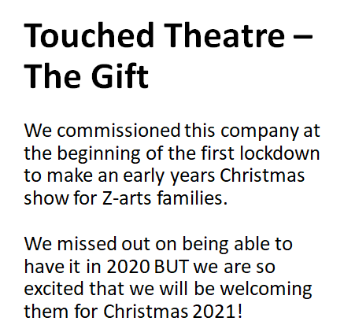
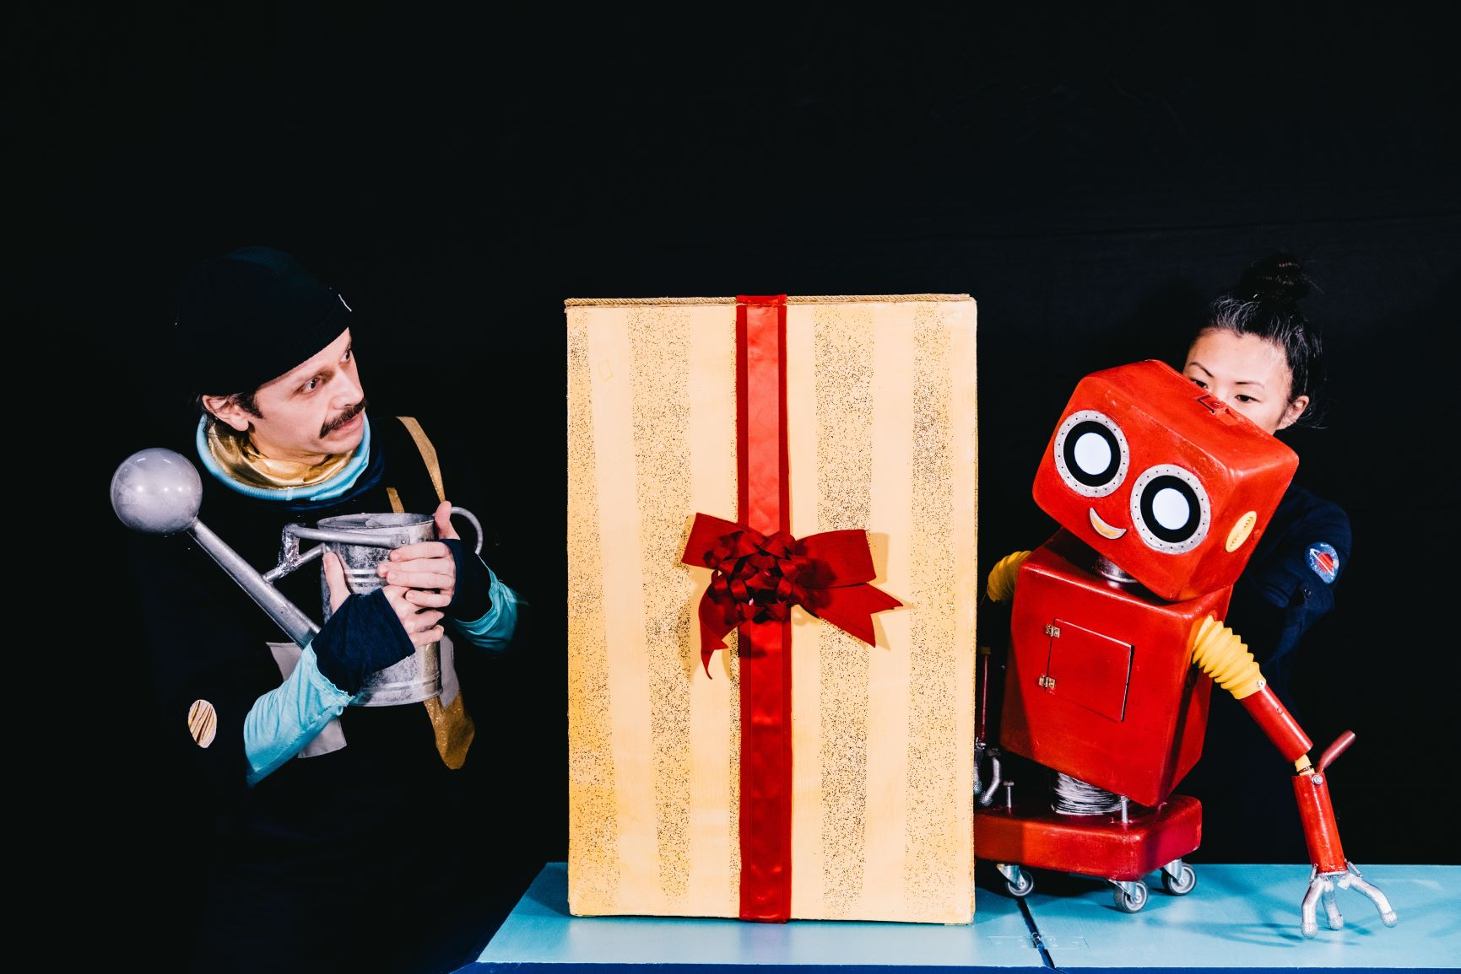
Photo credit: Rosie Powell

Slide 29
Artists & Creative Educators
Supported Through Our
Creative Development Department

Slide 30
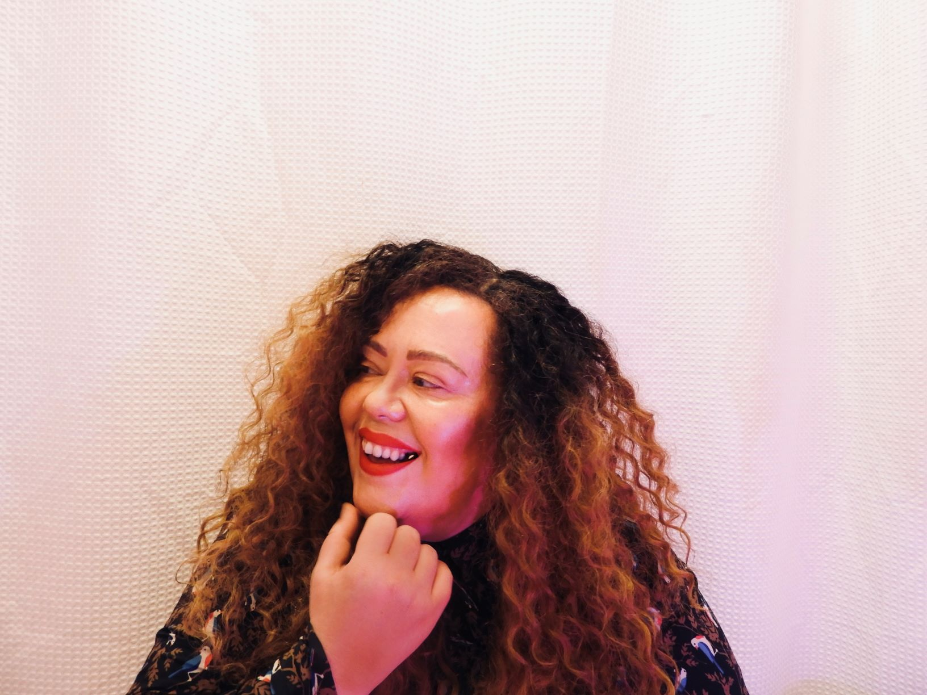
Charlotte Barber (SHAR)
Charlotte has over ten years of experience as a Singer and Songwriter. She is a music producer and writes and produces music for theatre and film. She is a freelance Music Facilitator in Singing, Songwriting and Music Production and is passionate about making music technology & songwriting accessible to all. She regularly delivers sessions with many organisations around the northwest and further afield.
"Z –arts are and have been a wonderful organisation to work with, They have helped me grow as an artist and facilitator throughout my career and are continually supportive in so many ways"
Find out more: www.sharofficial.co.uk"

Slide 31
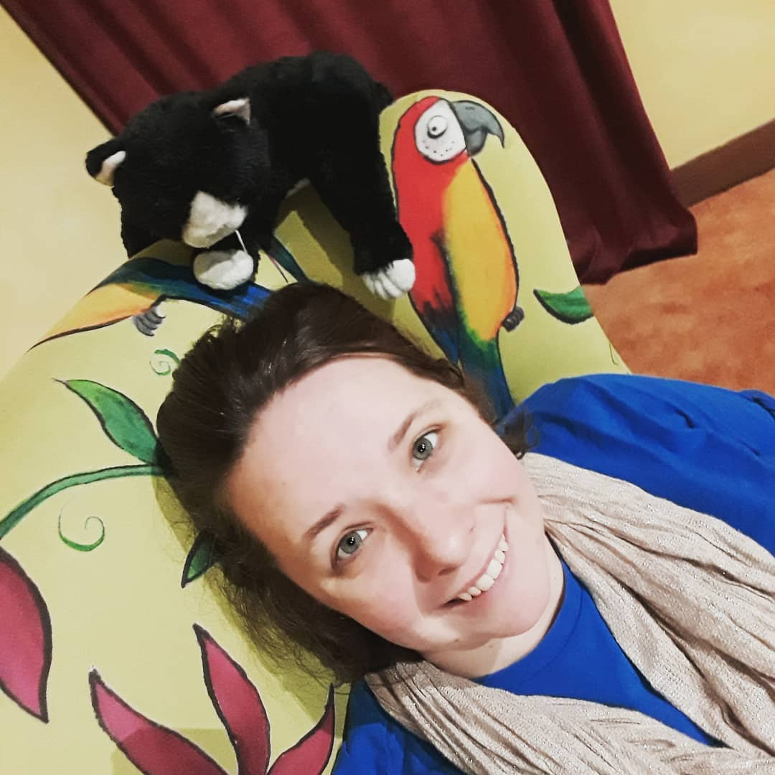
Felicity Goodman
Flick has being telling tales with Z-arts for 5 years. She has told tales in the Exhibitions, with families at libraries and helped school children tell their tales in workshops. She is also an Associate Artist at Manchester Art Gallery and runs Stitch with Tom Barry. Flick believes stories can change the world and that sharing them can bring us all together.
“Z-arts have provided space for me to grow my practice as a Storyteller and a Community Artist. Through one to one mentoring, participating in workshops and feedback sessions, they have given a platform for me to develop skills in working with families and schools. Z-arts are always considering how to offer children and young people with the best experiences to flex their creativity. As an artist, it is exciting to be part of an organisation that is always listening to the community they work with.”

Slide 32
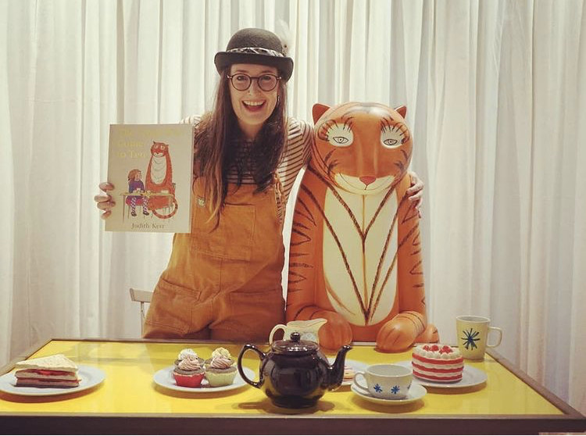
Angela Heenan
Angela has been working with Z-arts for the past 4 years. You can usually find her dressed up as weird & wonderful characters from books such as The Gruffalo and Room on the Broom!
Angela also loves bringing books to life as a Story Explorer at Z-arts.
“I feel Z-arts has always supported me as an artist and I feel part of a family. They are always open to my creative ideas and sometimes wild imagination in where we can take a book and turn it into a performance. Z-arts has helped my creativity and confidence as a performer and given me the chance to go bold with my ideas. I love working for Z-arts and appreciate all the opportunities they have given me over the years”

Slide 33
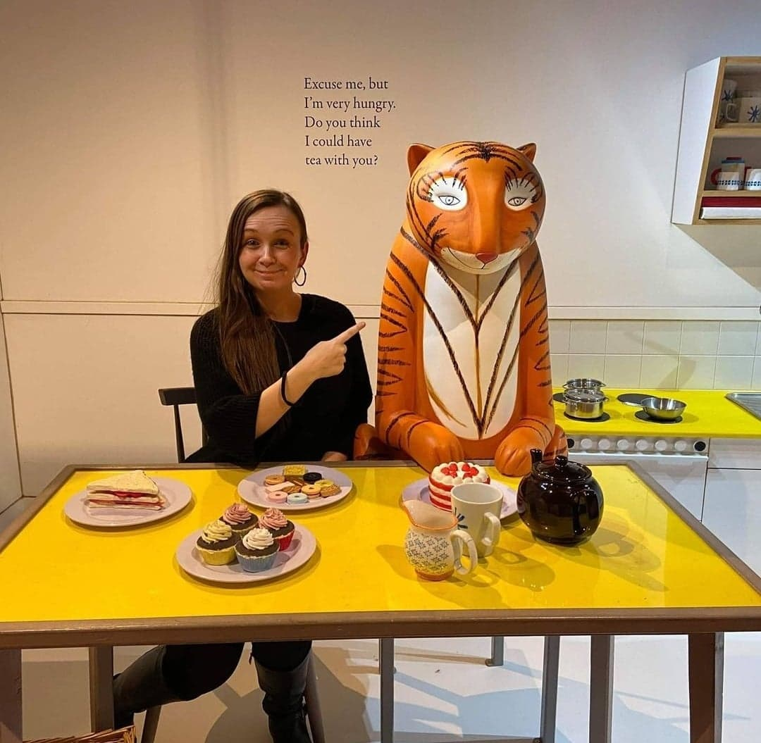
Tabitha Bowman
Tabitha has worked as a freelance artist with Z-arts for just under two years. She started out assisting in the arts and crafts area attached to the Gruffalo exhibition and helping out at events in the Arndale. Tabitha worked previously with young people and adults with additional needs so she started supporting a participant so they could better access creative sessions. Now, she is leading ZYP and Drama Stars sessions alongside working as a Story Explorer.
“Z-arts is a fantastic place to work. The Creative Team has given me several opportunities to develop professionally and work on lots of fun and experimental projects.”

