Slide 1


Artist Support Through R&D

Slide 2
Z-arts Artist Development
Z-arts supports artists who are interested in making theatre for young audiences (0-13) or as creative facilitators.
Our artists development work has expanded dramatically since becoming an NPO, and in the coming weeks we are creating a new structure which makes the offer more transparent to artists who want to work with us.
We can offer rehearsal space, but prefer to have some input as artistic advisors, especially from children.
We have two small strands of R&D budget – one for Z-arts, and another for Big Imaginations, which is allocated annually by committee (this year’s soon to be announced).
We also co-commission work, much of it already committed for this NPO period, but we are still seeking disabled artists who want to make work for young audiences.
The BI commission for 2020 will be launched, offered to artists in the NW, who are known to at least one network member, and it will be to make a piece of work in non-traditional spaces. See next slide for details.

Slide 3
Big Imaginations Commission
Criteria
Artist must respond to Creative Case for Diversity
non-traditional venues. Consider the diversity of audiences in Big Imaginations , including rural and non rural spaces
Environment and access - how would you make your work sustainable - and respond to Z-arts environmental policy
Children as co-creators
It needs to be made in the region
Open to invitation from BI members
Regionally based artists
Questions:
How do you respond to each criteria priority?
Budget breakdown - and how will you use the £8k?
How likely will it happen anyway?
What sort of non traditional spaces might they be?
Outcome = a tour ready piece, that's affordable to tour, Spring 2021.
Timescale:
Call-out 20th January
Deadline Sun evening 23rd March
Interview - 4th March -

Slide 4
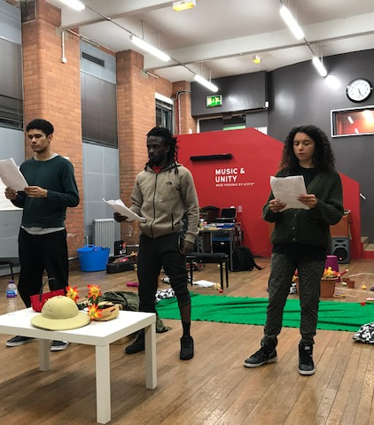
Elayne Ogbeta – Grandad Anansi
Working with a new Manchester writer since 2017, to develop her script. Now brought Half Moon (children’s venue in London) on board as co-commissioning partner.
Currently supporting Elayne to develop an R&D application to develop her practice and run a week’s rehearsal, to gain support for a tour of a full production in 2021
The show is an original story, based on Elayne’s own grandfather, who emigrated to England from Jamaica in the 1960’s. It links with the Jamaican Anansi fairy stories, but ultimately is the story of a grandad who needs to tell his grand-daughter he is moving back to Jamaica but doesn’t know how to break it to her. t is full of comedy, music and Jamaican tales.

Slide 5
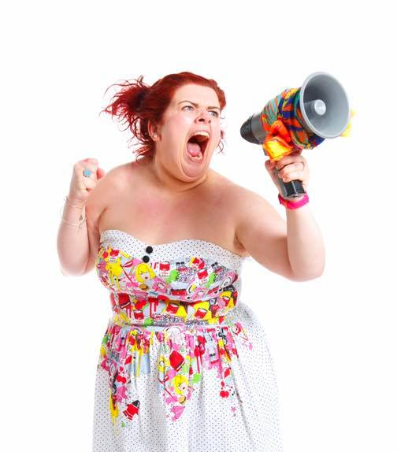
Art With Heart –STAN
Art With Heart are a Manchester company who made a big success with their last show, an autobiographical story about living with ADHD. We love them as they have a real authenticity to their work, as well as humour and artistic quality. So when they approached us for support to run a week’s R&D to develop a new show, STAN, about a friendship between a deaf girl and a hearing boy who was having problems at home (and Manchester Museum’s dinosaur, STAN), we wanted to support them.
They are investigating how to use captioning in a creative way that supports children with hearing needs, but who may not yet be reading well.
STAN is going to be Z-arts main commission for 2021.

Slide 6

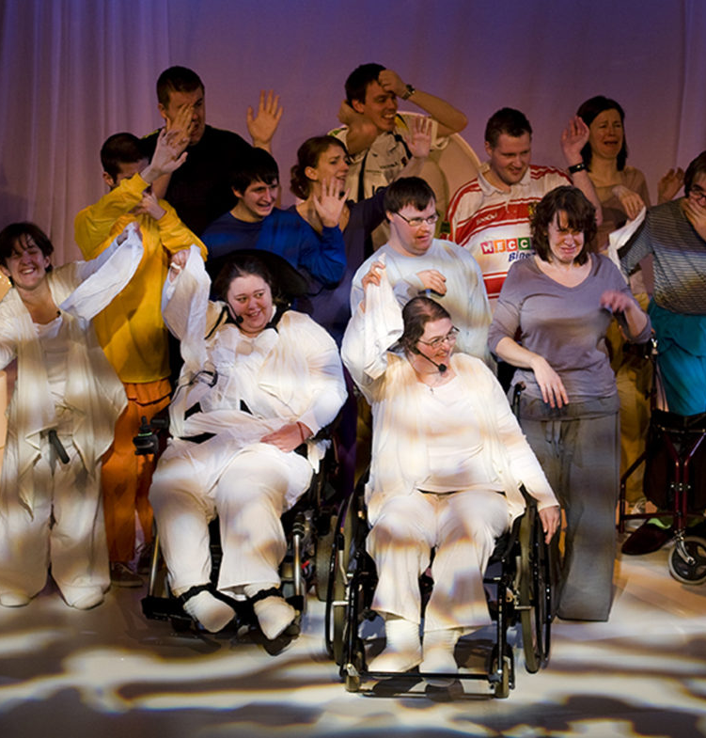
Proud and Loud
Proud and loud are also looking at creative captioning, and Z-arts have put them in touch with art With Heart, so they can share the learning around creative captioning. They are also recipients of a Big Imaginations Big Ideas R&D fund to support their production of Shadow Girl. We are also offering creative support, guidance and networking for Christmas With the Cratchetts, which may or may not end up as a family show, but we are working with the company to support it’s development, and introduce to more suitable venues if we feel that the show’s development might be limited if it should be better placed for an older audience.

Slide 7
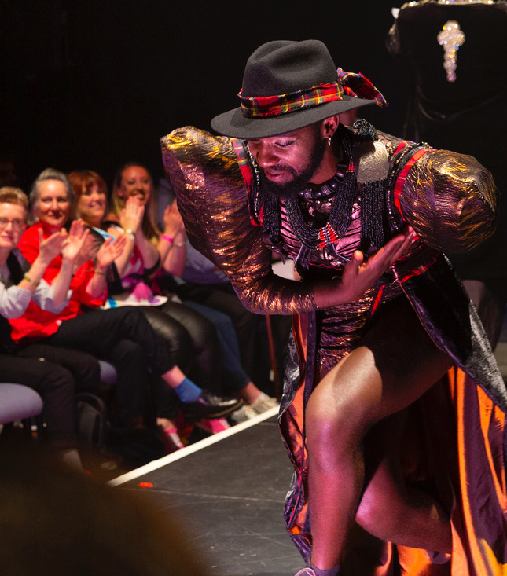
Darren Pritchard – Love Vogue Ball
Darren has been a Z-arts artist since 2000. The Founder of UK’s Vogue Ball’s, which are a success across the land, and director of rent Party which was made in STUN and went on to be Sheffield Crucible’s alternative Christmas Show.
We challenged Darren to think about taking the style of his work and turning it into a child-friendly show. After a couple of R&D periods, we have landed on the Love Vogue Ball, which will be a celebration of uniqueness including a history of vogue balls, aimed at children and their families, with lots of participation and mazing dancing and costumes – to be programmed as our birthday party in 2020.

Slide 8
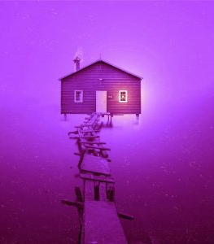
Half Moon – DUST
The first Z-arts / Half Moon co-commission – a new play written by award-winning children’s author Laura Dockrill, with music from a member of The Maccabee’s.
Theatre

Slide 9
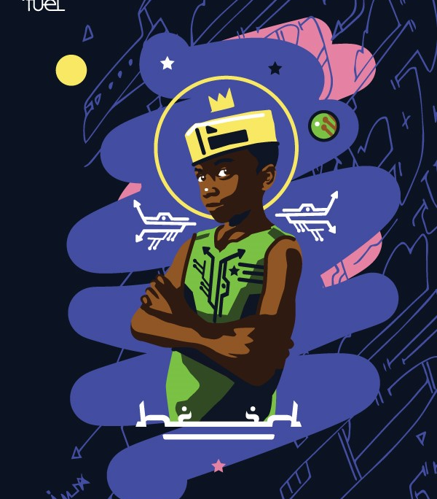
Fuel – The Little Prince
Co-commissioned by Fuel, Stratford Circus Arts Centre,
ASU Gammage, Z-arts, The Albany, Warwick Arts Centre, and Future Arts Centres.
Broken down in the Sahara Desert, desperate to repair her fighter jet, a pilot meets an extraordinary Little Prince. As he recounts his adventures, the pilot re-discovers the power of imagination, the importance of doing what we can to protect our natural world, and the true meaning of friendship.
In Inua Ellams’ magical retelling of the much loved story by Antoine de Saint-
Exupéry, The Little Prince descends from an
African race in a parallel galaxy.
An Afro-futurustic adventure for 7+.

Slide 10
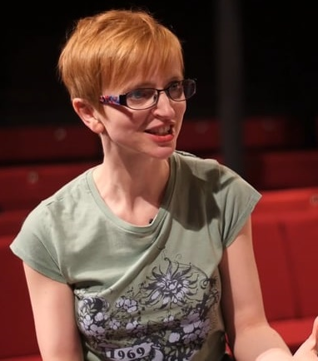
Sarah Punshon–Cinderella, the Ugly Truth
The company who brought us We’re Stuck! and The Astonishing vacuum Cleaner project is back creating a new version of Cinderella which looks at body image from a Black is Beautiful perspective.
Now supported by Polka in London to be their Christmas show in 2020, we are supporting the rehearsals and R&D in January, in order to consider it for Christmas 2021.

Slide 11
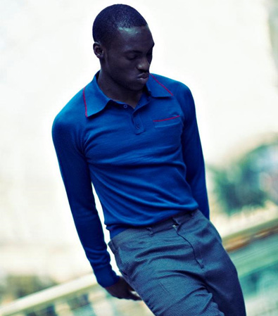
Chad Taylor–When I Hear Music
Manchester dance artist, who used to come to dance classes at Z-arts in his youth. Now supported via Spark Arts in Leicester. We came in as collaborator when he wanted to test some work with children in schools. His engagement with the children was very high, so we’re hoping to be able to work with him in an education setting again.
We will also support the early sharing of his new work in February next year, presenting to Big Imaginations members.

Slide 12
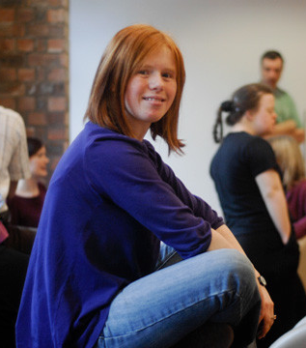
JoAnne HayesMind the Gap– “Colourful”
JoAnne is a learning-disabled artist who has developed an interactive painting workshop. Originally developed and trialled with adults with learning difficulties, we are working with Joanne to create and trial a version for our Z-access days, for families with children with additional needs to take part.
Looking at September 2020.

Slide 13
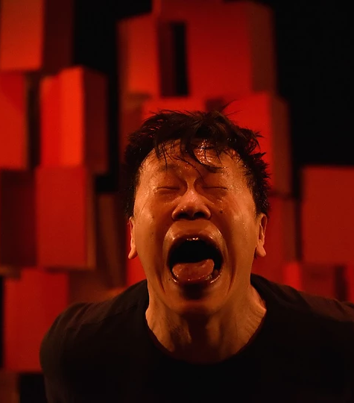
Joseph Lau–Monkey and Leopard
Joseph is a choreographer who made this show originally as a piece of outdoor dance. He then realized it could have a life as a family dance show, so we supported him and his company with rehearsal space and artistic mentoring to run an early R&D period.
Ultimately Joseph intends to tour the final piece internationally.

Slide 14
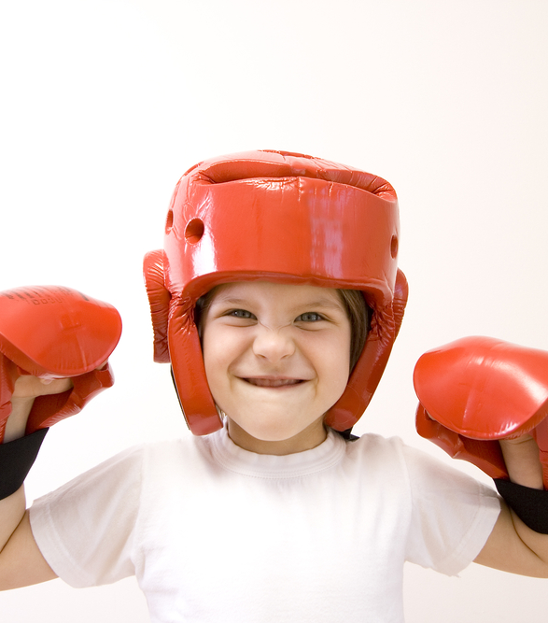
Oliver Sykes – Alfie’s First Fight
Oliver came to us to ask for support for his first play – a semi-auto-biographical story about a boy growing up in a working-class boxing family.
Now in partnership with the Manchester Children’s Book festival, and with Dominic berry as director, we are co-commissioning a first stage Live Literature tour that can go into schools and libraries, as part of our collaboration with Manchester Boys & Girls Clubs.

Slide 15
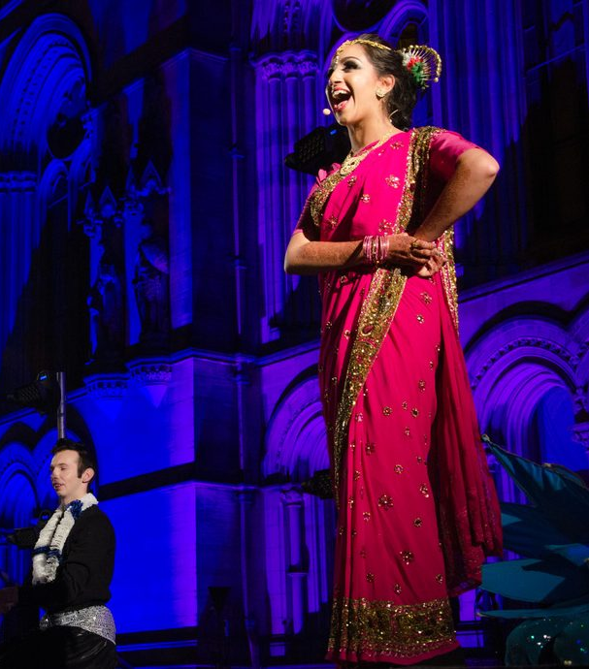
Ria Meera Munshi
Mentoring and support for Ria as she works out the next piece of theatre show wants to make, including help with the creative process and identifying creative partners.

Slide 16
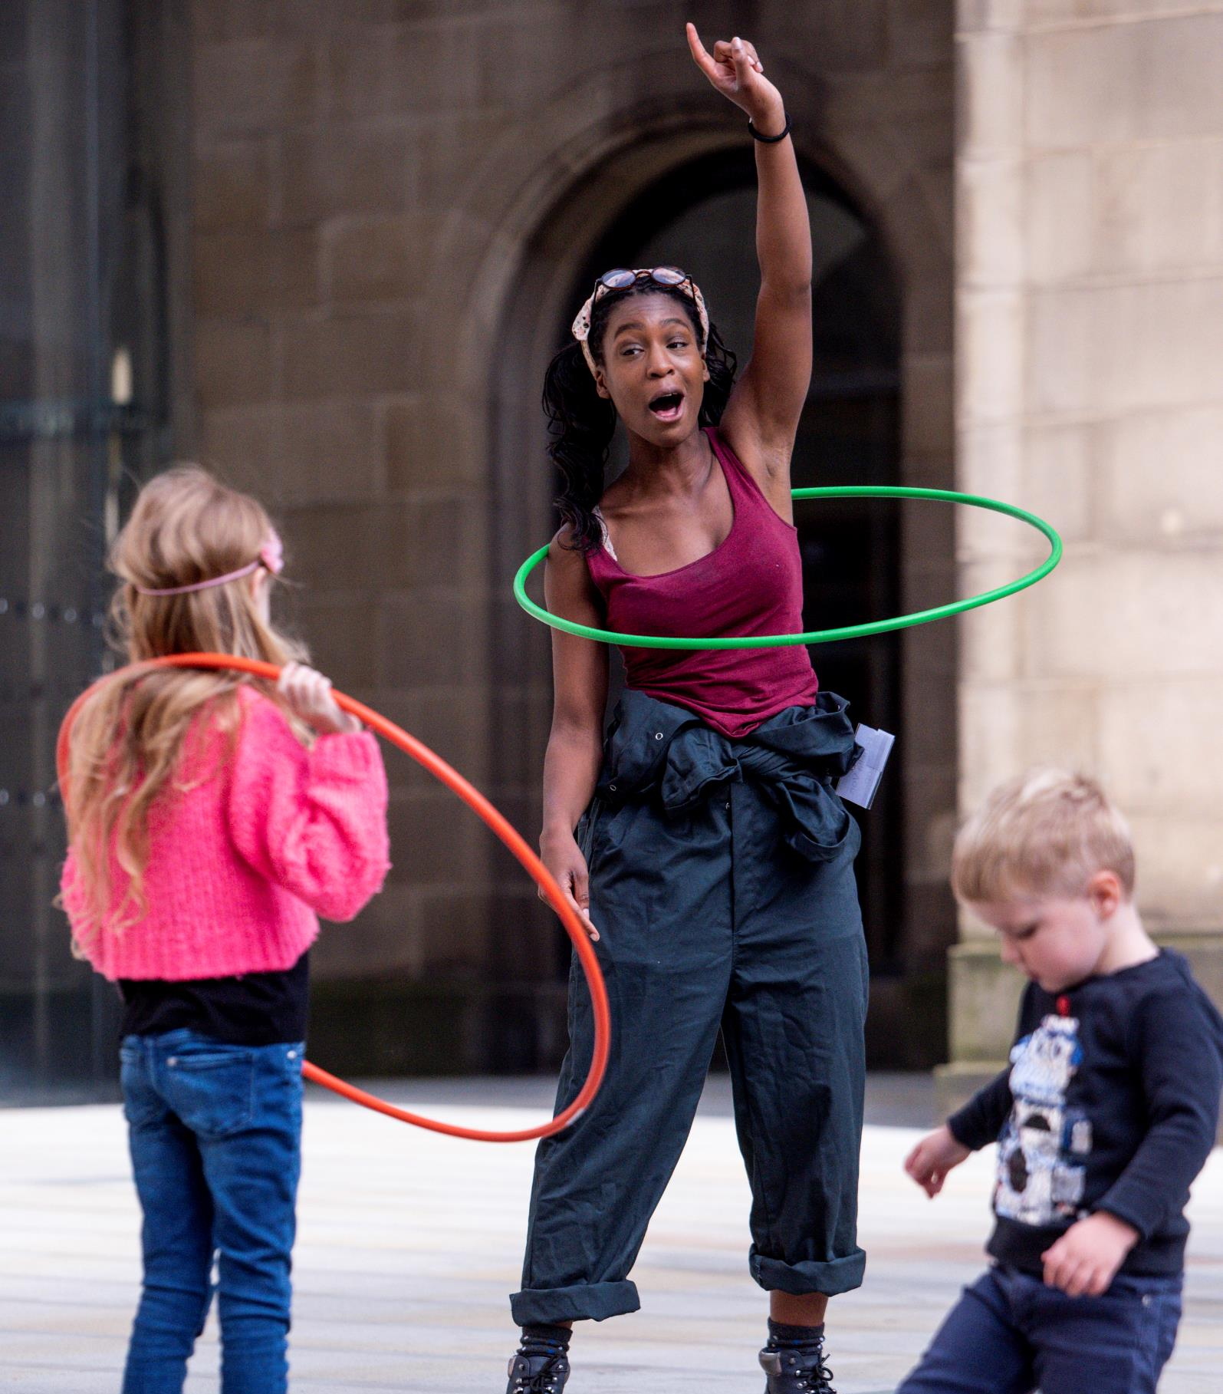
Ros Norford – The Lost Adventures of Fenella Von Hoop
Ros is a hula-hoop artist, who has led workshops in both Ministry of Lost and Founds. Now also supported by Twenty Stories High, we are offering creative advice and space, and children as audiences and feedback providers, as Ros creates her first full-length show.

Slide 17
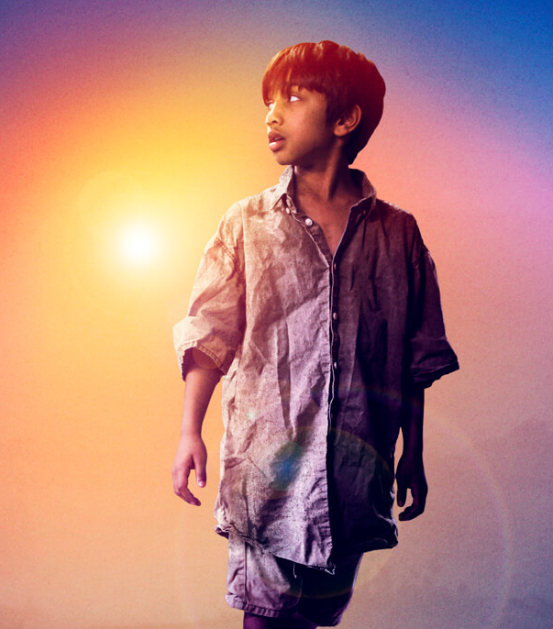
Sudha Bhuchar – Artichoke Hearts
Sudha, creator of Child Of the Divide, has approached us to become a partner in her early development of her next theatre piece for children, based on the award-winning book, Artichoke Hearts.
Z-arts are contributing some funds to help her secure the rights and create a script, which would then have a rehearsed reading in autumn 2020, as phase 1.

Slide 18
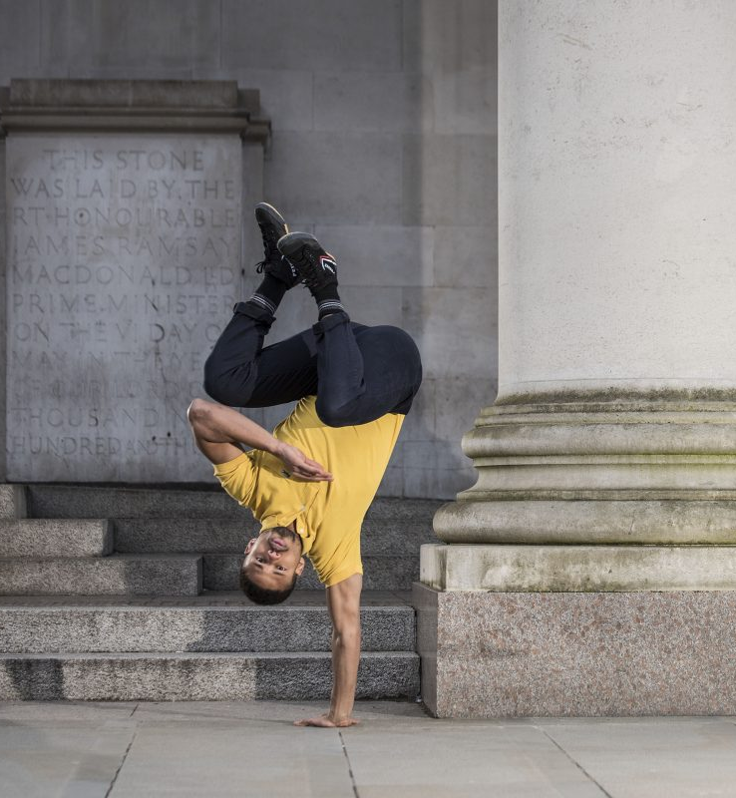
Company Chameleon– It’s good to talk
A Future Arts Centre’s Commission as part of the National Lottery 25th Birthday celebrations “Here and Now”.
This is a project which looks at mental health awareness and support, particularly using dance and movement. It will be a residency over 2020, including a performance of their sited dance piece, Witness This, in the Z-arts café, and a large-scale participatory dance in Hulme Park in October.

Slide 19


Artists & Creative Educators Supported Through Creative Development Dept
Jude Jagger – develop skills as a creative producer including budgeting, fundraising and development
Angela Heenan – developing practise for creating work for children
Stuart Bowden – support for artists development / support in writing proposals and applications
Lara Pomeroy – networking and extending her creative practise for schools
Story Explorers – developing facilitator skills

