Slide 1

Artist Development
2021/2022

Slide 2
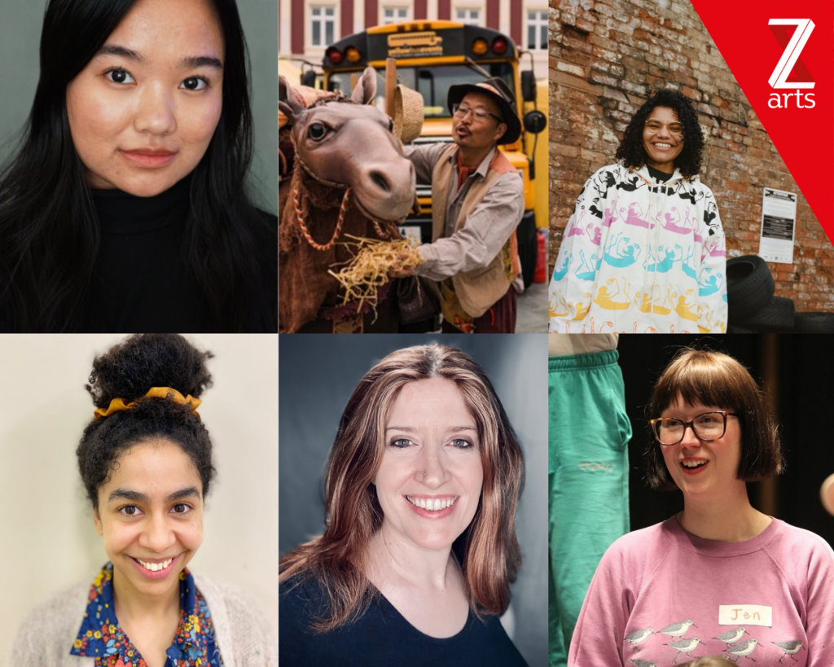
Watch This Space
Watch This Space was a development opportunity for artists who want to create work for children and families in the North West. Z-arts worked in partnership with New Earth Theatre, Young Identity, STUN, TripleC Danc and Lancaster Arts to offer this opportunity. This opportunity offered artists a creative space within the Z-arts building and funding to spend up to three weeks developing ideas. We offered the opportunity to test out ideas to audiences including our Bright Sparks members, take part in an informal sharing at the end of the residency, offered documentation support and advice sessions following the residency.

Slide 3
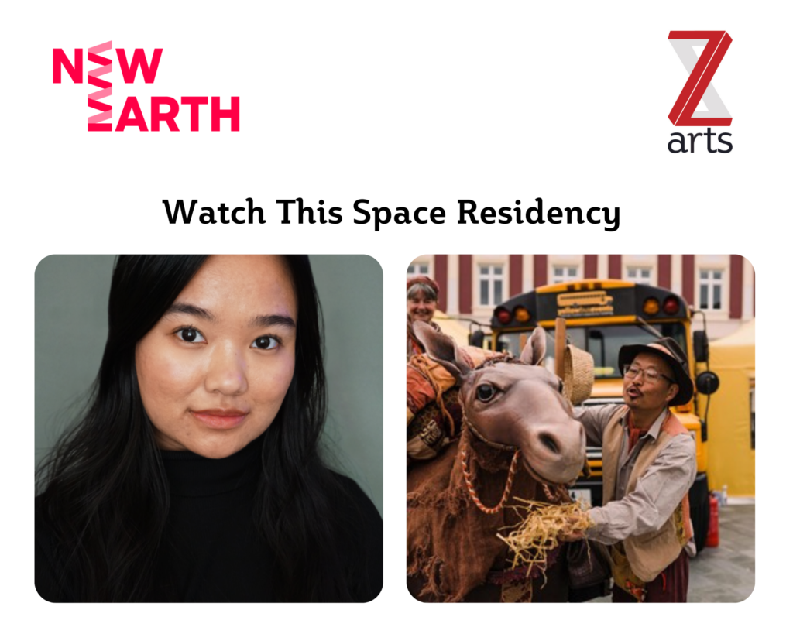
Watch This Space – New Earth Theatre
Our first residencies were in collaboration with ‘New Earth Theatre.’ We offered BESEA artists based in the North West this development opportunity who were interested in creating work for children and families.
Nadia Anim spent her residency with Z-arts and New Earth Theatre exploring the differences and similarities of movement and games between Malaysian and British culture, as well the very unknown and non-binary in between and experiences of what the two cultures looks like as a hybrid. This third culture world that many mixed heritage children live in is something she explored on a bigger picture, starting with what she know. As a Malay-Chinese-Indian kid who grew up in a British environment, this was her my starting point.
Andrew Kim spent 5 days teaching the basics of puppet movement to 4 British Asian artists based in the north of England. Each day, he focused on one or two styles of puppetry (hand puppets, shadow puppets, rod/tabletop puppets, masks) and led skill-building exercises and improvs. At the end of the week, the participants shared some of their workshop puppet scenes. This is start of a larger project which Andrew is starting to train and introduce a more diverse voices into British puppetry.

Slide 4
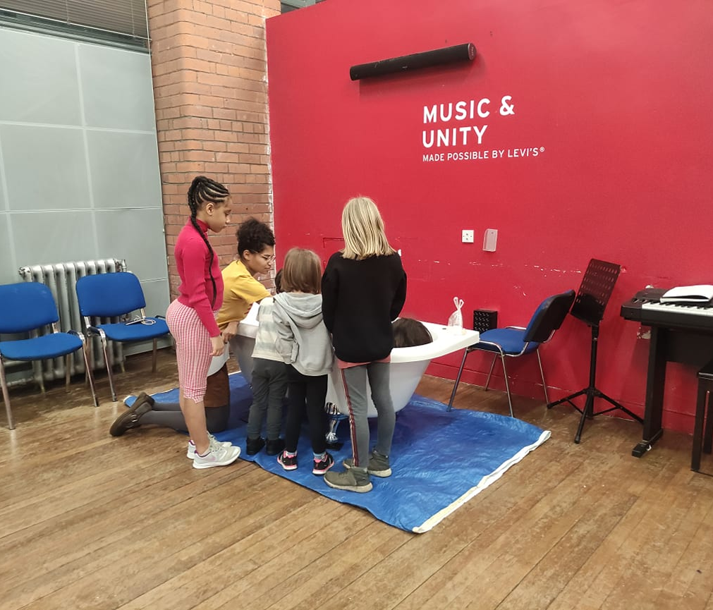
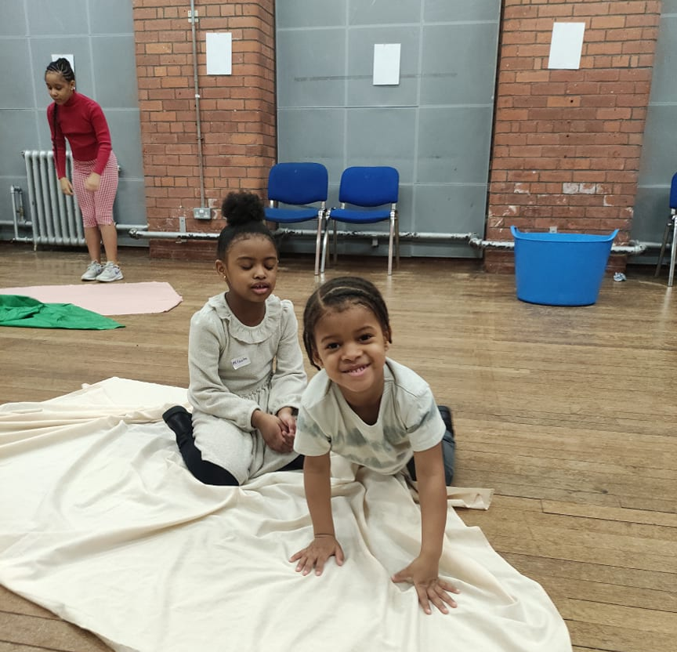
Watch This Space – Young Identity
Ella Otomeow spent 3 weeks in the space here at Z-arts developing a new piece based on the theme of water. Ella ran a workshop with Bright Sparks children about their relationship with water. Ella then devised the start of a play which she is looking to develop further.

Slide 5
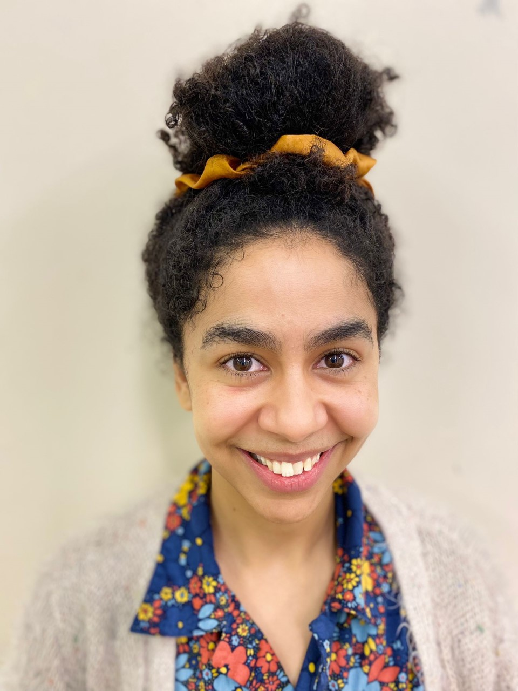
Watch This Space - STUN
Holly Wright was the artist selected for the opportunity in collaboration with STUN theatre. Holly developed the first draft of a play that explored the themes of race, emotion and creativity. Holly spent the three weeks developing her ideas and working with actors and other creatives which culminated with a sharing at the end of her residency.

Slide 6
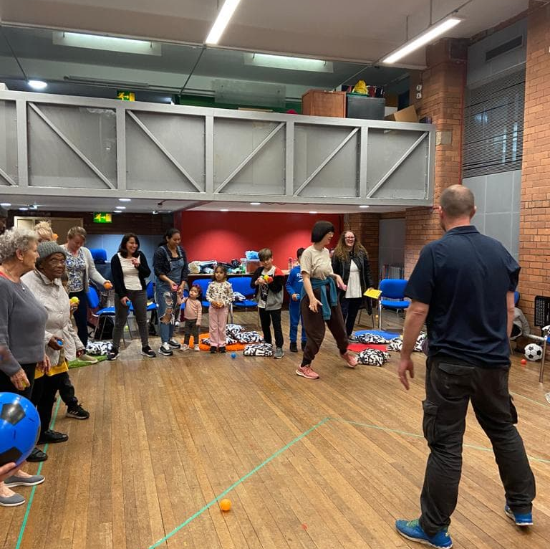
Watch This Space – Lancaster Arts
Jennifer Malarkey was selected for the residency in collaboration with Lancaster Arts to explore place and intergenerational practice. The first phase of the project took place in Lancaster and the second phase in Hulme.
At Z-arts, Jennifer hosting a ‘Celebrating Balls’ event with people off all ages from the local community. This event encouraged discussions about place and meaningful interactions between generations.

Slide 7
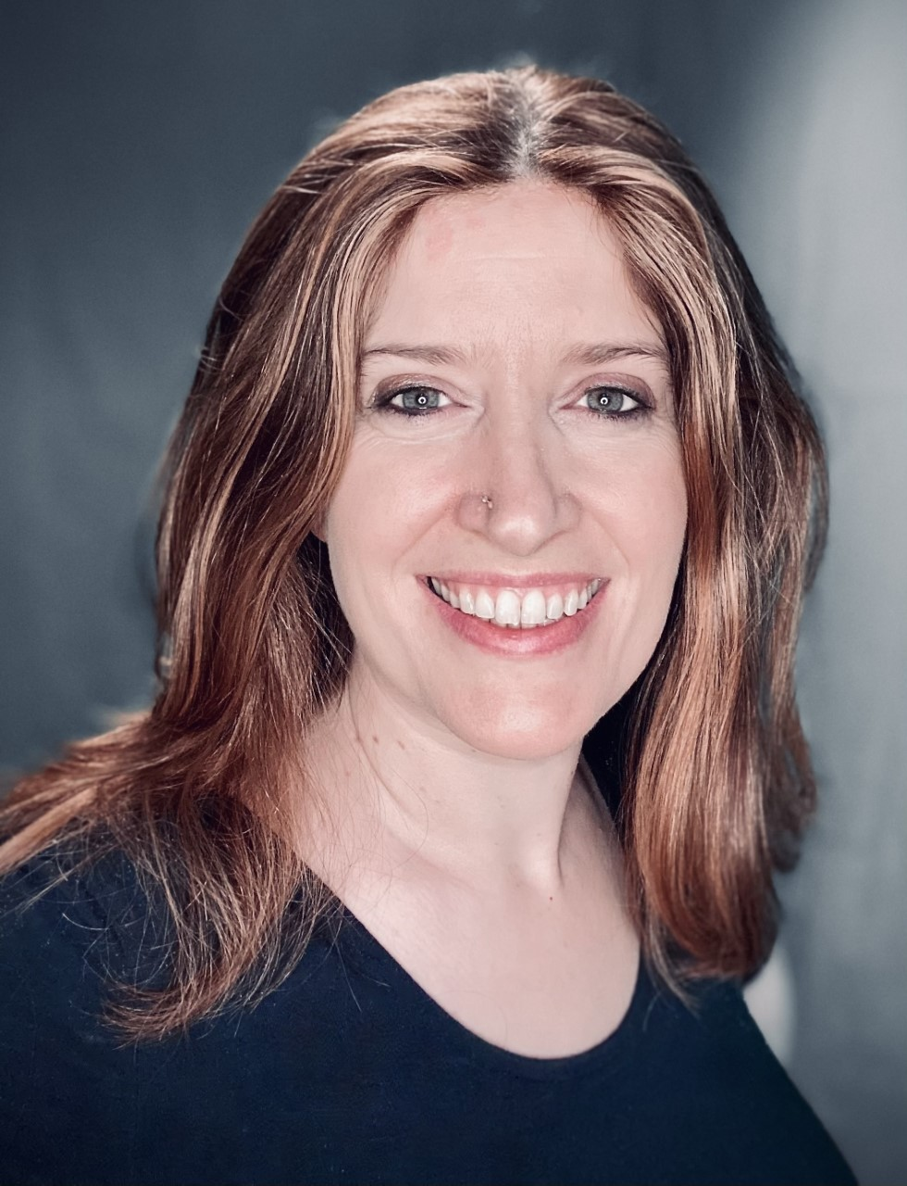
Watch This Space – TripleC and DANC
Louise Croombs was selected after a series of workshops with TripleC to develop a script with support from writer Cathy Crabb. Louise shared two scripts with TripleC and the Z-arts team with accompanying music. Louise is looking at ways this can be developed further.

Slide 8
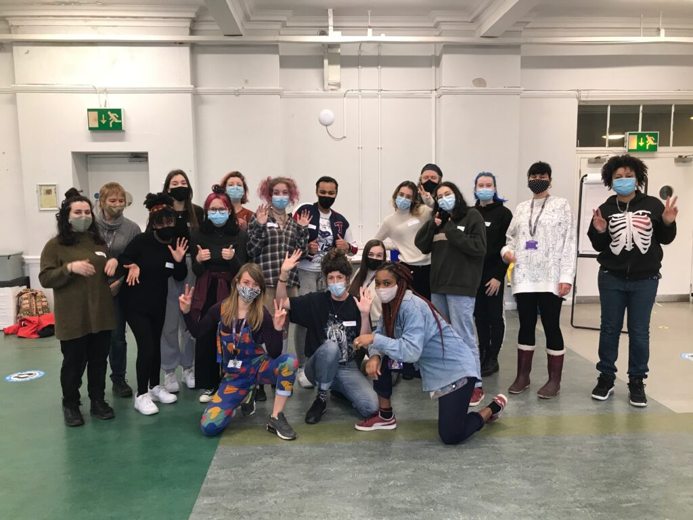
Creative Facilitator Training Programme
In January, we launched our Facilitator Training Programme. This programme offers the opportunity for 12 young people aged between 16-25 to come and train with us, assist in our Bright Sparks classes, work towards an Arts Award and attend monthly training sessions here at Z-arts. Our trainees and assistants will be with us until July 2022.
To engage with a diverse range of applicants, we advertised the recruitment for the programme in many ways. We went to local schools and spoke to young people; we went to the Millennium Powerhouse in Moss side and to the Manchester Foyer which offers assisted living for young people. We advertised next door in our local job Centre and invited potential applicants to visit the venue before to speak to one of our team. We ran an open day style workshop on a Saturday afternoon which gave applicants to chance to meet our team, have a tour of the building, take part in taster activities and ask any questions they had. We held separate meetings with individuals who couldn’t make that date or who needed greater reassurance about our venue before applying. We offered a building tour for young people from Manchester Foyer as a lot of the young people from there were anxious about coming to the venue for the first time. We showed them where their sessions would be and helped to film applications for them.
Participants will attend a training session each month. The first session was an introduction to the programme, a chance for them to meet our lead facilitators, CEO, and some of our wider team too.

Slide 9
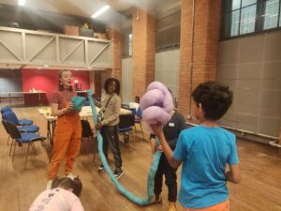
Seed Funding
In March, Z-arts offered an opportunity for two creative facilitators to design and deliver a brand-new workshop based on the environment. Facilitators were offered up to a week of space here at Z-arts, payment for their time, support by our team and a trial session with a group of our Bright Sparks members. We selected artists Jamie-Lee Wainman and Hattie Kongaunruan to design a workshop based on the environment
In May, we had Jamie-Lee Wainman in the space. Jamie ran a workshop around 3D printing. Jamie set out to explore the world of 3D printing through play and creativity. Jamie wanted to together with the participants look at how a 3D printer works, why it is sustainable process, and the creative possibilities it brings our future. There was also a 3D printer which was set up printed live. Eight of our Bright Sparks members attended the workshop and gave Jamie feedback after the session. They really enjoyed learning about how a 3D printer operates and the environmental benefits in using it. They also said they would be interested in participating in futures sessions on 3D printing.
Hattie Kongaunruan is planning to run a workshop where participants build their own eco warrior sculptures using household objects. Hattie will be running this workshop with a group of Bright Sparks members.

